Slide 1
Brief Overview of the Passenger Transport Sector in the Philippines
Gilberto M. Llanto
C.P. ROMULO HALL, NEDA SA MAKATI BUILDING
May 7, 2013

Slide 2
Outline of the presentation
Structure of the Market
Performance of the sector
Policies, laws, and programs
Public and private partnerships in the sector
Consumer and producer concerns

Slide 3
Structure of the Market: Passenger Transport via Roads
Motor Vehicle Service Providers
buses
Regulators
Land Transportation Franchising and Regulatory Board (LTFRB): franchise to operate, routes, fares
Land Transportation Office (LTO): car registration, driver’s license
Taxi cabs and public utility vans
jeepneys
Riding Public
Notes:
Land Transportation Franchising and Regulatory Board (LTFRB) – attached to the Department of Transportation and Communications (DOTC); Regulation of market entry, service standards, and fare setting for all road-based public transport in the country, except tricycles and nonmotorized vehicles
Land Transportation Office – attached to the DOTC; Enforcement of the provisions of RA 4136;
Registration of motor vehicles , licensing of drivers, and enforcement of LTFRB’s regulations to ensure that public vehicles operate within their franchises

Slide 4
Structure of the Market Service Providers: Motor Vehicles
Table 1. Number of For Hire Motor Vehicles registered by Type of Vehicle, Philippines
For Hire | 2011 | Percentage
Cars | 33,131 | 3.41%
Utility Vehicles (includes taxis, jeepneys, etc.) | 229,330 | 23.62%
Buses | 25,262 | 2.60%
Trucks | 21,786 | 2.24%
Motorcycles/ Tricycles | 658,466 | 67.82%
Trailers | 2,971 | 0.31%
Total | 970,946 | 100.00%
In 2011, Metro Manila alone accounts for 28.6% of vehicles in the country.
Utility vehicles (inc. taxis and jeepneys) – 36%
Buses – 1%
Notes:
Breakdown of percentage in vehicles in Metro Manila in 2011 [This includes all classifications of vehicles (i.e. private, for hire, government)
]:
Cars – 22%
Utility Vehicles – 36%
Buses – 1%
Trucks – 4%
Motorcycles/Tricycles – 36%
Trailers – 1%
Number of vehicles by mode of transportation which use EDSA and other major and minor roads:
400,000 privately owned cars (45%)
409,000 passenger jeepneys and FX taxis (47%)
61,000 trucks and trailers (7%)
6,087 buses (1%)

Slide 5
Structure of the Market: Passenger Transport via Rail Systems
System Operators
(all are attached to DOTC)
Light Rail Transit Authority: LRT Line 1, LRT Line 2 (Metro Manila)
Regulator
DOTC: approves fare adjustments; regulation by contract (for the lease and maintenance of MRT-3)
DOTC-Metro Star Express: MRT 3 (Metro Manila)
Philippine National Railways (inter-provincial rail system)
Riding Public
Notes:
Metro Star Express Project – a unit inside the DOTC; not a GOCC; headed by a Project Director

Slide 6
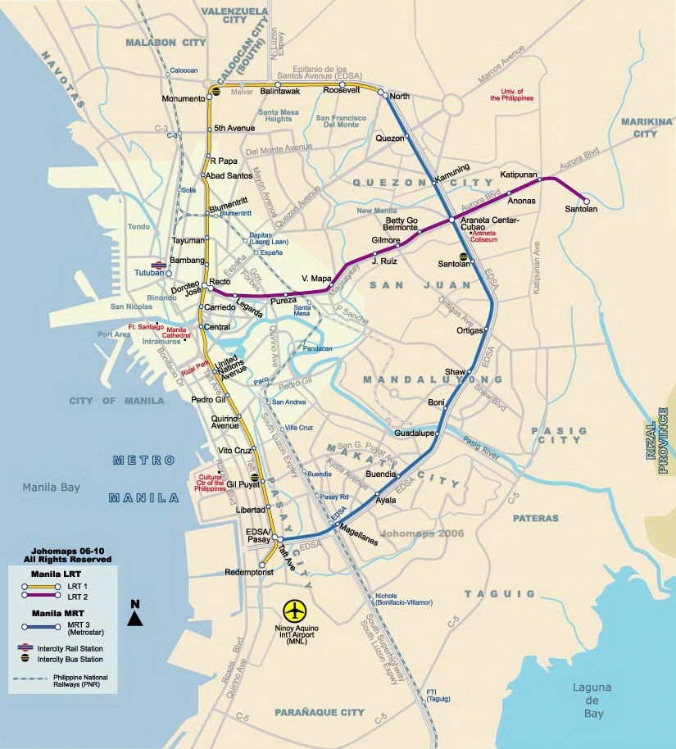
http://www.maps.nfo.ph/wp-content/uploads/2011/02/Manila-LRT-MRT-map-2.jpg

Slide 7
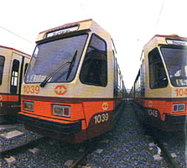
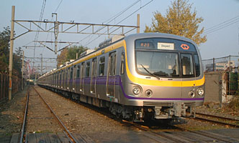
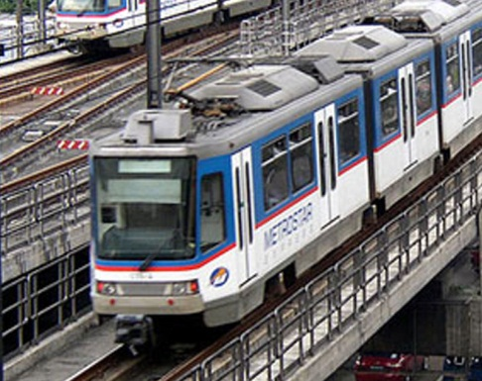
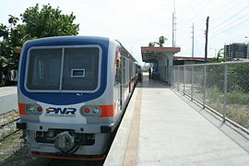
Structure of the Market: Passenger Transport via Rail Systems
Table 2. Passenger Traffic and Gross Revenue Collection in 2012
 | Ave. Passenger Traffic (in millions of passengers) | Ave. Gross Revenue Collection (in millions of pesos)
LRT 1 | 170.72 | 2513.97
LRT 2 | 70.33 | 924.97
MRT 3 | 54.81 | 672
Source: LRTA, MRT
Notes:
Light Rail Transit (LRT) Line
Light Rail Transit Authority (LRTA): Wholly owned government corporation that is responsible for the construction, operation, and maintenance of all LRT lines in the Philippines
First LRT system in Southeast Asia
LRTA was created on July 12, 1980 under EO 603, as amended by EO No. 830 dated September 1982, and EO No. 210 dated July 7, 1987.
15 km elevated railway system servicing the Taft Avenue - Rizal Avenue route between Baclaran, Pasay City and the Bonifacio Monument in the City of Caloocan
Under the LRT North Extension Project, a further 5.7 km elevated line has been constructed.
In terms of its performance, from 2009 to 2012, the LRT system has experienced an increasing trend in:
Average passenger traffic
Average gross revenue collection
Average load factor
Average farebox ratio: declining ratio from 2009 to 2011, but has increased in 2012
2. LRT Line 2 (Megatren)
13.8 km mass transit line that traverses five cities in Metro Manila namely Pasig, Marikina, Quezon City, San Juan and Manila
Performance from 2009-2011
Increasing trend in:
Ave. passenger traffic
Ave. gross revenue collection
Ave. load factor
Ave. farebox ratio (but has significantly declined in 2010 due to increase in operation and maintenance cost)
3. Metro Rail Transit 3 (MRT 3)
Through a Build-Lease-Transfer Agreement,
Metro Rail Transit Corporation has become the responsible agency in the construction and maintenance of the MRT.
The Department of Trade and Communications (DOTC) holds the franchise and supervises operations and collection of fares.
Highest recorded number of passengers transported in a single revenue day is 622,880 as of August 17, 2012.
4. Philippine National Railways
State-owned transit system which operates two railways (i.e. Metro Manila, Bicol Region)
Began operations on November 24, 1892
PNR is an attached agency under the DOTC
The PNR currently operates in parts of Metro Manila and in the provinces of Laguna, Quezon, Camarines Sur, and Albay.

Slide 8
Performance of the Sector as of 2011
ROAD TRANSPORT | RAIL TRANSPORT
Installation of nonmotorized transport facilities for ensuring road safety and security | LRT did not meet its 2011 target for actual increase in consolidated passenger volume
A 378.2% decrease in the number of locations with pedestrian-vehicle conflict in 2011 | Completed Capacity Expansion Project Phase II for Line 1
Mixed results in reducing buses in Metro Manila (aimed to decongest major roads) | Operations were challenged by technical problems
Notes:
On Urban Transport:
Installation of nonmotorized transport facilities to ensure safety and security in the streets of Metro Manila
Construction of footbridges and installed rotundas and intersections, complete with LED traffic lights and road signs by the MMDA
A 378.2% decrease in the number of location with pedestrian-vehicle conflict in 2011
The MMDA’s program on reducing buses in Metro Manila which aims to alleviate traffic has mixed results
For air conditioned buses, the aim of increasing occupancy rate was below the 2011 target (mainly due to fare increase)
For nonairconditioned buses, target for 2011 has been achieved.
On Rail Transport
Light Rail Transit (LRT) system in Metro Manila, was not able to meet its 2011 target for the actual increase in the consolidated passenger volume, despite posting a performance of 11.41 percent.
Its performance in terms of increasing the consolidated farebox ratio or the ratio of revenue to operations and maintenance cost (O&M) also failed to meet its target.
In 2010, the Light Rail Transit Authority (LRTA) completed the Capacity Expansion Project Phase II for Line 1, involving the procurement of 48 light rail vehicles, which increased the capacity of the existing line of 27,000 passengers per peak hour per direction (pphpd) to 40,000 pphpd.
However, the operations were challenged by technical problems in signalling, condition of tracks, shortened operations, and suspension of classes and work. The train derailment which occurred near the Roosevelt station in February 2011 also affected revenues for almost two months.

Slide 9
Policies, Laws, and Programs: Main Legal and Regulatory Provisions
Legal Provision | Purpose
Land Transportation and Traffic Code (RA 4136, 1964) | Governs the registration and operation of motor vehicles and licensing of owners and drivers, and establishes traffic rules
Public-Private Partnerships Law (RA 6957 as amended by RA 7718, 1994) | Lays down the rules for private sector financing and infrastructure development
Motor Vehicle User’s Charge (RA 8794, 2000) | Provides additional resources for maintenance safety, and air pollution control, and for establishing a Road Board for the prudent and efficient management and utilization of these resources
Government Procurement Reform Act (RA 9184, 2002) | Harmonizes procurement processes across all national line agencies and LGUs, simplifies prequalification and award, enhances transparency, and encourages electronic bidding

Slide 10
Policies, Laws, and Programs
CHALLENGES:
Manila-centric development -> Philippine Development Plan 2011-2016 prioritizes ‘decongestion of Metro Manila and the spread of development to adjacent regions’
Absence of National Transport Plan
EO currently being reviewed by the DOTC
Lack of integration between national and local govts
Overlapping and conflicting functions of transport agencies
Transport safety and security concerns
Notes:
Absence of an integrated and well-coordinated national transport plan that will guide the prioritized finding and implementation of transport projects, as well as the physical planning and intermodality of transport infrastructure.

Slide 11
Policies, Laws, and Programs
STRATEGIES
Adopt a comprehensive long-term National Transport Policy
Develop strategic transport infrastructure and maintain/manage/expand existing infrastructure assets
Separate the regulatory and operation functions of transport and other concerned agencies
Comply with safety and security standards
Conduct impact analysis and comprehensive transport network studies to determine the most appropriate outcome indicators
Notes:
As indicated in the Socioeconomic Report 2010-2012 published by the NEDA, EO on NTP is currently being reviewed.
On NTP:
Should clearly establish the government’s policies in the areas of resource generation and allocation; the criteria for the preparation of agency plans, programs and projects; cost recovery and subsidies; regulations for passenger transport services; urban transport and settlements; transport logistics; and governance.
The roles of the private sector vis-à-vis those of government agencies and other authorities as well as LGUs in the development, operation and management of various transport infrastructures will be defined in conjunction with the crafting of a NTP.
The government will also address the inadequate linkage between the planning and budgeting processes to ensure that resources are allocated to their most important uses for transport infrastructure and management.
On Transport Infra:
Prioritize asset preservation: the “user-pays” principle shall be applied for this purpose
RA 8794 may be amended to include fuel levy or some other form of road user contribution in order to expand the Road Fund.
Promote environmentally sustainable and people-oriented transportation
On Separation of regulatory and Operation functions
In rail transport, the policy, planning, and regulation functions shall be separated from the delivery of train services, which also serves to allow private sector participation.
On Safety and Security:
Road safety will be promoted through the implementation of the Road Safety Action Plan.
DPWH’s Safer Roads Program is continuously implemented by using the Traffic Accident Recording and Analysis System (TARAS) and the International Road Assessment Program (iRAP), under which about 3,000 km of national roads were considered “high risk roads”.
LTFRB issued Safety Compliance Orders (SCOs) to operators of PUVs that were involved in vehicular accidents to have their drivers drug tested and trained under the University of the Philippines (UP)-National College of Transportation Studies (NCTS) and to have their units inspected for roadworthiness.
LTO’s PUV Maintenance Program was also implemented to prevent vehicular accidents
Bantay Lansangan Road Sector Report Card Rating procedures for continuous monitoring of road safety measures with the participation of the civil society

Slide 12
Policies, Laws, and Programs
UPDATES ON KEY REFORMS
The government has been addressing capacity constraints in mass urban transport but new projects are not proceeding as planned
PPP projects under the PPP law are delayed
The law and implementing rules on the motor vehicle user’s charge (MVUC) may be amended to make the imposition of the tax more rational
For local roads, an incentive-based policy reform program is currently underway.
Notes:
Notes on the new projects not proceeding as planned.
The Light Rail Transit (LRT) Line 1 North Extension Project, which will complete the Metro Rail Transit (MRT) Line 3-LRT Line 1 Loop, is ongoing. These two lines and LRT Line 2 are physically interconnected but passenger transfer from one line to another is still less than seamless because the transfer is not very convenient and the passengers do not enjoy the benefits of a single ticketing system. The MRT Line 3's capacity of 22,500 passengers per direction per peak hour has been breached in 2004 and the facility is currently operating at 26,500 passengers per direction per peak hour, way above its capacity. Because of lack of incentives by the private owner to invest in capacity expansion, in 2009, the government acquired a majority 76 percent stake in the company which owns the facility. The government hopes that the savings in rental payments will provide funds for the much needed capacity expansion. Meanwhile, the implementation of new mass urban transport projects that aim to decongest Metro Manila further is seriously delayed. The MRT Line 7, to be implemented as a Build-Gradually Transfer-Operate-Maintain contract, has still not achieved financial closure as of this writing. The LRT Line 1 South Extension is still in the project development stage despite ten years of project preparation and the 2009 cabinet-level decision to pursue it under a public-private-partnership (PPP) scheme.
On amending MVUC:
For example, it is common worldwide to use a fuel charge to raise money from road users because fuel consumption is proportional to road usage and, thus, a surcharge on fuel may be included in the MVUC. Another is the modification of the levels of MVUC such that these are commensurate with the wear and tear the vehicles inflict on roads. Currently, trucks are charged disproportionately much less than the cost of the damage they inflict on roads. Raising taxes may be a sensitive issue at this point considering the global financial crisis and the recent calamities that the country experienced due to typhoons and flooding, but this option should be kept open as a medium- to long-term reform strategy.
Ibid.
KEY REFORMS
Some of the maintenance of land transport assets (i.e., maintenance of national, provincial, and city roads nationwide; improvement of drainage; installation of adequate traffic lights, and road safety and pollution monitoring devices) had been undertaken in the last few years using revenues from the Motor Vehicle Users’ Charge (MVUC).
For local roads, an incentive-based policy reform program is currently underway. This uses incentives or grants to finance road maintenance and rehabilitation to motivate LGUs to institute policy reforms in local government systems and processes, and improve performance in road rehabilitation and maintenance and other service delivery.
Despite notable accomplishments in the transport sector, the institutional and bureaucratic reforms proposed under the previous Plan seeking to separate the operation and regulation functions of transport agencies have not been achieved.

Slide 13
Public-Private Partnerships
The following are the planned PPP projects on passenger transport in Metro Manila (as of September 2012):
LRT Line 1 South Extension and Operation and Maintenance (DOTC)
Automatic Fare Collection System (DOTC)
Integrated Transport System (DOTC)
Operation and Maintenance of LRT Line 2 (DOTC)

Slide 14
Consumer and Producer Concerns
Road accident ranks 4th in the list of causes of death in the Philippines, according to the Department of Health
Persistence of truck overloading
National data as of 2011 shows that 32.2% of the trucks weighed are overloaded
Poor regulation and enforcement of rules
Inability to modernize

Slide 15
Thank you!

