Slide 1
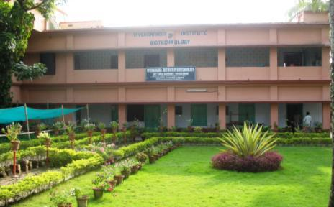
Co-ordinated Project on Rural Energy
Debipur, 2012
Vivekananda Institute of Biotechnology Sri Ramkrishna Ashram, Nimpith South 24-Parganas, West Bengal- 743 338 Phone: +91-3218-226003; Fax: +91-3218-226201,221666 Email: vibsran@rediffmail.com URL: vibsran.org

Slide 2
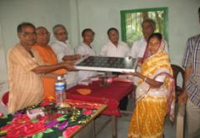
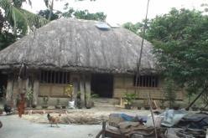
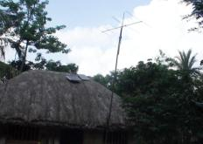
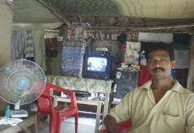
To make an effort to develop a model for energy service
for the
people of Sundarbans - Coastal zone of India

Slide 3
APPROVED PROJECT OBJECTIVES
To develop a model to increase the energy
efficiency of households in an innovative
way
To replace diesel/kerosene use in different
commercial activities of the target area
To provide the energy service through an
entrepreneur

Slide 4
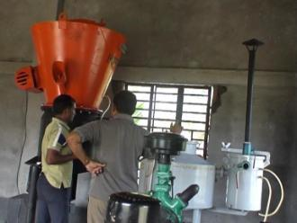
BASE LINE DATA
Local Energy Problems
Proposed Technology Solutions
Electricity - a dream because of geographical disadvantage
Kerosene – source of home light
Commercial energy source – diesel powered generator
An energy service centre run by an entrepreneur.
Home lightning system would include the solar based power involving the LED fittings.
Commercial power requirement is to be met through single fuel(wood) based Gasifier.
Community participation in the program through sharing of capital cost and paying a service provider i.e., the entrepreneur.
Bio Gas at individual household level for cooking purpose

Slide 5
ACTION PLAN & METHODOLOGY
Action Plan | Methodology
Village selection and acquiring land for plant room and site office/ service station. | Organizing the village level discussion etc. programs with panchayets, school teachers, consulting primary/secondary data.
2. Selection of beneficiaries. | Conducting survey/workshop with villagers / panchayats, documenting the energy requirement of the house hold / commercial agencies, finally depending on the eagerness of the beneficiaries.
3. Selection of service providers. | Organizing workshop with the unemployed village youths (educated) involving panchayats .
4. Selection of the models and evaluation of performance of home lighting systems and gasifier. | Workshop at NB Institute of Renewable Technology (NBIRT) for the technical finalization.
5. Training for repairing, maintenance and operation of home lighting system and gasifier. | One week training for institute staff and same for the entrepreneurs. Operation and maintenance of gasifier and other training taken.

Slide 6
OBJECTIVES & ACHIEVMENTS
Approved objectives | Achievements
To develop a model to increase the energy efficiency of a house hold. | 60 Sets of LED based home lighting system comprising of 5 watts LED fitting (2) Solar panel of 37 Wp Charge controller 40Ah battery have been installed
To replace diesel/kerosene used in different commercial activities in the target area( particularly generator) | Procurement of a 10KW proposed gasifier Construction work of gasifier shed Installation of gasifier is completed (under the guidance of Sri. S.P. Gonchoudhary) Transmission and distribution work is in progress (Innovation : treated bamboo poles for distribution)
To provide the energy service through a entrepreneur. | Two entrepreneurs have been selected and one is working
To provide Bio gas plant | 12 bio-gas units were installed in the village

Slide 7
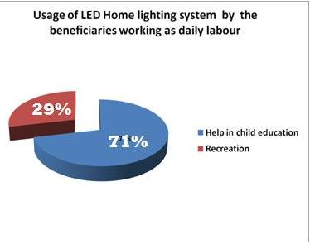
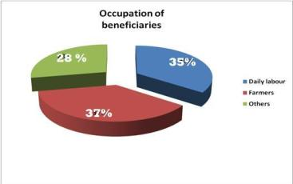
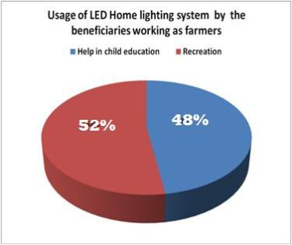
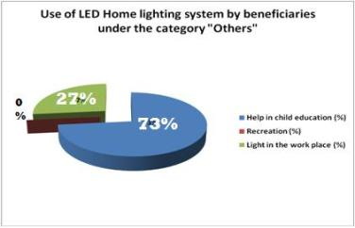
Some statistics on the project

Slide 8
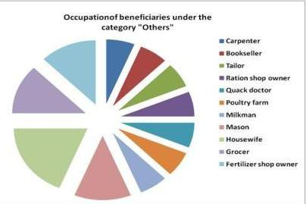
Some statistics on the project

Slide 9
DELIVERABLES
Technology package
Solar based LED system
Gas based power system
Bio-gas based home cooking system
Societal Aspect
Involvement of the entrepreneur
Formation of groups (JLG)
Involvement of Villagers
More than 1000 of villagers have shown interest in this project.
Presently four panchayats are involved in this project.
The entrepreneur is selected, to whom the work will be
handed over after the completion of project.
Linkages with Institutions
NBIRT.

Slide 10
PROJECT BENEFITS
Over 1000 of people and 6 organizations are motivated and mobilized for replication of project achievements
Replacement of diesel/kerosene(saving the environment)
Cost saving
Unique home lighting system
Saving from snake/insect bites/fire or such hazards
Two micro-enterprises
Many bio-gas based units done in the village (through a parallel initiative) reducing use of kerosene/LPG/fire wood and also producing excellent bio-fertiliser

Slide 11
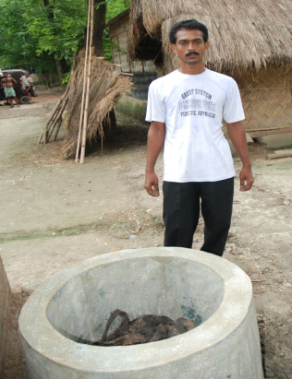
Bio-gas Initiative
A parallel programme to the CP-Rural has seen construction and usage of bio-gas in many households at Debipur.
Cow dung is poured into the chamber leaving it to rot and give off bio gas which is then passed onto nearby kitchen through rubber pipeline.
Piyush Kirtania
from Purba Debipur with his bio-gas unit

Slide 12
Bio-gas Initiative…contd.
From a bio gas plant, a family with four cattle or 25 kg of cow/cattle dung can have at least 2 hours of biogas supply (using one standard oven) twice daily. This makes a total of four hours every day for cooking, quite sufficient for a five to six people family.
A gap of approximately six hours is needed to gather bio-gas inside the chamber and that is in keeping with the normal cooking schedule of any household (morning and evening).

Slide 13
Bio-gas Initiative….contd.
With an initial cost of around Rs. 12000 for the construction of chambers and almost no recurring cost, this is an ideal solution for the rural families with domestic cattle.
This is green energy with no harm to the environment, low cost and easy to maintain. In addition, the bio-gas slurry extract can be applied as bio-fertilizer or in making of vermi-compost.

Slide 14
“To advance a nation or a community
– in addition to propping up its weakest
and most helpless members,
one should also lift up the best and the most gifted, so as to make them of the greatest service to the country."
Jamsetji Tata

