Slide 1
Change Strategy for Zambia
CREW Project
Faith Mwamba
CUTS Lusaka

Slide 2
Outline
Identification of Problem
Key Emerging issues
-Staple food Sector (Maize)
-Bus Transport Sector
Change Strategy Issues (Maize and Transport)
Mapping of who to Influence
Key Applicable tools
Change Strategy
  Advocacy and Lobby
  Education/Media Engagement
Suggestions from the NRG Members

Slide 3
Identification of the problem
Diagnostic was done to determine the problem.
Two sectors (of public interest) were identified;
  Maize Sector
  Passenger (Bus) Transport
  Analysing the core problem from the key emerging issues in both sectors is necessary to determine the most appropriate approach or baseline for the advocacy plan

Slide 4
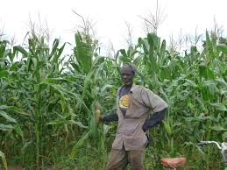
Key emerging issues- Maize sector

Slide 5
Key Emerging Issues- Maize Sector
Staple (maize) sector: Policy framework promotes creation of a monopoly (FRA) and dominance by government supported programmes (FISP) resulting in inefficiencies and less consumer welfare gains.
Government policies provide an unfair advantage to FRA for procuring maize from farmers thus creating a monopoly and limiting private sector participation
Subsidised fertiliser provided by the government has resulted in crowding out private sector
Uncertainty in supply of inputs due to inefficiencies which affects agricultural production
Benefits of subsidised maize provided to millers do not accrue to the millers- maize meal prices still increase

Slide 6
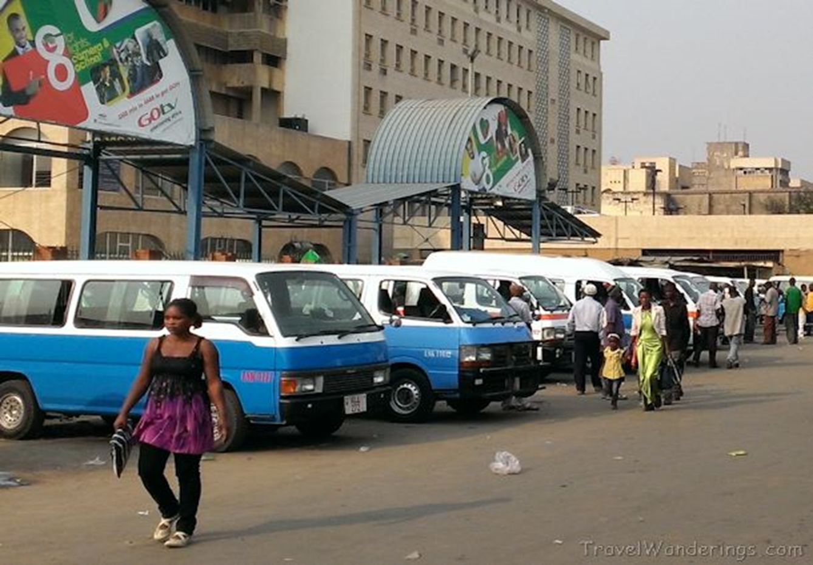
Key Emerging issues-Bus Transport

Slide 7
Key Emerging issues- Bus Transport Sector
Bus transport: High concentration of buses resulting in difficulty in regulating the sector coupled with non coordination between the policy makers and implementers in ensuring consumer/ producer welfare gains
The regulatory framework allows for the sector to be dominated by private players who operate mainly on the demand and supply principle
Impact of presence of associations in the bus transport sector and interactions with regulatory authorities
Lack of service level agreements SLA’s between MoT and RTSA limits accountability and efficient delivery of the policies
Lack of a route allocation policy allowing operators to ply anywhere, at will, mainly based on profitability

Slide 8
Change Strategy Issues- Maize Sector
Advocate/lobby for more transparent procurement processes in the downstream and upstream (input suppliers) to curb collusive bidding as experienced recently
Advocate/lobby for the enhancement of the institutional and network capacity of the FRA to improve its accessibility to farmers especially those in rural communities
Advocate/lobby for a defined (scientific) price regulation mechanism will tremendously benefit consumers
Advocate/lobby for improving the input market for maize through developing a clear development policy or introducing key incentives for the input market.

Slide 9
Change Strategy Issues - Bus Transport Sector
Advocate/ Lobby for addressing the political economy issues surrounding the sector through facilitating better coordination and cooperation between RTSA and Ministry of Transport
Advocate/ lobby for more and inclusive participation of consumer organisations & others at public sittings and committees for purposes of policy outcomes
Advocate/ lobby for implementation of the route allocation policy (through LA’s) to enhance consumer access and regulate access competition in the bus transport sector
Advocate/ lobby for a justified Scientific formula in price/ fare setting or revision processes.
Advocate/ lobby for mandatory standards to be set on quality of mini and midi buses (i.e seats and ventilation)

Slide 10
Mapping of who to Influence
Category | Staple Food | Bus Transport
Line ministries and Deptt | MoA, MCTI | MoT, MLGH, MCTI
Regulators/ other relevant institutions | CCPC, FRA | RTSA, LA’s, ZABS, CCPC
Business Associations/ Ngo’s | ZNFU, MAZ, GTAZ | PPDAZ, CRAZ, ZACA, LLBOC, UTTA
Research Institutions | IAPRI, ZIPAR, CUTS, | CUTS, ZIPAR
Media | Both national and private media institutions | Both national and private media institutions

Slide 11

Key applicable tools

Slide 12
Key Applicable tools
    Advocacy
    Lobby
    Media Engagement (Note: This is a cross cutting issues and can influence A and B)
These are the most preferred tools/Approach to influencing the identified Policy and Practice Related issues

Slide 13
Advocacy/Lobby Plan- Maize Sector
Issue | Approach | Outcome indicator
Advocate/lobby for more transparent procurement processes in the downstream and upstream (input suppliers) to curb collusive bidding as experienced recently | Round Table meetings (CCPC, ZPPA, ACC) One on One meetings with Key influential constitutional Office Holders
Advocate/lobby for the enhancement of the institutional and network capacity of the FRA to improve its accessibility to farmers especially those in rural communities | Engage with FRA to conduct a power mapping and catalogue of existing farmers Engage with MAL/FRA to increase budgetary allocation for the above purpose
Advocate/lobby for a defined (scientific) price regulation mechanism will tremendously benefit consumers | Lobby for a study to be undertaken which defines international best practices of prices setting Media Articles on the issue Other write ups (policy briefs, briefing papers etc) Initiate media debate

Slide 14
Advocacy/Lobby Maize Sector
Issue | Approach | Outcome Indicator
Advocate/lobby for improving the input market for maize through developing a clear development policy or introducing key incentives for the input market | Round Table meetings (MAL, MCTI, ZRA, Farmer Organisations, MAZ) One on One meetings with Key influential constitutional Office Holders Media Articles on the issue Other write ups (policy briefs, briefing papers etc) Initiate media debate

Slide 15
Advocacy/Lobby -Bus transport
Issue | Approach | Outcome Indicator
Advocate/ Lobby for addressing the political economy issues surrounding the sector through facilitating better coordination and cooperation between RTSA and Ministry of Transport | Advocate for key engagement meeting defining the vertical and horizontal relations between the two institutions and others Hold bilateral meetings with each institutions
Advocate/ lobby for more and inclusive participation of consumer organisations & others at public sittings and committees for purposes of policy outcomes | Advocate for key engagement meeting defining the vertical and horizontal relations between the two institutions and others Hold bilateral meetings with each institutions
Advocate/ lobby for implementation of the route allocation policy (through LA’s) to enhance consumer access and regulate access competition in the bus transport sector | Engaging bus drivers/ commuter ass. to create demand for the implementation of the policy -Round Table meeting -Facilitate issuance of joint statements Engage LA and RTSA TO define challenges halting implementation of the policy and define remedial actions

Slide 16
Advocacy/Lobby -Bus Transport
Issue | Approach | Outcome Indicator
Advocate/ lobby for a justified Scientific formula in price/ fare setting or revision processes. | Encourage MoT/RTSA to conduct a regional analysis on price setting Media Articles on the issue Other write ups (policy briefs, briefing papers etc) Initiate media debate
Advocate/ lobby for mandatory standards to be set on quality of mini and midi buses (i.e seats and ventilation) | Facilitate consensus building meetings among the key interest groups in the sector (ZABS, Commuter and Bus Operators’ Association, CCPC etc Write press articles on the impact of lack of defined standards on consumer welfare (death/ fatalities etc)

Slide 17
Media Engagement
Purposes:
  To popularize the research outcomes for public consumption
  Create and develop a carder of media personnel supporting the projects outputs/outcomes
Approach
  Hold media tours (visiting media houses and sharing project objectives and status)
  Hold or organize an Editors Meeting (these are gate keepers and hence their knowledge on the project is required)
  Holder Press Briefings on a particular issue from the study

Slide 18
Suggestions from the NRG Members

Slide 19
            Ends….

