Slide 1
CREW PROJECT: PHILIPPINES
Developments, Challenges and Future Areas for Pro-Competitive Reforms
Filomeno Sta. Ana III – Coordinator, Action for Economic Reforms (AER)

Slide 2
Reform Advocacy: Rice and Public Bus Sectors
In the rice sector, the trade monopoly of the National Food Authority (NFA) and the quantitative restriction (QR) on rice importation are barriers to competition. Although the economy in general will gain from competition, the farmers’ welfare will suffer. The challenge, to make the reform equitable and credible is how to help the producers/ farmers adjust to the upcoming lifting of the QR in 2017. Partnering with rice farmers in accomplishing a roadmap on rice competitiveness (includes an adjustment package) is a way to move forward.
In the bus transport sector , cut-throat competition and a system of perverse incentives result in traffic congestion and the attendant economic losses. The counter-intuitive competition reform is to rationalize the number of buses and have consolidation of bus companies and to adopt a wage system that incentivizes good driving behavior.

Slide 3
Elements of the Strategy
Mapping of Stakeholders
Department of Agriculture, Consumer Groups, NGOs, Research Institutes
Identifying champions in the Executive and Congress, the private sector, and civil society organizations
Shaping Public Opinion: Traditional and Social Media

Slide 4
Meeting with Major CSOs
From June to August 2015, AER established a database of civil society organizations (CSOs) that are stakeholders. Meetings and consultations with the major CSOs were held towards identifying the reforms, promoting dialogue and debate, and expliring unities.
List of CSOs:
Rice sector:
Federation of Free Farmers (Leonardo Montemayor, President, Former Department of Agriculture Secretary of the Philippines),
Federation of Free Farmers Cooperative Inc. (Raul Montemayor, President)

Slide 5
Meetings with Stakeholders
Kilusang Magbubukid ng Pilipinas / Peasant Movement of the Philippines (Rafael V. Mariano, President, Former party-list representative in Congress)
Pambansang Kilusan ng mga Samahang Magsasaka / National Confederation of Small Farmers & Fishers’ Organizations (Raul Socrates Banzuela, National Coordinator) *The above farmer organizations are considered the biggest in the Philippines.
Philippine Partnership for the Development of Human Resources in Rural Areas (Felicidad Corpus, Researcher)

Slide 6
Meetings with Stakeholders
International Rice Research Institute (Bruce Tolentino, Deputy Director General)
Rice Watch Action Network (Hazel Tanchuling, National Coordinator )
Bus transport sector:
Provincial Bus Operators Association of the Philippines (Alejandro Yague Jr., President)

Slide 7
Discussion with Top Government Officials
Meetings with high-level government officials who have responsibilities related to policy formulation or regulation vis-a-vis the rice sector or the bus sector.
Government Officials Met:
Winston Ginez (Chairman, Land Transportation Franchising & Regulatory Board)
Renan Dalisay (National Food Authority Administrator)
Sally Bulatao, (Special Technical Adviser, Office of Agriculture Secretary Prosy Alcala)
Judy Carol Dansal (Industry Services Director, National Food Authority)

Slide 8
Press statements and columns
Press releases, published by some of the country’s leading newspapers, like BusinessWorld, BusinessMirror and Rappler
Opinion pieces in BusinessWorld and other publications

Slide 9
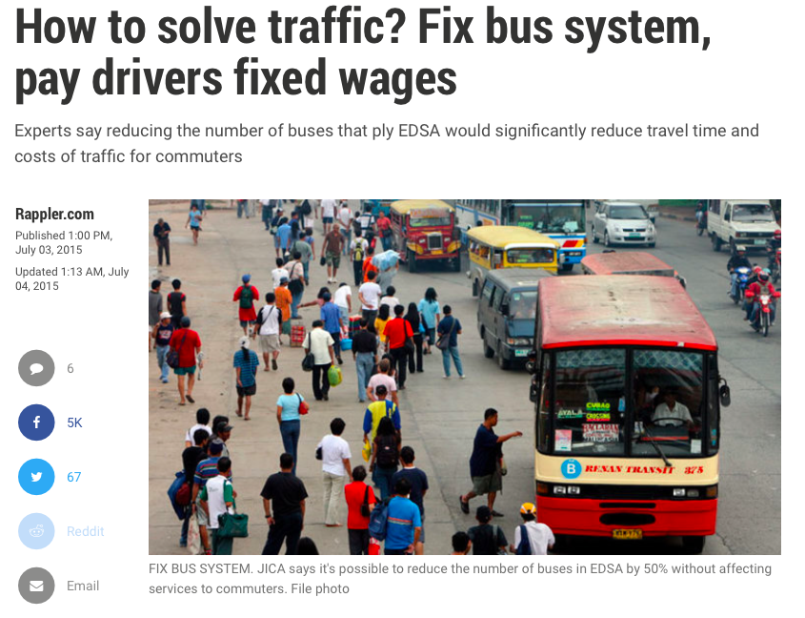
Press Releases
These articles shared on facebook also had a good social media reach
Shaping public opinion: Press release captured by 3 newspaper

Slide 10
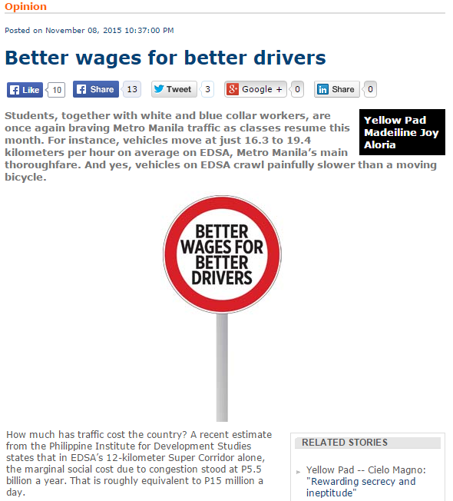
Opinion Articles

Slide 11
Challenges
RICE
Acknowledging the unlikely extension of Quantitative Restrictions, many CSOs prioritize the call for the fast-tracking of investments on rice such as irrigation canals and increased budget on research. These are relevant measures, but are insufficient to address competitiveness and farmers’ losses. Further, the major farmer organizations cannot come out publicly in support of the lifting of the QR, but will rather focus on improving the competitiveness of farm production and the promotion of the welfare of farmers, including adequate safety nets.
BUS TRANSPORT
The LTFRB is prioritizing the development of the Bus Rapid Transit projects in Manila, but there is no clear strategy as to how bus consolidation or rationalization will be done. A statement from the LTFRB to increase the number of buses even contradicts the reform proposal for consolidation.

Slide 12
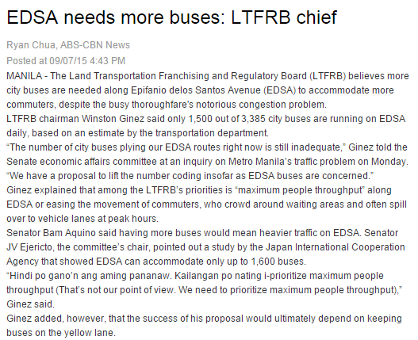
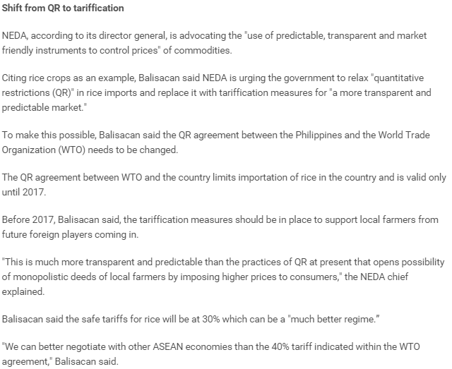
Challenges

Slide 13
New Developments
Elections: Tendency for politicians to adopt populist measures
Transition to a new administration: Inertia in reform process
Formulation of new strategy based on the make-up of the new administration

