Slide 1
Bus Transport Sector Diagnostic Country Report Philippine Institute for Development Studies (PIDS)

Slide 2
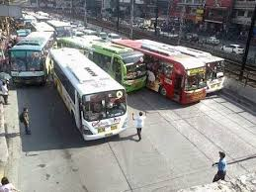

Slide 3
Context
Metro Manila
Mega Manila (MM + CALABARZON) and Greater Capital Region (MM+Regions III & IVa)
Population and economic growth
Increased Need for Public Conveyance and Motorization
Direct benefits, costs and externalities

Slide 4
Metro Manila
12 million people at 191 persons/ha
2 million vehicles plying the streets (2010)
1000 km of road infrastructure within 16 cities and 1 municipality
covering 620 sqkm
Inter and Intra-city transport:
Mass rail transit: LRT1, LRT2, MRT3 and PNR south commuter line
Bus
Other PUVs
Private cars
CONGESTION

Slide 5
Key Statistics
low motorization (9 cars per 1,000 people)
Road network: 33T km national; 1T km MM
Poverty at 28% national/ 6% MM
Bus market structure index: substantial competition
1,122 operators and 12,595 buses operating in Metro Manila
13,752 road accidents per year (10% bus)
10M person trips/day; 70% by PUV, 30% by private car

Slide 6
Key Statistics
50% bus reduction on EDSA possible w/o decrease in service level (JICA 2014)
Average speed of EDSA buses ranged 16.3 to 19.4 kph
Multiple road hazards: floods, structures, etc
Bus occupancy rate as low as 52% (PLANNADES 2007)
Routes with excess capacity
The poor spend at least 20% of their income for transport

Slide 7
Policy and Institutional Timeline
1936
Public Service law
Public Service Commission (PSC)
1950s
DPWTC
Bureau of land transportation (BLT)
PSC transfers franchise powers to
Public Utilities Commission (PUC)
Metro Manila Traffic Management
1975
MMC
MMTMA
1978
Traffic Operations center (TOC)
1979
Traffic Mgt Steering Comm
1970s
PUC becomes
Board of Transportation (BOT)
1979
Ministry of Transportation and Comm
(MOTC)
1985
BOT and BLT merged
Land Transportation Comm (LTC)
1995
MMDA
1987
LTC replaced by
LTFRB & LTO

Slide 8
Regulatory Framework
Bus transportation regulation through DOTC and its line agencies (LTFRB, LTO), national police and local governments
LTFRB – regulation of entry & exit, bus fares
LTO – road safety, licensing and registration
MMDA, PNP, LGUs – traffic management & transport regulations
NEDA, DPWH – infrastructure planning and development

Slide 9
Bus Transport Timeline
1975
Metro Manila Transit Corporation / “Love Bus”
Government as largest operator with 701 units from 4000buses
1976-77
Reorganization of >120 private operators into 4 consortia
Relaxed number of consortia to <10
1980-89
Bus operators regrouped to 14 consortia
Government-led bus leasing program ended the streamlined arrangement
1992
Deregulation of Bus Transport (1992)
Supreme court ruling disallowing arbitrary fare change (1994)
2003
Moratorium on issuance of new franchises
Moratorium lifting and policy accommodations allowed for entry legally and kabit/colorum illegally
current
Manila bus operators and buses total 1122 and 12595, respectively
Prevalence of small operators averaging 10-14 units/operator/route

Slide 10
Cost – Benefit Analysis
Congestion
Road infrastructure at excess capacity
Lack of road discipline
Vehicle operation expenses
Foregone wages by riding public
External costs

Slide 11
Cost – Benefit Analysis

Slide 12
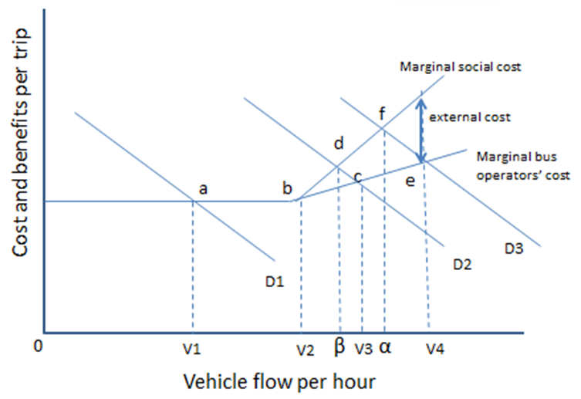
Cost – Benefit Analysis
The goal for traffic managers is to move traffic flows to optimal rates/levels (from V3 to β and V4 to α) where marginal social costs equal marginal social benefits.
We estimate the movement in marginal social cost as traffic de-congestion is assumed given hypothetical policy augmentations.
MSC_{t} (marginal social cost of congestion)= MEC_{t} + MBOC_{t}

Slide 13
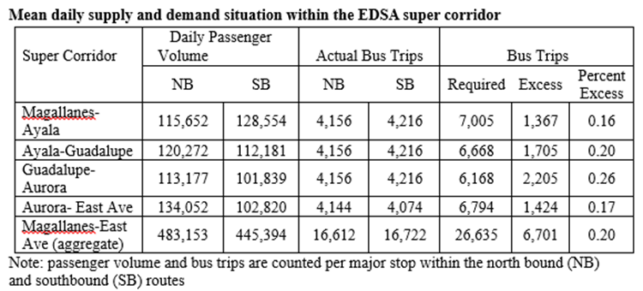
Cost – Benefit Analysis

Slide 14
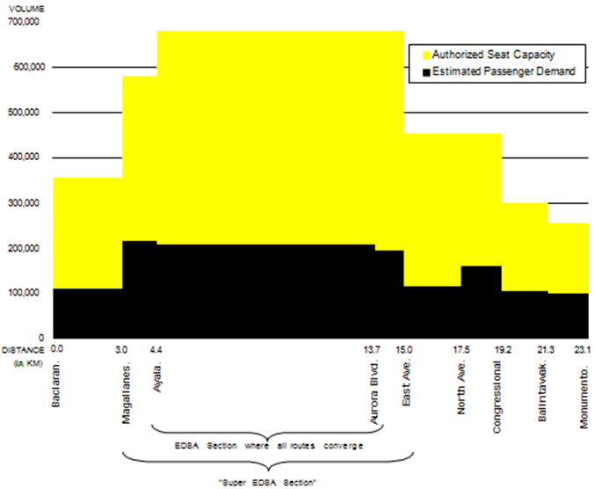
Cost – Benefit Analysis
Bus Seat Capacity &
Passenger Demand
Source: Transportas 2006

Slide 15
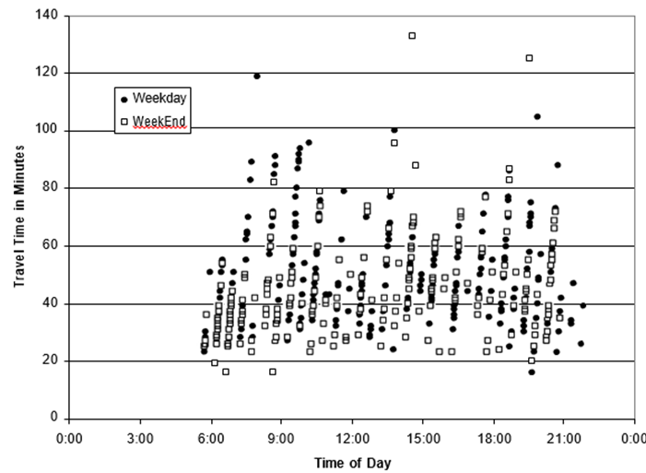
Cost – Benefit Analysis
Range of Bus Travel Time
Source: Transportas 2006

Slide 16
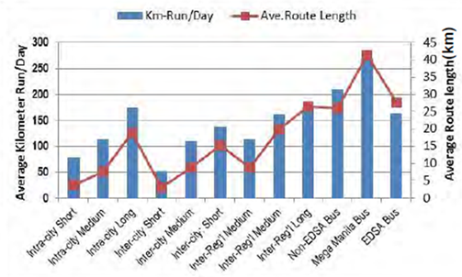
Cost – Benefit Analysis
Route Length & Average Kilometer run
Source: JICA 2014

Slide 17
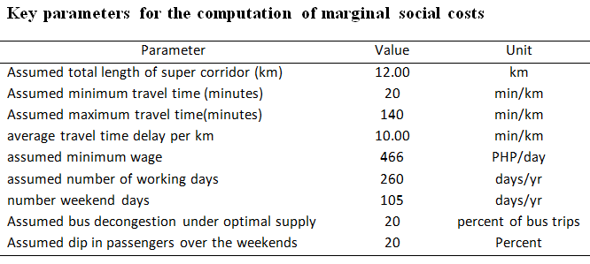
Cost – Benefit Analysis

Slide 18
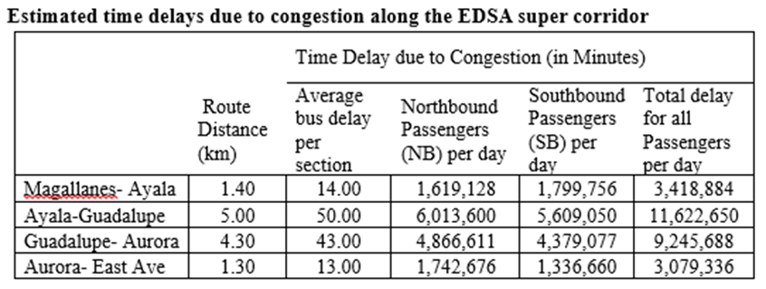
Cost – Benefit Analysis

Slide 19
Cost – Benefit Analysis
Congestion Cost per Day

Slide 20
Cost – Benefit Analysis

Slide 21
Cost – Benefit Analysis
The marginal social cost due to congestion was estimated at PHP 5,508,971,237 per year.
Marginal costs from forgone wages of passengers amounting to PHP 4,569,759,077 ; while marginal bus operators’ cost PHP 939,212,160.
Figures imply that an effective decongestion policy that will lead to a decrease in bus trips by 20% within the EDSA super corridor will yield a net present value of PHP13.2B in the medium term (3yrs) and PHP19.86B in the long term (6yrs) at 12% discount rate.

Slide 22
National Transport Framework/Plan
Philippine Development Plan 2011-2016
National Transport Plan (AusAid 2010)
MegaManila Transport Infrastructure Development Roadmap (JICA 2014)
DOTC- UP
Bus Rapid Transit Plan
(BRT)

Slide 23
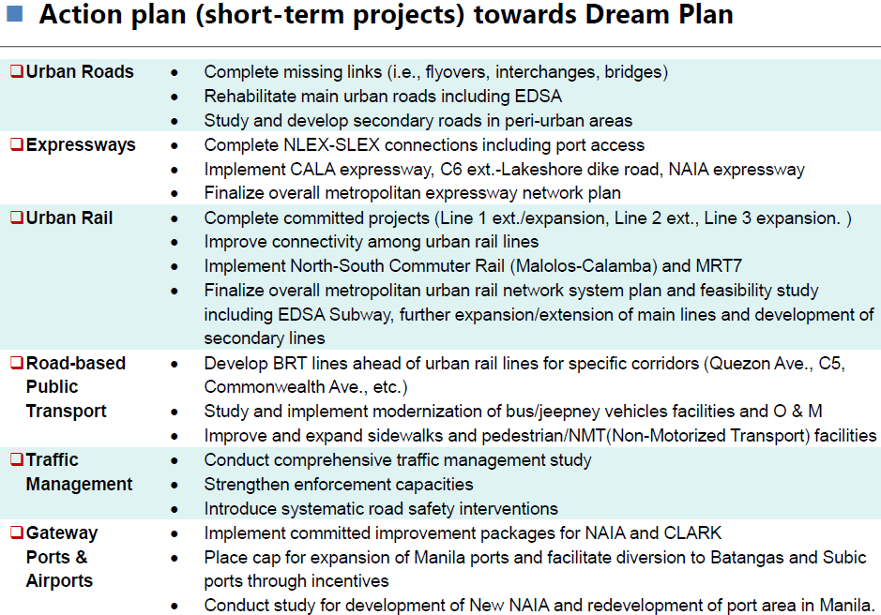
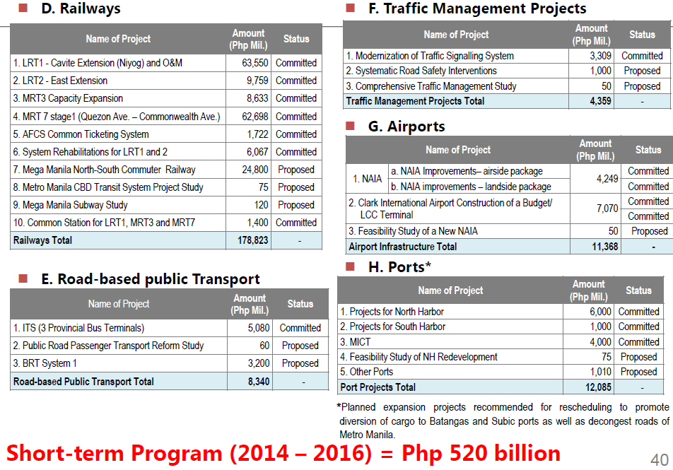
Source: JICA 2014

Slide 24
Source: JICA 2014

Slide 25
Lessons for Policy
Regulatory bodies as institutional reincarnates; need structural augmentation and more trained personnel for enforcement
Unfettered sector evolution: Fragmented bus operators with oversupply of buses
Inadequate regulatory enforcement results to illegal bus operations, poor traffic discipline, and safety concerns for riding public
Vehicular volume is too immense for existing road infrastructure
Short Term: Cut vehicular flow through strict traffic management
Long Term: Implement wide-spectrum approach, including infrastructure development and competition reforms

Slide 26
Points for Advocacy
Organize bus operators
Agglomeration allows for regulatory ease
Enhances accountability and in-sector policing
Look into the welfare of drivers and conductors
Boundary system burdens the lowly worker
Assured daily wage will make drivers more compliant to traffic rules
Enforce policy and harmonize sectoral plans
Traffic management and enforcement
PDP/NTP (AusAid 2010)/MegaManila Roadmap (JICA 2014)/ DOTC- UP BRT plan

Slide 27
THANK YOU !

