Slide 1
Findings and Inferences from project-BRCC (West Bengal)
National Policy Forum
8th October 2012, New Delhi
Prithviraj Nath
CUTS Calcutta Resource Centre
pn@cuts.org

Slide 2
Overview of Pharmaceutical Sector
The genesis of Indian pharmaceutical industry is always traced back to 1901 West Bengal when scientist Acharya Prafulla Chandra Ray laid the foundation stones of Bengal Chemical & Pharmaceutical Works Ltd (BCPL).
West Bengal saw the advent of many new pharmaceutical manufacturers during 1970s with the advent of the Patents Act and also encouraging Industrial policy by Govt. Of India.
In 2005 product patent was first introduced and GMP was also introduced during this time.
West Bengal saw a gradual decline in numbers of manufacturing units from around 1100-1200 in early 90’s to 550 -600 in early 2000s to just around 166 at present. (Source: Directorate of Drug Control, West Bengal)
Most of the firms, around 120, are situated in and around Kolkata, around 40 firms are located in North & South 24 Parganas and the rest in other districts of West Bengal.

Slide 3
Overview of Healthcare Sector
The growth in private healthcare started picking up since the 1990s and introduction of National Health Policy 2002(Govt. of India) and PPP policy 2006(Govt. of West Bengal) boosted it.
The total number of health units in the State is roughly around 2000 (leaving out sub-centres) including both private and public units.
The number of private hospitals outnumber the public hospitals in the state by more than triple, while the proportion of hospital beds show a absolute reverse statistics with the government figures being more than double the private counterparts.
The average number of private health care institutions (excluding physician’s chambers) is 0.58 per 10,000 population in the municipal areas of West Bengal
Kolkata has emerged as the healthcare hub in eastern India with around 121 leading nursing homes and 63 large hospitals. There are roughly 188 diagnostic centres in and around Kolkata.
Other districts with appreciable presence of private healthcare are North & South 24 Parganas, Howrah, Hooghly, Bardhaman and East & West Midnapur.

Slide 4
Methodology for the survey
Sample Composition:
Pharmaceuticals - 50
Bulk drug manufacturers - 5
Formulations – 45
Private Hospitals ( 2:2:1 ratio was attempted) - 50
Big Hospitals (more than 100 beds) - 22
Medium Hospitals (30 -100 beds) - 16
Small Hospitals (15-30 beds) – 12
Medical Representatives - 40
Sectoral Associations – 6
Govt. Authorities and regulatory bodies-3
Local Community – 6
Prescriptions Analysed-305
Research Tools: (a) Questionnaire Survey (b)Focus Group Discussion
Districts covered: Kolkata, North & South 24 Parganas,Nadia, Bardhaman,Jalpaiguri,Siliguri,Howrah.

Slide 5
Macro Level issues influencing Business Responsibility in the 2 sectors in the State
Weak Regulatory Regime, more importantly the implementation thereof, to address the issue of unethical business practices in the face of intense competition.
Stringent norms under GMP difficult for SME Pharmaceutical units – Counter Competitive.
Lack of an appropriate HR policy for MRs.
Lack of proactiveness and mandate among Business Associations to promote responsible business behaviour by their members.
Government’s role was opined to be inadequate by many of the sectoral associations.

Slide 6
Evidence suggesting violation of ‘Business Responsibility’ in the pharmaceutical sector
Majority of pharmaceutical surveyed units don’t have dedicated environment management department.
Pharmaceutical firms are mostly not willing to fix salaries of Medical representatives
Low awareness on UCPMP, NVGs, etc. among pharmaceutical units
20 out of 50 pharmaceutical companies surveyed sponsor events like meeting, workshop, seminar etc for doctors.
Medical Representatives (MR) said that gifts are given to doctors though they may not ask for it
Though many of the MRs were not forthcoming, some did agree that there is a nexus between doctors and pharmaceutical firms.

Slide 7
Communities’ Voice
Out of the 6 communities surveyed only 2 complained about environmental problems.
They experience health related problems like headache, vomiting and the bad smell causes discomfort.
Water bodies in the locality are also polluted.
Weak monitoring and implementation and violation of guidelines by pharmaceutical firms lead to such problems.
The community members fight these issues jointly through local club.
Opined that industry should be located in special industrial zone.

Slide 8
Evidence suggesting violation of ‘Business Responsibility’ in the private healthcare sector
On Regulations:
Around 75% of the hospitals follow code of Optimal Healthcare
Other guidelines like those on prescriptions, RUD, etc. are not so religiously followed.
Low awareness on UCPMP, NVGs, etc. among Hospitals
Bigger hospitals seem slightly better off than medium and small hospitals in this respect

Slide 9
Prescription Analysis
Auditable Prescription: 305
Total number of complete prescription: 14
Prescription not auditable: 22 (8 were illegible)
Number of Drugs per prescription: 2.9
Rational Prescription: 1.96 %
Irrational Prescription: 98.03 %
Prescription containing antibiotic: 26.55 %
Prescription containing Analgesics: 27.54 %
Average Costs per prescription per day: INR 55.00
Most irrationally prescribed drugs were:
(a) Antibiotics (b)NSAIDs (Non-Steroidal Anti-Inflammatory Drugs)
(c) PPI (Proton pump inhibitors, gastric acid reduction) (d) H2 Blockers (gastroesophageal reflux disease) (e) Vitamins (f) Antipsychotics (g)Antihistaminics (allergies)
No banned drugs were prescribed

Slide 10
Corporate Social Responsibility
17% of the Pharma firms and 73% of the Hospitals have CSR policy.
The reasons for having CSR activities has mostly to do with goodwill and image. Though hospitals seem to more inclined towards CSR as integral part of their business than Pharmaceuticals.
Perception about business responsibility/CSR is mostly limited to charitable initiatives like medical camps, free treatment for the poor, etc.

Slide 11
Recommendations
Creating incentives for recognising and adopting business responsibility as part of the core business activity and taking penal actions for violation.
Pharmaceutical Industry being a very important part of healthcare system needs proper surveillance of the Govt. specially the work conditions and job security of the MRs as these are the determinants of unethical practices.
Detailed audit of the CME expenses of the pharmaceutical firms and audit of the income-expense of the service providers.
Multi-stakeholder dialogues on important issues and specific guidelines to make policy making more participatory leading to higher ownership.
Govt. can weigh down the cost of environmental externalities caused by smaller firms if the GMP norms are relaxed for them vis-à-vis the increasing retail price of medicines produced by the bigger firms and reconsider separate GMP norms for the smaller companies.
Capacity building of private sector/industry on voluntary guidelines – charting a sector specific roadmap to this end

Slide 12
Recommendations
Higher involvement of Civil Society Organisations towards monitoring ethical & environmental concerns, spread awareness, demystifying technical & jargonised guidelines, rules for common consumers, redressal of grievances etc. to ensure higher transparency.
Associations to more actively engage to help make the private sector more responsible and make them aware about the rules and regulations-inclusion of business responsibility clauses in the mandate of associations and periodic assessment with support/facilitation from Ministry of Corporate Affairs
Compliance through better self-regulation, capacity building, better communication amongst all stakeholders and greater transparency by encouraging higher consumer understanding and participation.
To realise that strong corporate governance and responsible business conduct brings better transparency and better credit rating, goodwill etc. which in turn help them gain financially as well.

Slide 13
THANK YOU

Slide 14
Awareness among Pharma Companies on Selected Regulations and Guidelines

Slide 15
Do you have any dedicated Environmental management department in your firm?
Do you have any infrastructure in place to reduce negative environmental effects?
Do you think that implementation of regulatory laws should be done differently depending on the size and nature of the unit?

Slide 16
Perception of Pharmaceutical companies about implication of salary structure on Ethical behaviour and areas of ethical concern

Slide 18
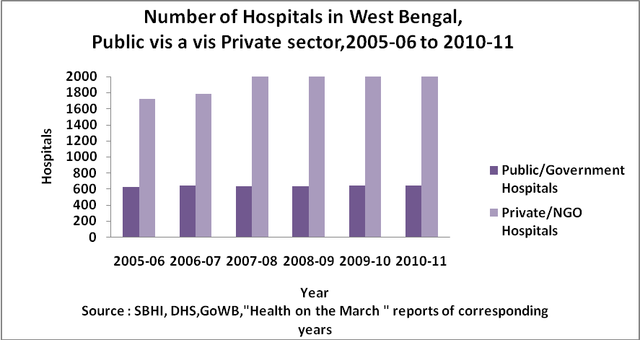
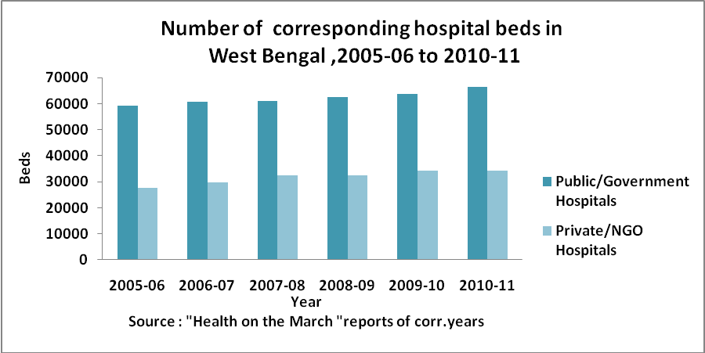

Slide 19
Compliance with selected Guidelines by Private Hospitals

Slide 20
Awareness among Private Hospitals on Selected Regulations and Guidelines

