Slide 1
Findings and Inferences from project-BRCC (West Bengal)
State Focus Group Dialogue
14th September 2012, Kolkata
Prithviraj Nath
CUTS Calcutta Resource Centre
pn@cuts.org

Slide 2
Overview of Pharmaceutical Sector
The genesis of Indian pharmaceutical industry is always traced to 1901 West Bengal when scientist Acharya Prafulla Chandra Ray laid the foundation stones of Bengal Chemical & Pharmaceutical Works Ltd (BCPL).
West Bengal saw the advent of many new pharmaceutical manufacturers during 1970s with the advent of the Patents Act and also encouraging Industrial policy by GoI
In 2005 product patent was first introduced and GMP was also introduced during this time.
West Bengal saw a gradual decline in numbers of manufacturing units from around 1100-1200 in early 90’s to 550 -600 in early 2000s to just around 166 at present. (Source: Directorate of Drug Control, West Bengal)
Most of the firms, around 120, are situated in and around Kolkata, around 40 firms are located in North & South 24 Parganas and the rest in other districts of West Bengal.

Slide 3
Overview of Pharmaceutical Sector
Past Trends
A gradual decline in numbers of manufacturing units early 90’s owing to:
Dependence on government (CMS which declined with time)
Increasing competition and stringent norms (GMP in 2005)
Shift in business strategy
Lack of finance from banking sector due to default on loan repayment
Recent Trends
New areas like Biotechnology, Contract Research and Manufacturing Services (CRAMS)
New policies promoting biotechnology and FDI (upto 100% )
Sikkim is fast emerging as a strong contender for West Bengal due to easier access to China

Slide 4
Overview of Healthcare Sector
The growth in private healthcare started picking up since the 1990s
National Health Policy 2002 welcome private participation and Government of West Bengal officially came up with the PPP policy in 2006
The total number of health units in the State is roughly around 2000 (leaving out sub-centres) including both private and public units.
The number of private hospitals outnumber the public hospitals in the state by more than triple, while the proportion of hospital beds show a absolute reverse statistics with the government figures being more than double the private counterparts.

Slide 5
Overview of Healthcare Sector
An estimated segregation of available hospitals beds in municipal towns is as follows:
29% private hospitals
53% State Health Department
13% other government departments
6% municipalities.
The average number of private health care institutions (excluding physician’s chambers) is 0.58 per 10,000 population in the municipal areas of West Bengal
Kolkata has emerged as the healthcare hub in eastern India with around 121 leading nursing homes and 63 large hospitals. There are roughly 188 diagnostic centres in and around Kolkata.
Other districts with appreciable presence of private healthcare are North & South 24 Parganas, Howrah, Hooghly, Bardhaman and East & West Midnapur

Slide 6
Methodology for the survey
Sample Composition:
Pharmaceuticals - 50
Bulk drug manufacturers - 5
Formulations – 45
Private Hospitals ( a 2:2:1ratio was attempted) - 50
Big Hospitals (more than 100 beds) - 22
Medium Hospitals (30 -100 beds) - 16
Small Hospitals (15-30 beds) – 12
Medical Representatives - 40
Sectoral Associations – 6
Local Community - 6
Districts covered: Kolkata, North & South 24 Parganas, Nadia, Bardhaman, Jalpaiguri

Slide 7
Methodology
Research Tools
Questionnaire Survey
Focus Group Discussion
Prescription Audit (305 prescriptions)

Slide 8
Findings from the Study

Slide 9
Evidence suggesting violation of ‘Business Responsibility’ in the 2 sectors
On Regulations:
Around 75% of the hospitals follow code of Optimal Healthcare
Other guidelines like those on prescriptions, RUD, etc. are not so religiously followed.
Low awareness on UCPMP, NVGs, etc. among Hospitals and Pharmaceutical units
Bigger hospitals seem slightly better off than medium and smal hospitals in this respect
Majority of pharmaceutical surveyed units don’t have dedicated environment management department.

Slide 10
Evidence suggesting violation of ‘Business Responsibility’ in the 2 sectors
Pharmaceutical firms are mostly not willing to fix salaries of Medical representatives
20 out of 50 pharma companies surveyed sponsor events like meeting, workshop, seminar etc for doctors.
Medical Representatives (MR) said that gifts are given to doctors though they may not ask for it
Though many of the MRs were not forthcoming, some did agree that there is a nexus between doctors and pharma firms.

Slide 11
Corporate Social Responsibility
17% of the Pharma firms and 73% of the Hospitals have CSR policy.
The reasons for having CSR activities has mostly to do with goodwill and image. Though hospitals seem to more inclined towards CSR as integral part of their business than Pharmaceuticals.
Perception about business responsibility/CSR is mostly limited to charitable initiatives like medical camps, free treatment for the poor, etc.

Slide 12
Prescription Analysis
Auditable Prescription: 305
Total number of complete prescription: 14
Prescription not auditable: 22 (8 were illegible)
Number of Drugs per prescription: 2.9
Rational Prescription: 1.96 %
Irrational Prescription: 98.03 %
Prescription containing antibiotic: 26.55 %
Prescription containing Analgesics: 27.54 %
Average Costs per prescription per day: Rs. 55.00

Slide 13
Prescription Analysis
Most irrationally prescribed drugs were:
Antibiotics
NSAIDs (Non-Steroidal Anti-Inflammatory Drugs, arthritis)
PPI (Proton pump inhibitors, gastric acid reduction)
H2 Blockers (gastroesophageal reflux disease)
Vitamins
Antipsychotics
Antihistaminics (allergies)
No banned drugs were prescribed

Slide 14
Social, Environmental and Economic Impacts of such violations
Expenditures on gifts, seminars, etc. add to the end price of medicines
Doctors often prescribe expensive medicines in spite of availability of cheaper version in the market. Lack of faith on non-branded/generic drugs also another important reason
Weak RUD regulations and Weak prescription audit system lead to more out of pocket expenditure by patients
Growing skepticism and lack of faith on part of the common consumer on the service delivery mechanism
Environmental problems and long term health hazards in the vicinity of the production area
Unhealthy competition and unethical practices in a bid to race to the top

Slide 15
Drivers/Factors influencing Business Responsibility in the 2 sectors in the State
Weak Regulatory Regime, more importantly the implementation thereof, to address the issue of unethical business practices in the face of intense competition
Stringent norms under GMP difficult for SME Pharmaceutical units – Counter Competitive
Lack of an appropriate HR policy
Lack of proactiveness and mandate among Business Associations to promote responsible business behaviour by their members.
Government’s role was opined to be inadequate by many of the sectoral associations

Slide 16
Initiatives and Feedback from Government , Regulatory Agencies and Associations

Slide 17
Department of Health & Family Welfare
Initiatives
Meeting with State PCB and BMW management entities to ensure adherence of BMW rules
The Government is mulling over the idea of Standard Treatment Protocol (STP) to reduce drug resistance
Meetings with hospital association to get their inputs on STP before finalizing such guidelines
Opinion & Issues
Main problems are non-promotion of generic drugs and big difference between the production costs and the retail price for the drugs.
STP should be mandatory for all healthcare service providers.
Strict monitoring through India wide network involving FDCA of different States can help overcome these challenges
In the long run self-regulation can help solve these issues in a better way

Slide 18
Directorate Of Drug Control
Initiatives
Training programmes for Pharma companies
Regular meeting with Pharma companies to generate awareness about GMP
Meetings with hospital and pharma companies to discourage them from adopting unfair means for marketing and distribution
Discussion with collectives to chart a roadmap to deal with problems facing the sector.
Opinion & Issues
Performance has improved in the last 10 years better regulations, monitoring, and awareness building.
Need for a roadmap to address challenges facing pharmaceutical sector
Active roles by pharmaceutical associations and self- regulations can help in solving these issues in a better way.
Regulatory laws should not be determined or differentiated based on the nature and size of the unit.

Slide 19
Department of Environment
Initiatives
There are no specific work agenda related to Pharmaceutical Sector and Bio Medical Waste management(BMWM). The mandate mostly lies with the State Pollution Control Board (SPCB)
The department has engaged with pharma/hospital associations through seminars, meetings etc. and interactions to build awareness about environment norms / regulations
Opinion & Issues
Main problems for the pharmaceutical sector are surface water pollution and land pollution
Healthcare sector problems are hazards to local community and rag pickers due to wrong disposal of BMW and reuse of used syringes
Interactions and support from Ministry of Environment and Forests are very limited
Industry associations, civil society associations, media etc. can help by raising the awareness level about environment concerns
The main challenges which SPCB faces are: (i) low reach in rural areas (ii) lack of manpower to conduct raids (iii) capacity building (iv) shortage of fund

Slide 20
Indian Medical Association (IMA)
Opinion & Issues
Has guidelines for the healthcare providers but don’t have mechanisms to ascertain its compliance
Lack of communication between government and private hospitals
Government doesn’t involve IMA in the policy making
STP should not be mandatory for private hospitals/doctors
Strict implementation of rules and guidelines can make the private healthcare system more responsible

Slide 21
Bio Medical Waste Management Firm
Opinion & Issues
Improper segregation of wastes due to lack of trained staff are the main challenges faced by hospitals.
Hospitals are well aware about the Bio-Medical Waste Rules and the present rule is adequate and comprehensive.
Rated the State Pollution Control Board’s performance as excellent and best in the country.

Slide 22
Small Scale Drug Manufacturers’ Action Committee
Opinion & Issues
Lack of awareness and financial constraints are the main difficulties of the firms for adhering to the regulatory requirements.
The practice of awarding tenders only to the lowest bidder (L1) is problematic or small farms. This is gradually weeding out small scale units
Regulations need to differentiate between firms on the basis of nature and size instead of a uniform norms. (since pollution potential is lower for small formulations)
Issues can be better solved if regulations are consistent and there is strict enforcement of regulations.
Self-regulation also helps in tackling these kind of problems in a better way.

Slide 23
Communities’ Voice
Out of the 6 communities surveyed only 2 complained about environmental problems.
They experience health related problems like headache, vomiting and the bad smell causes discomfort.
Water bodies in the locality are also polluted.
Weak monitoring and implementation and violation of guidelines by pharmaceutical firms lead to such problems.
They fight these issues jointly through local club.
Opined that industry should be located in special industrial zone.

Slide 24
Overall Recommendations
Thrust on recognising business responsibility as part of the core business activity and creating incentives for adopting the same
Capacity building of private sector/industry on voluntary guidelines – charting a sector specific roadmap to this end
Multi-stakeholder dialogues on important issues and specific guidelines to make policy making more participatory leading to higher ownership
Stricter implementation of existing rules & regulations through better self regulation, capacity building, better communication amongst all stakeholders and greater transparency by encouraging higher consumer understanding and participation.

Slide 25
Broad Recommendations
Associations to more actively engage to help make the private sector more responsible - inclusion of business responsibility clauses in the mandate of associations and periodic assessment with support/facilitation from Ministry of Corporate Affairs
Higher involvement of Civil Society Organisations and community towards monitoring ethical & environmental concerns, spread awareness, demystifying technical & jargonised guidelines, rules, for common consumers, etc.
Capacity building of common consumers on rules, redressal of grievances, etc. to ensure higher transparency

Slide 26
Limitations
Limited time frame
Higher Sample size could have helped to reflect a more comprehensive picture
Nature of the study resulted in scepticism amongst some players and survey was affected due to that.
Limited knowledge about voluntary guidelines amongst players meant that many questions were left unanswered or partially answered
Not a lot of secondary literature/data is available on related issues.

Slide 27
THANK YOU

Slide 28
Annexure

Slide 29
Awareness Matrix-Associations
 | Small Scale Drug Mfs. | Sembramky | IMA | AHEI | BCDA | IPA | WBMSRU
Medical Ethics,2002,MCI | Yes | NA | Yes | Yes | Yes | Yes | Yes
BMW Management Rules | NA | Yes | NA | Yes | NA | NA | NA
NVG | No | Yes | No | No | No | No | NA
UCPMP | No | NA | Yes | No | No | Yes | Yes
29

Slide 30
Awareness Matrix-Policy Makers & Regulators
 | Department of Health & Family Welfare | Department of Environment | Directorate of Drug Control
Medical Ethics,2002,MCI | Yes | NA | NA
BMW Management Rules | Yes | NA | NA
NVG | Yes | Yes | No
UCPMP | Yes | NA | Yes
30

Slide 31
Compliance with selected Guidelines by Private Hospitals

Slide 32
Awareness among Private Hospitals on Selected Regulations and Guidelines
Awareness among Pharma Companies on Selected Regulations and Guidelines

Slide 33
Do you have any dedicated Environmental management department in your firm?
Do you have any infrastructure in place to reduce negative environmental effects?
Do you think that implementation of regulatory laws should be done differently depending on the size and nature of the unit?

Slide 34
Perception of Pharma companies about implication of salary structure on Ethical behaviour and areas of ethical concern

Slide 36
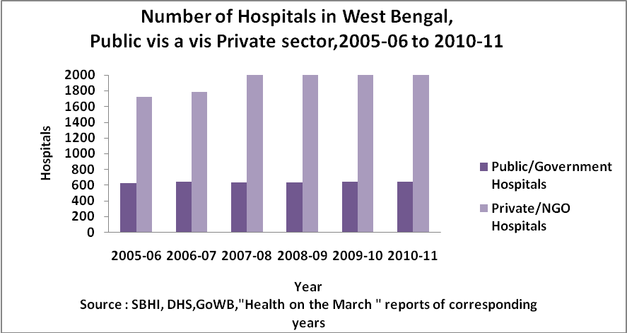
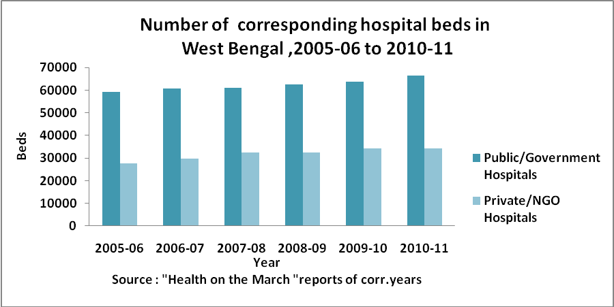

Slide 37
