Slide 1
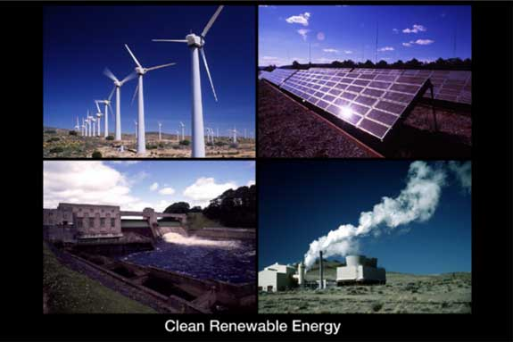
SCHOOL ADVOCACY ON RENEWAL ENERGY
Group 1
SHYAMAL PRASAD JANA
DEBASIS PANDA
KALYAN SARKAR
DIPAK KHUTIA
SUKUMAR BERA
SUCHANDRA GANGULY
SANJIB BHANJA
SHUBHRA CHOWDHURY

Slide 2
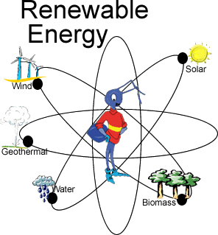
WHAT IS RENEWAL ENERGY?
Renewable energy is energy which comes from natural resources such as sunlight, wind, rain, tides, and geothermal heat, which are renewable (naturally replenished). About 16% of global final energy consumption comes from renewables, with 10% coming from traditional biomass, which is mainly used for heating, and 3.4% from hydroelectricity.

Slide 3
Why are we thinking about renewable energy?
High environment pollution
climate change-prolonged summer, irregularity of monsoon and seasons at large.
global warming- decreasing in food production, health hazards, change in biodiversity.
Land-use problems like tsunami, earthquake.
Depletion of conventional energy like fossil fuel like coal, petroleum etc.

Slide 5
A STRANGE FACT
Due to lack of awareness, there is a high demand for conventional energy which is harmful. There is a high demand for conventional energy so the cost of it is increasing day by day. but on the other hand, renewable energy on the other hand is environment-friendly and the cost also also is comparatively less and gradually decreasing.

Slide 6
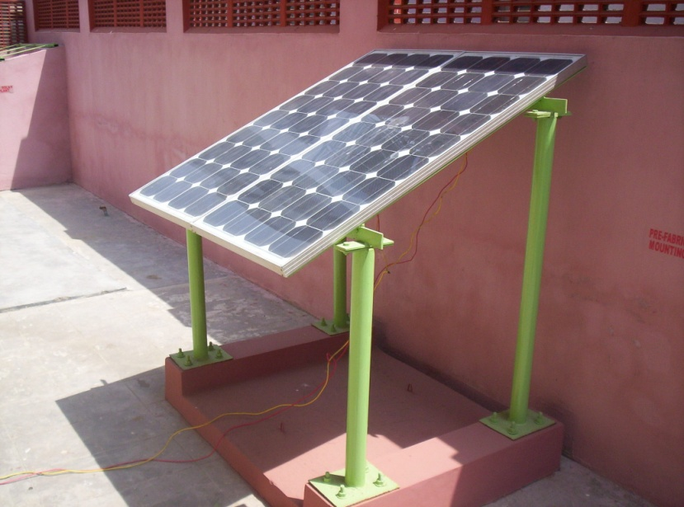
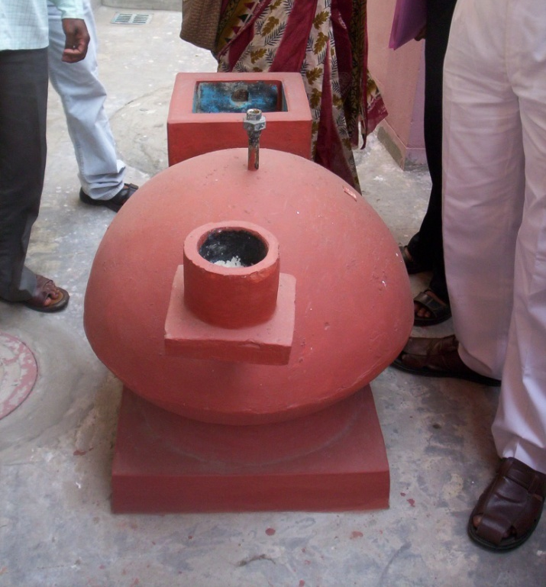
Teacher and school committee initiative
Introduction of renewable energy like solar energy, biogass sources in domestic and institutional use as more as practicable. School can conduct the cooking of mid-day meals in biogass and improved chullah or solar energy and this energy can even be used in laboratory.
Introduction of renewable energy knowledge and use in school curriculum and syllabus. District inspectors can be convinced to give this proposal to N.C.E.R.T for implementation. To provide knowledge through both theory and practical classes.

Slide 7
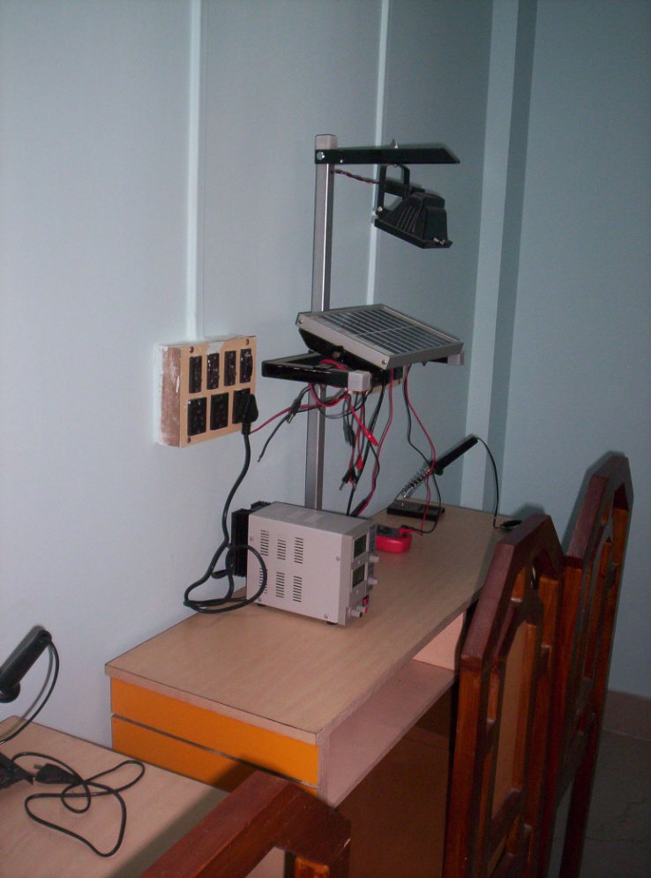
Teacher and school committee initiative (contd.)
Arrangement of seminar, debate, sit-and-draw competition, renewable energy exhibition and model display to increase awareness and interest among students and daily consumes.
students and teachers are needed to be exposed to renewable energy manufacturing plants, demonstrated area and renewable energy generating stations in a regular interval.
Arrangemment of skit, street play by students to increase interest among all classes of people. Campaigns can be conducted by students to introduce solar energy in vegetable markets, shopping malls.

Slide 8
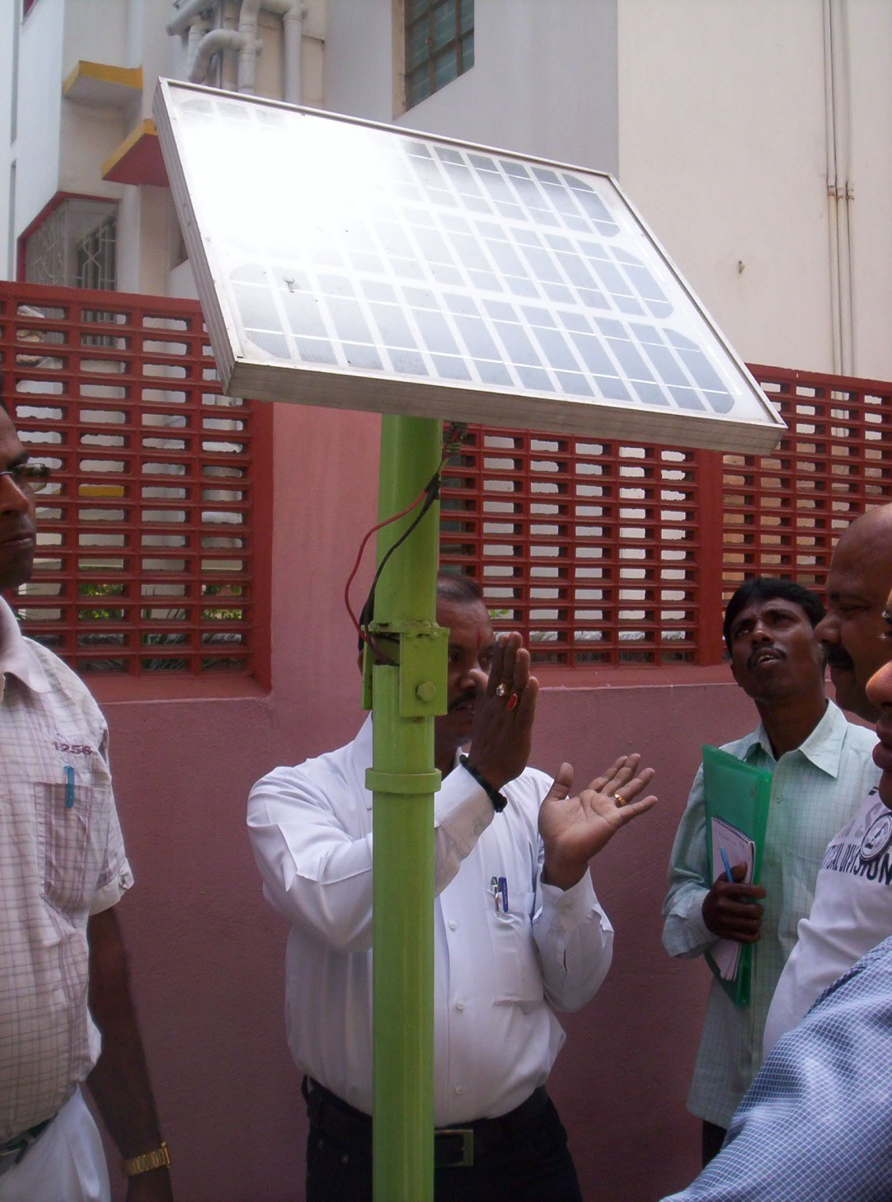
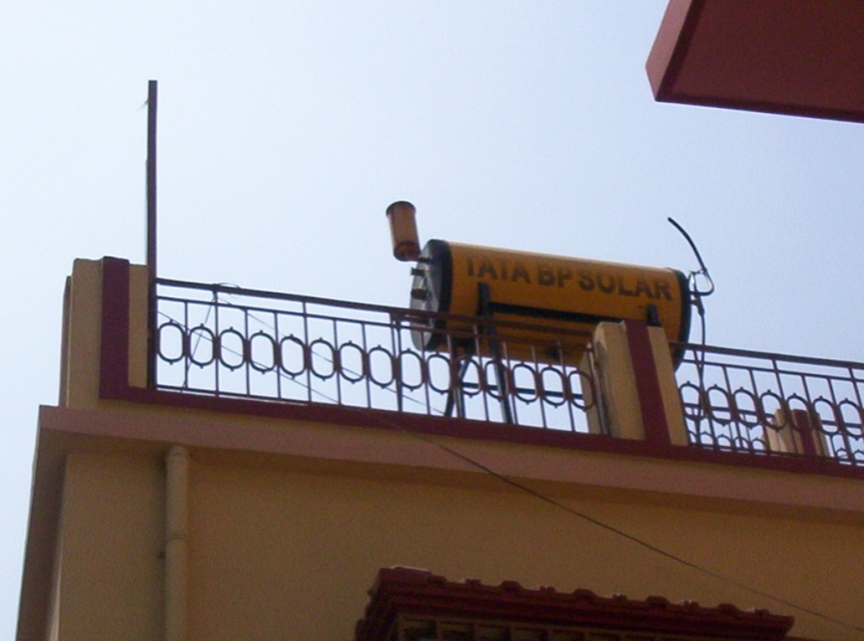
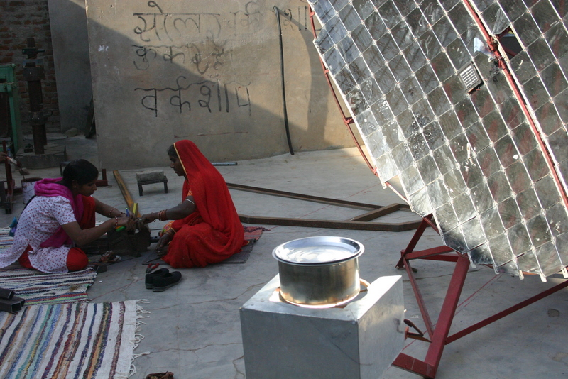

Slide 9
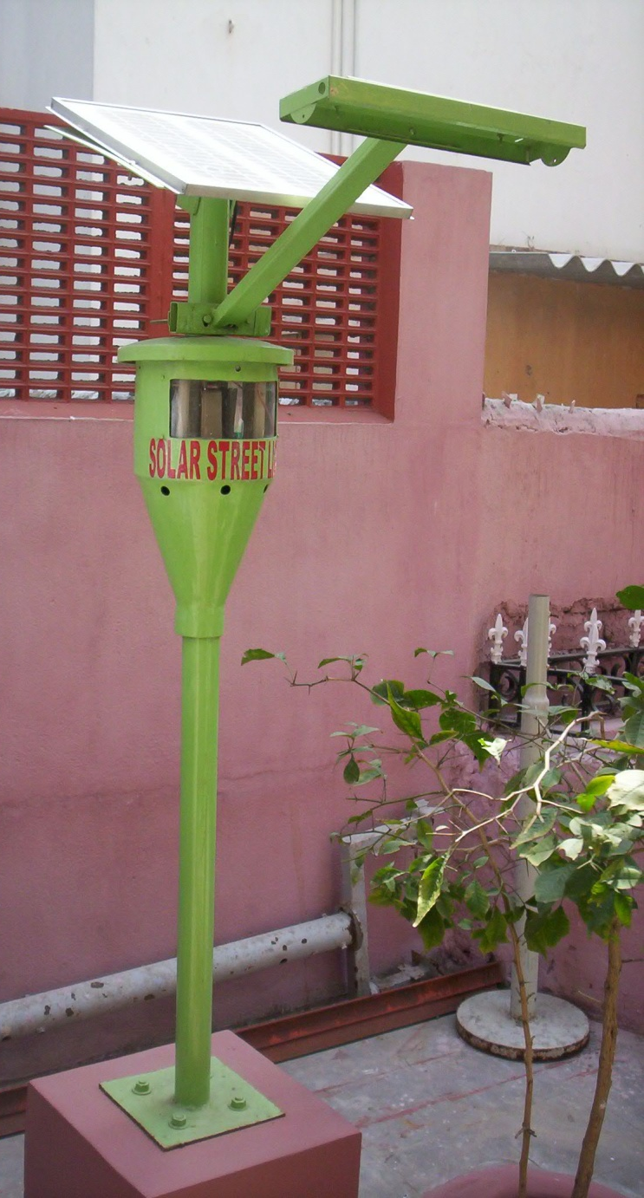
Teacher and school committee initiative (contd.)
School should take initiative to electrify the school buildings in solar energy.
Schools should include renewable energy also in the form of vocational training.

Slide 10
THANK YOU

