Slide 1
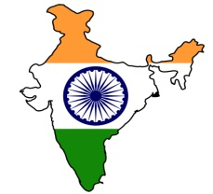

How to create political will for change?
Contact: marc.saxer@fesindia.org

Slide 2
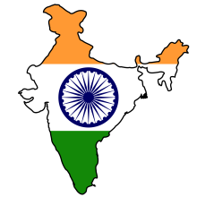

In a conservative political economy…
Status quo alliance
Narratives, myths and symbols
Progressive Policy Initiatives
Political economy, policy paradigms
Institutions, rules and norms
Contact: marc.saxer@fesindia.org
… progressive policy initiatives often fail to be implemented.
Notes:
2

Slide 3


The strategic trap:
In a hegemonic situation, policies can not be changed…
National Security
Development
Paradigm:
Policy:
Stop
Go
Contact: marc.saxer@fesindia.org
… if paradigms stay the same
Notes:
The difference becomes relevant in terms of coalition building: the lowest common denominator allows only a few stakeholders to join forces across the aisle, while a vision for a Good Society allows to build a broad societal coalition for change.

Slide 4
Policies are hard to shift within old paradigm…
Struggle for innovation
Paradigm | Extractive growth Few extract from the many | Inclusive growth: Lift all boats
Policy | Defend status quo | Promise innovation
Struggle for democracy
Paradigm | State enforces universal rules | State responds to needs of citizens
Policy | No recognition of difference | Recognition of differences (local, religious, race, gender, ethnic)
Struggle against corruption
Paradigm | Corruption is immoral behaviour of a few rotten apples | Corruption is the DNA of the patronage system
Policy | Anti-corruption inhibition sanction individuals | Empowered people to resist abuse of power
Contact: marc.saxer@fesindia.org

Slide 5
… to prepare ground for policy change,
paradigm needs to shift
Foreign Policy/Struggle for Peace
Paradigm | National Security | Win-win cooperation
Policy | Close borders (Pakistan) | Open borders (Bangladesh)
Struggle for gender justice
Paradigm | Demography curse | Demographic divided
Policy | Kill unborn girls | Capabilities for all
Struggle for social security
Paradigm | Competition between nation states | Moving up the value chain
Policy | Curb “luxury” welfare | Invest in capabilities for all
Contact: marc.saxer@fesindia.org

Slide 6
So why don’t we simply change the paradigm?
EXCLUSIVE SOCIETY WITH PRIVILEGES FOR THE ELITES
GOOD SOCIETY WITH FULL CAPABILITIES FOR ALL
Contact: marc.saxer@fesindia.org
Change is not the outcome of a struggle between those who seek to uphold the status quo and those who want change

Slide 7
Who are those who resist change? …
Elites fear loss of status and privilege
Middle classes fear the abuse of power and resent corruption
Socially conservatives fear the loss of identity and moral decay
Contact: marc.saxer@fesindia.org
…those who benefit, and those who fear

Slide 8

So we need a broad societal change alliance…
The Rainbow Coalition
Contact: marc.saxer@fesindia.org
… why does such a Rainbow Coalition not emerge?

Slide 9

The isolation trap:
Those who want change are tribalized into small movements with different interests and diverging priorities…
Contact: marc.saxer@fesindia.org
… scaling up these isolated struggles into a broad societal alliance is a hard-to-solve collective action problem

Slide 10


The technical trap
Decision-makers change quickly
and have vested interests …
?
?
?
Technical Solution
Policy Implementation
Political Process
?
?
?
Contact: marc.saxer@fesindia.org
Technocrats and academics who fail to give politically viable policy options will be sidelined in the political process

Slide 11
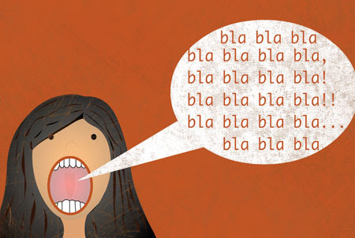
The language trap:
Political communication often focuses on
facts and interests…
Contact: marc.saxer@fesindia.org
… failing to speak to morality and identity of people
Notes:
Hence, the EoT strategy has three dimensions.

Slide 12
Strategic Approach:
The political ground for policy changes needs to be prepared…
Paradigm shift
Redefinition of expectations + interests
Policy shift
Status quo scenario
Excess imagination
Change narrative
Practical vision
Contact: marc.saxer@fesindia.org
… on the paradigm level.

Slide 13
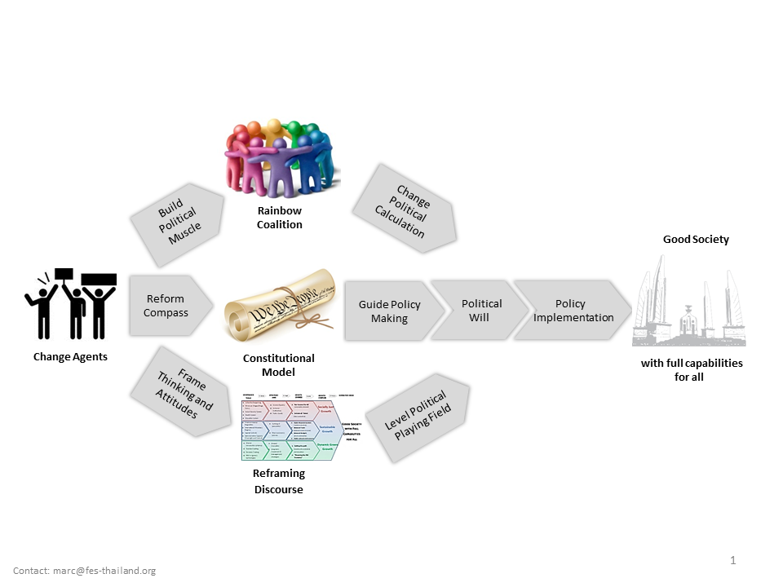

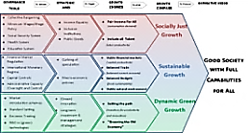
To generate political clout for the struggle over the paradigm shift…
Build
Political Muscle
Change alliance
Change Political Calculation
Good Society
Reform
Compass
Guide Policy Making
Political
Will
Policy
Implementation
Change agents
with full capabilities
for all
Model
Frame Thinking and Attitudes
Level Political Playing Field
Contact: marc.saxer@fesindia.org
Change Narrative
… a comprehensive strategy is needed which combines
actors, ideas and resources

Slide 14
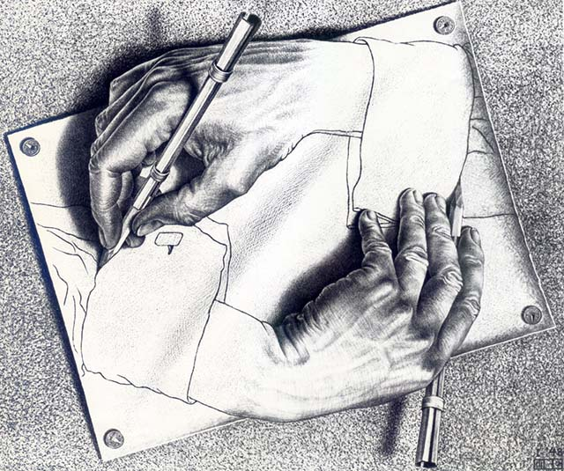
The medium which connects actors, ideas and resources is language: the Discourse
The Great Transformation
„Change you can believe in“
Contact: marc.saxer@fesindia.org
A transformative project needs a change narrative to capture the imagination about „what can be said and done“.

Slide 15
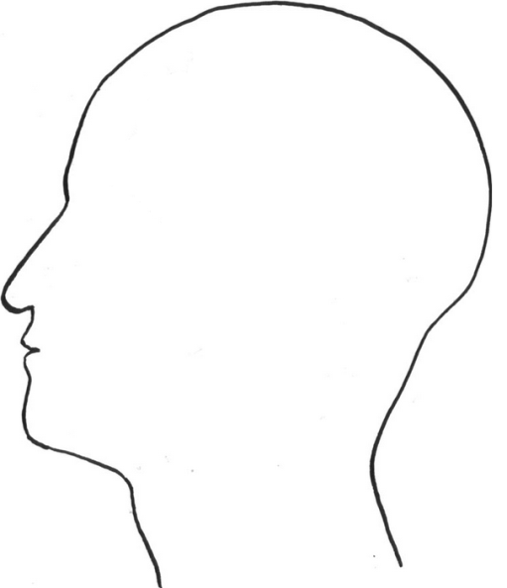
Actors do not define their interests in isolation, but within the frames of their discourse communities
Myths
Perceptions
Narratives
.
Paradigms
Social Moral
Attitudes
Historical Experiences
Definition of Interest
Notes:
Therefore, those who seek democratic change need to change the way the society thinks and talks about itself.
Norms need to be redefined, Values have to be filled with new meaning.
Society needs a vision of a better tomorrow to aspire to. Only the utopia of a Good Society can inspire people to overcome their differences and struggle together for a better future.
15

Slide 16
Discourses outside the mainstream can easily be sidelined, dismissed or sanctioned...
Madness
Taboo
Radical
Traitor
Irrational
Extremist
Unreasonable
Mainstream
Conspiracy
Irresponsable
Contact: marc.saxer@fesindia.org
Illegal
Political Incorrectness
National Security Threat
Crazy

Slide 17
If a discourse becomes hegemonic,
the vast majority will no longer question it …
Social Sanctions
Discourse
Hegemony
Legal Sanctions
Contact: marc.saxer@fesindia.org
…but accepted it as reasonable, appropriate or simply
„The Truth“.

Slide 18
By defining what can be said and done...
Radical
Mainstream
Extreme
Taboo
Illegal
Taboo
Radical
Mainstream
Extreme
Taboo
…discourse hegemony defines the political field
Contact: marc.saxer@fesindia.org

Slide 19
Policy discourses are embedded into discourse communities...
Discourse Community I
Discourse Community II
Policy Discourse
Paradigm Discourse
Narrative Discourse
Metaphysical Discourse
Contact: marc.saxer@fesindia.org
… discourse steering can influence, guide, justify
or define interests and positions.

Slide 20
1970s
Club of Rome at the fringe
Technology-driven
Growth
Redistributive
Social Justice
Growth
as a problem as a solution
De-growth
Market
State
Contact: marc.saxer@fesindia.org

Slide 21
1980s
Environmental Protection resonates with more people
Market-driven Growth
Redistribution
Social Justice
Growth
as a problem as a solution
Environ-mental Protection
De-growth
Market
State
Contact: marc.saxer@fesindia.org

Slide 22
1990s
Sustainability moves closer to the center
Market-driven Growth
Third Way
Social Growth
Sustainable Development
Growth
as a problem as a solution
Environmental Protection
De-growth
Market
State
Contact: marc.saxer@fesindia.org

Slide 23
2000s
Climate change builds first bridges,
but is dismissed as de-growth
Market-driven growth
Third Way Growth
Sustainable Development
Growth
as a problem as a solution
Carbon
Development Initiatives
Emission Trading
Climate
Change
Environmental Protection
De-growth
Market
State
Contact: marc.saxer@fesindia.org

Slide 24
2010s
Green New Deal occupies the center
and changes the paradigm
Green Growth
Technology-driven growth
Inclusive Growth
Green
New
Deal
Sustainable Development
Green Jobs
Growth
as a problem as a solution
Greening the Economy
Climate
Change
Environmental Protection
De-growth
Market
State
Contact: marc.saxer@fesindia.org

Slide 25
A discourse alliance is forming…
US government
Green NGOs
Swedish government
Green Party
Italian government
Protestant churches
Spanish government
Greenpeace
German government
Catholic Church
Utilities Enel
Social Democrats
Rating Agencies
Utilities E.ON
German Labor Federation
Investment funds
Pension Funds
Bank of England
...even partnerships for Rainbow Coalition
Contact: marc.saxer@fesindia.org

Slide 26
By changing the interpretation, expectation and definition of interests of actors…
  In 2015, electricity from solar first time cheaper than all other energy sources
  Bank of England / German government warn against “carbon bubble”
  Fossil industry stocks lose AAA ratings
  Pension Funds (largest investors in the world) shift portfolios
  G7 pledges end of carbon economy
  Germany is phasing out nuclear energy, legislates energy transformation
  Spain, Italy, Sweden and Portugal start to wind down coal
  Changing business plans: Utitilies giants E.On (Germany) and Enel (Italy) sell all conventional power plants. Enel partners with Greenpeace — which has previously been deeply critical of Enel's carbon footprint. Vattenfall (Sweden) sells all conventional plants in Germany. RWE and EnBW (Germany) announced that they are thinking of shifting their energy generation towards renewable.
Contact: marc.saxer@fesindia.org
… the new paradigm discourse shifts resources and policies

