Slide 1
Project Launch Meeting
National Competition Policy and
Economic Growth in India - ComPEG
Presentation on Project Overview
Natasha Nayak, CUTS

Slide 2
OUTLINE
Introduction: Competition As a Driver of Economic Growth
Tools of effective competition: policy and law
Competition Policy vis-à-vis Competition Law
NCP: Current scenario in India
Purpose and Objectives
Implementation
Research Plan & Methodology
Evidence Based Advocacy for Reforms (Flow chart)
OECD Competition Assessment Tool Kit
Economic Gains: Select Sectors
Advocacy Plan

Slide 3
COMPETITION AS A DRIVER OF ECONOMIC GROWTH
Expected benefits from competition reforms: annual gain in real GDP of 5.5%, consumer gains by A$9bn (Australian Productivity Commission)
Robust and significant negative link between competition and inflation both at aggregate and sectoral levels (OFT)
Differences in levels of competition account for more than 50 per cent of the current gap in GDP per capita between the Euro area and the United States (Bayoumi et. al.)

Slide 4
…Continued
“Strong competition policy is not just a luxury to be enjoyed by rich countries, but a real necessity for those striving to create democratic market economies” Joseph Stiglitz
Study of IDA countries: the world’s poorest countries tend to have low levels of competition in domestic markets and a high degree of market dominance (FIAS, 2007)
e.g. When competition was introduced in generic drugs in South Africa, prices for antiretroviral drugs fell by up to 88% since 2003 and access increased from 20,000 to 155,000

Slide 5
TOOLS OF EFFECTIVE COMPETITION
Competition Policy
Full set of measures including though not restricted to the law necessary for ensuring competitive market structures/behaviours (WTO)
NCP Work in progress
Competition Law
Regulatory mechanism to check anti-competitive practices
Competition Act of 2002

Slide 6
Competition Policy vis-à-vis Competition Law
FDI Policy
Trade Policy
Industrial Policy
Disinvestment Policy
Fiscal Policy
IPR Policy
Labour Policy
Procurement Policy
… others …

Slide 7
NCP: CURRENT SCENARIO IN INDIA
C-NCP under MoCA
DraftNCP2011http://www.mca.gov.in/Ministry/pdf/Draft_National_Competition_Policy.pdf, Cabinet Committee on Competition and Advisory Council (proposed)
Competition impact assessment studies for 13 sectors commissioned by IICA and CIRC http://www.iica.in/SectorStudies.aspx
Evidence of distortions in rules, regulations and policies revealed. Also documented in Quarterly CUTS Distortions Dossiers http://www.cuts-ccier.org/Competition_Distortions_India.htm
CUTS journey of pursuing competition reforms in India http://www.cuts-ccier.org/pdf/CUTS- journey_of_pursuing_competition_reforms_in_India.pdf

Slide 8
PURPOSE
Create necessary and sufficient conditions for adoption of legislative changes to enhance competition in select sectors: pharmaceuticals, electricity, petroleum and natural gas
OBJECTIVES
Ensuring that government policies are aligned with the principles of competition
Translating benefits of enhanced competition to realisation of the objective of sustained economic growth
Formulating a template/methodology for similar studies for other sectors subsequently

Slide 9
IMPLEMENTATION
Stage I : Research and advocacy for legislative reforms (June 2012-March 2013)
Stage 2: Advocacy and monitoring implementation of NCP
(March-December 2013)
Study the progress of implementation of NCP
Advocacy with stakeholders on adoption of proposed reforms

Slide 10
RESEARCH PLAN & METHODOLOGY
Formation of Project Advisory Committee for guidance and assistance through project tenure
Formation of Research Review Group to review research output
Identifying competition distortions in select sectors
Competition Checklist, OECD Competition Assessment Toolkit
Proposing corrective measures through legislative reforms
Literature review
Perception surveys, one to one interviews and stakeholder consultations
Mapping political economy challenges in implementing reforms in select sectors
Literature review
Structured questionnaires and stakeholder consultations
Quantification of economic gains (measured as increase in consumer and producer surplus) from enhanced competition as an outcome
Study market structure, concentration, entry barriers, conditions, firm behaviour etc.

Slide 11
Assessment
Competition distortions in sectoral laws and policies
Based on Competition Checklist
Competition Assessment Toolkit (Impact Assessment Study)
Formulation of corrective measures
Suggesting Iegislative reforms and implementation (subject to political economy challenges)
Outcome
Enhanced competition in select sectors
Economic Gains
Quantitative analysis
STAGE I: EVIDENCE BASED ADVOCACY FOR REFORMS
Producer Surplus
Consumer Surplus

Slide 12
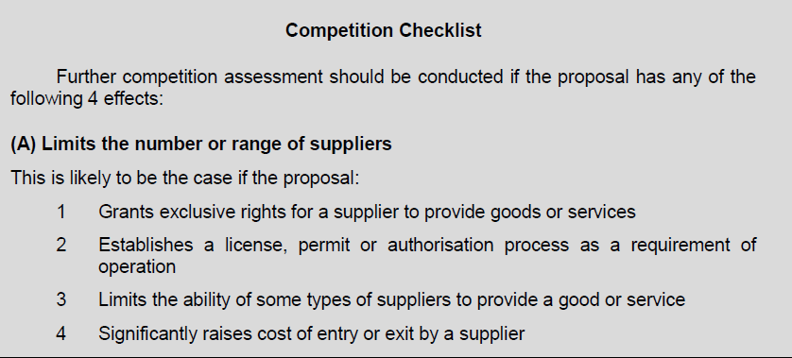
OECD COMPETITION ASSESSMENT TOOLKIT

Slide 13
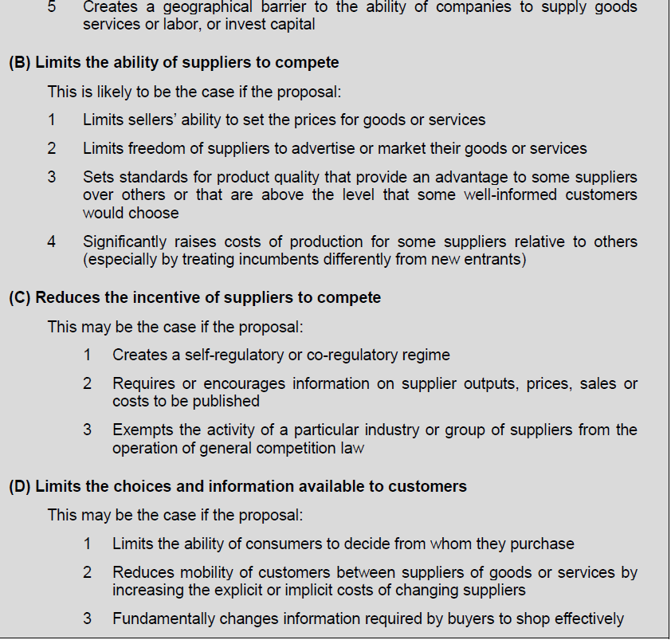
….Continued

Slide 14
ECONOMIC GAINS: SELECTED SECTORS
Pharmaceuticals: Gains from lowering entry barriers, promoting generic entry, addressing abuse of patent monopolies and other issues
Electricity: Gains from reducing market concentration/ market power on prices, addressing implementation challenges in competitive bidding, unbundling, open access etc.
Petroleum & Gas: Gains from addressing dominance of few firms on prices, distortion of competitive neutrality in favour of government owned firms and lowering entry barriers to generate competition in segments etc.

Slide 15
ADVOCACY PLAN
Role of Competition Advocacy in Effecting Reforms
Engagement with specific sectors: sectoral associations
Regular engagement with stakeholders: industry associations, relevant ministries, departments, academics, media, consumer groups (electronic as well as in person)
Sensitisation of Parliamentarians through various fora such as PARFORE
National dialogue with stakeholders to disseminate all research and survey findings

Slide 16
THANK YOU

