Slide 1
Outline of Advocacy Activities in Ghana CREW Project
Appiah Adomako
CUTS Accra
Notes:
Notes on behalf of shreya: for the PAC meeting on Nov 19
1. In the slides the mapping is only done for bus
for the maize sector, the mapping has not been included
please include a slide for the same.
2. 3For specific advocacy agenda:
the agenda for maize has been included in the slides
but for the agenda on bus transport
the slide has not been included
3. For the table in developing the advocacy plan:
you are free to remove the section on indicators for success. we feel that it would be premature to already indicate the indicators for success
4. For the approach:
you would have to fill any the prospective actions that CUTS Accra plans to take to advocate for the specific issues

Slide 2
Outline
Approach: linking evidence with advocacy, targeting ‘outcomes’
Mapping relevant stakeholders for advocacy
Sector specific advocacy agenda
Developing the Advocacy Plan
Endnotes – Overall suggestions by NRG members

Slide 3
1. Linking evidence-based outcomes with advocacy
Identifying ‘cases’ or ‘stories’ from the field work
Cases that help link:
Competition reforms > Market effects > Implications on beneficiaries (consumers and producers)
Possibility of quantifying results?
Compelling case studies (qualitative, anecdotal)
Developing working relations with key stakeholders.
Creating and conveying the advocacy message(s)

Slide 4
2. Mapping stakeholders for advocacy –
Bus Transport
SH Categories | National Level
Ministry | Ministry of Transport, Ghana Road Coordinating Council
Regulator & Specialised entities | Ministry of Transport
Research Institution, NGO | CUTS, ISSER
Business Associaton | Bus Owners and Operators Associations, GPRTU, PROTOA
Media | National Media | Local, Vernacular Media

Slide 5
2. Mapping stakeholders for advocacy –
Maize Sector
SH Categories | National Level
Ministry | Ministry of Food and Agriculture (MOFA), Directorate of Crop Services
Regulator & Specialised entities | MOFA
Research Institution, NGO | CUTS, ISSER
Business Associaton | Peasant Farmers Association of Ghana, Co
Media | National Media (mainly radio and TV) | Local, Vernacular Media

Slide 6
Advocating on What?
Maize and Bus Transport Sectoral Issues

Slide 7
3. National advocacy issues
Staple Food/Maize
Pro-competitive reforms in seeds sector is working in the interest of farmers.
Private sector’s involvement in the sales and distribution of fertilizers have also increased the usage of fertilizers among fertilizers.
How can this experience be replicated in other inputs, e.g. – credit?
Greater thought needed in engaging private sector in infrastructure and service provision (supply-chain)

Slide 8
3. National advocacy issues
Bus Transport
Introduction of new regulations and standards in the sector.
Competition Reforms in the Bus Transport Industry - Policy Framework
National Road Transport Regulatory Authority- a policy prescription
Policy Reform on Strengthening Private Sector Operation in Bus Transport
Route rationalization

Slide 9
4. Specific advocacy agenda Maize
National seed policy and its implication on production and farmers
Fertilizers sector reforms and implications for farmers
The role of NAFCO on price setting
National seed policy and its implication on production and farmers

Slide 10
5. Specific advocacy agenda Bus Transport
Route rationalization and its impact on efficiency and utilization of resources
Road transport regulatory authority and its role in setting and enforcing standards in road transports
Regulating the sector to ensure standardization
Controlling the “union cartel” in passenger transports.

Slide 11
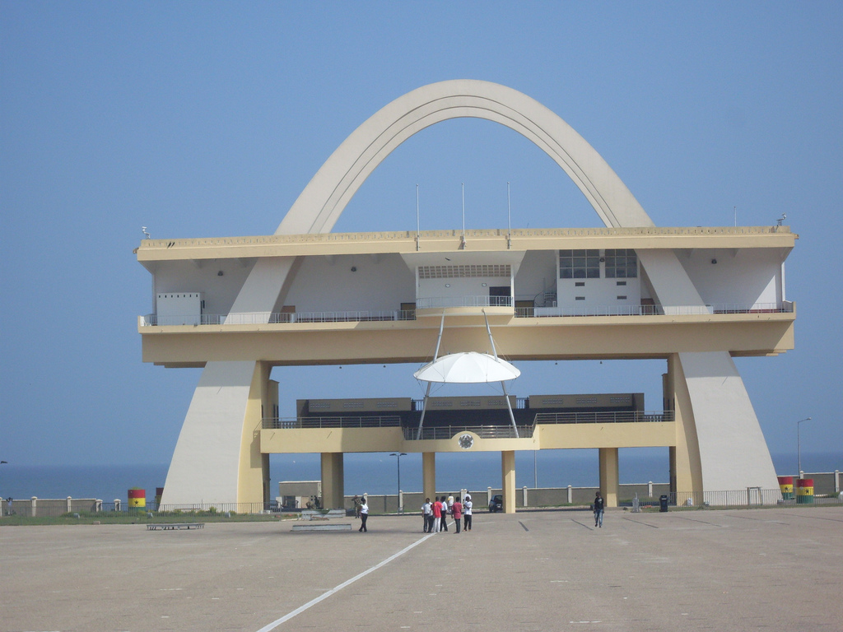
Advocating How?
Strategy for Success

Slide 12
5. Developing the Advocacy Plan Maize
ISSUE | APPROACH | RESPONSIBILITY
National seed policy and its implication on production and farmers | Direct engagement with the stakeholders and also educating the grassroots farmers on the same. | MOFA
Fertilizers sector reforms and implications for farmers | Direct engagement with the stakeholders and also educating the grassroots farmers on the same. | MOFA
The role of NAFCO in price setting |  | MOFA

Slide 13
5. Developing the Advocacy Plan (BUS TRANSPORT)
ISSUE | APPROACH | RESPONSIBILITY
Introduction of new regulations and standards in the sector. | Direct engagement with the MOT, NRSC , DVLA and the Parliament of Ghana | Ministry of Transport, Transport Unions and Transport Operators, NRSC, DVLA
Establishment of Road Transport Regulatory Authority | Direct engagement with the MOT, NRSC , DVLA and the Parliament of Ghana | Ministry of Transport, Parliament
Route rationalization | Direct engagement with relevant stakeholders (transport unions, municipal and metropolitan authorities | Transport Union, Municipal and Metropolitan Authorities

Slide 14
Thanks for your attention!
apa@cuts.org

