Slide 1
Outline of Advocacy Activities in India CREW project
Neha Tomar & Shreya Kaushik
CUTS
November 19th, 2014 (Bangkok, Thailand)

Slide 2
Outline
Linking evidence with advocacy
Advocating on what
National advocacy issues
State-specific advocacy issues
Advocating to Whom
Mapping stakeholders for advocacy – National and State level
Envisaged Activities for the National Advocacy Plan
Envisaged Activities for the State Advocacy Plan

Slide 3
1. Linking evidence with advocacy
Identifying ‘cases’ or ‘stories’ from the states
Cases that help link:
Competition reforms > Market effects > Implications on beneficiaries (consumers and producers)
Possibility of quantifying results?
Compelling case studies (qualitative, anecdotal)
Developing working relations with key SHs (national & state)
Creating and conveying the advocacy message(s)

Slide 4
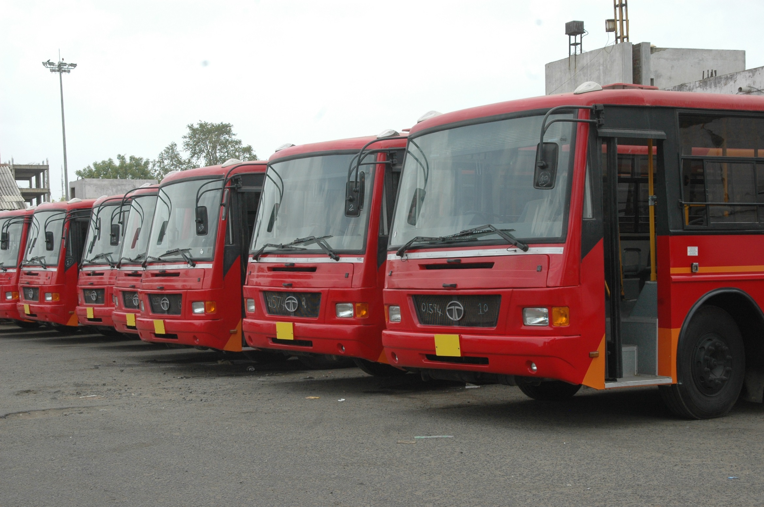
Advocating on What?
Wheat and Bus Transport Sectoral Issues

Slide 5
3. National advocacy issues
Staple Food/Wheat
Pro-competitive reforms in seed sector in Bihar is working in the interest of farmers. How can this experience be replicated in other states
Greater attention needed in effectively engaging private sector in infrastructure and service provision (supply chain)
APMC reforms designed to deliver benefits mostly for large and middle level farmers, who can reach and sell at the ‘mandi’

Slide 6
4. State specific advocacy issues Wheat
Making a case study of the seed sector in Bihar
Institutional reforms in PACS – unleashing its potential of easy access at the grassroots
Impact of abolishment of AMPC Act (on the stakeholders) in Bihar
Understanding challenges of engaging private sector in providing infrastructure services

Slide 7
3. National advocacy issues
Bus Transport
Institutional strategy for promoting competition in the process of public procurement (promoting PPPs in Bus Service)
Advocating for the overhauling of the existing public transport policy framework which is outdated in the current scenario
Possibility of having (modern) state public transport authority – market has evolved but regulatory framework has remained archaic

Slide 8
4. State specific advocacy issues Bus Transport
Advocating for abolishment of legal monopoly of GSRTC in Gujarat
Exploring the need of covering the private operators plying for AMTS under in the policy umbrella in Ahmedabad
Institutional strategy to promote competition in PPPs in city transport, BRTS
Highlight the need for a modern, state public transport regulatory authority in M.P.
Understand and share ‘good practices’ in promoting an effective bus transport system, from across some states

Slide 9
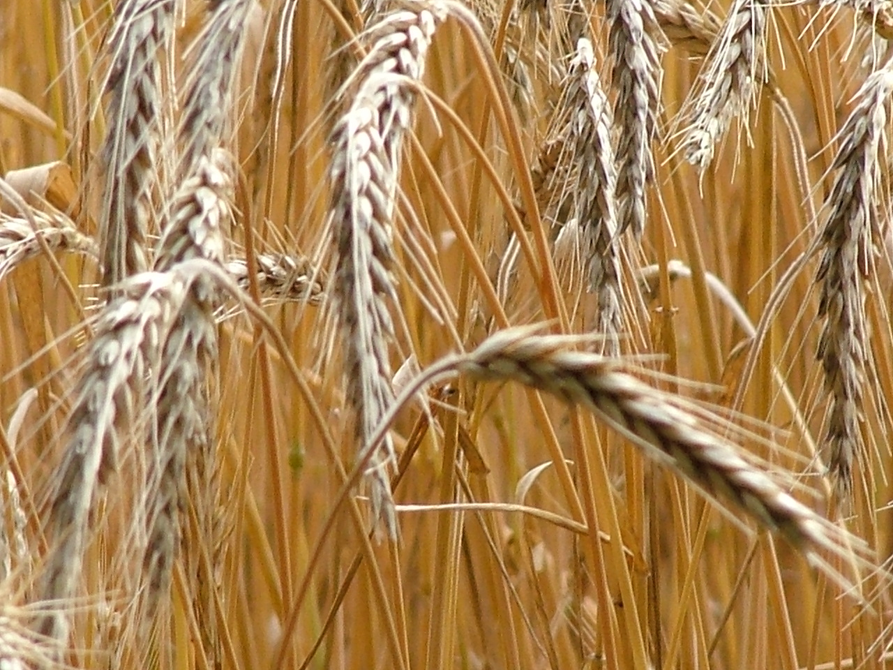
Advocating to Whom?
National and State Level SHs

Slide 10
2. Mapping stakeholders for advocacy – National and State level
Wheat
SH Categories | National Level | State Level
Nodal Ministry/Deptt. | Ministry of Agriculture | Deptt of Agriculture, Deptt of Coop
Regulator & Specialised entities | Competition Commission of India, CACP, | State Seeds Corpn, BSFC, RajFED
Research Institution, NGO | ICAR, NIAM | BASIX, FnF, BAMETI
Business Assocn | Bharat Krishak Samaj, NABARD | Central Coop Banks, Farmer groups
Media | National Media | State& Vern. Media

Slide 11
2. Mapping stakeholders for advocacy – National and State level
Bus Transport
SH Categories | National Level | State Level
Nodal Ministry/Deptt. | MoRTH, MoCA | Deptt. of Transport, Municipal Corpn.
Regulator & Specialised entities | Competition Commission of India | Janmarg, AMTS, BCLL
Research Institution, NGO | CEPT, Embarq, CUTS
Business Assocn | Bus Operators, Bus Owners, Operators Associations and Private players involved in provision of infrastructure
Media | National Media | State, Vernacular Media

Slide 12
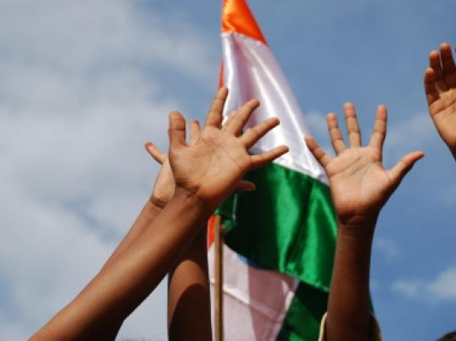
Advocating How?
Strategy for Success

Slide 13
5. Envisaged Activities for the Advocacy Plan NATIONAL LEVEL
Initiate dialogues with policy makers on the key sector specific reforms and design a sustainable way forward (Eg: Comments already provided on the draft Road Transport and Safety Bill, Bill Blow-Up on Road Transport & Safety Bill)
Engaging with the relevant private SHs in understanding bottlenecks/good practices in existing PPPs (through discussion forums etc.)
Engaging with CCI in reviewing the current public procurement in the states

Slide 14
5. Envisaged Activities for the Advocacy Plan STATE LEVEL
Common | Wheat | Bus Transport
Interstate Seminars: Platform for knowledge exchange among state level SHs vis-à-vis the project findings | Discussions with Dept of Agric. Bihar on assessing the impact of abolishment of APMC | CN on advocating for ‘State Transport Regulatory Authority’ in MP
 | Advocating for replication of seed reforms in Bihar in other states | Advocating for a better route rationalisation study and its proper implementation in MP
 | CN emphasising the need for revamping the PACS (Dept pf Agric. Bihar) | Reviewing the legal structure of AMTS vis-à-vis operation
 | Initiate dialogue with Dept of Agric. Rajasthan to effectively implement the APMC act

Slide 15
Thank you for your kind attention!
nt@cuts.org
shk@cuts.org

