Slide 1
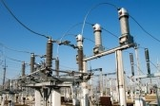
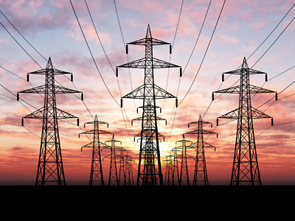
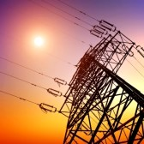
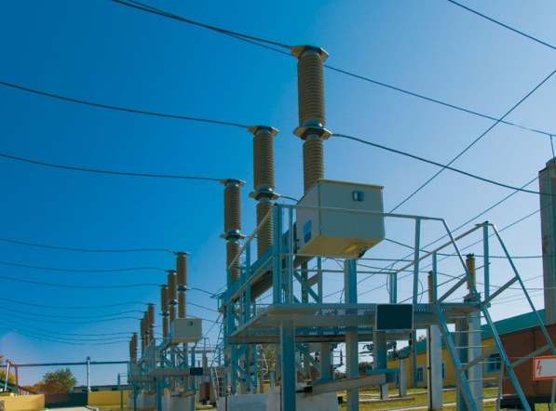
National Competition Policy and Economic Growth in India – Electricity Sector
Nathan Economic Consulting India Pvt. Ltd.

Slide 2
Executive Summary
Until 1991, the electricity sector in India was a vertically integrated monopoly, largely owned by the State
Post liberalization, the sector was gradually opened for the private sector
Electricity Act of 2003 marked a paradigm shift in the sector by introducing competition in all segments of electricity supply – generation, transmission and distribution
However, in practice, competition in the electricity sector still seems to be distant hope, due to political interventions and regulatory hurdles
Things that need to be changed include political expediency and monopolization by state monoliths
In Nathan’s view more competition needs be brought in the sector. The role of political economy requires a relook and the regulatory framework governing the autonomy of the statutory bodies need further opening up. Further, policies to ensure ease in attaining Open Access by private players, and augment the electricity supply in the economy need to be undertaken.

Slide 3
Government Regulations : Coal and Electricity
Coal
Government owned Coal India Ltd (CIL) holds around 80 percent of India’s overall coal production. This monopoly by CIL in coal (primary fuel) production gives preferential treatment to the public generating companies, resulting in relatively fewer private companies in the segment. CIL is under the CCI scanner for abuse of dominance
Government’s initiative in the last 5-6 years to allocate coal blocks to private players backfired as competition neutrality was ignored. Comptroller and Auditor General (CAG), has recommended a competitive bidding process.
To study the same, we study the auction and non auction models of coal supply in US, Australia, China, South Africa and Indonesia
Electricity
The sector has seen several acts - Electricity Act, 1910, Electricity Supply Act, 1948, Amendments to Electricity Supply Act, 1948, The Electricity Regulatory Commission Act, 1998, Electricity Act, 2003 (Act)
The most important amongst all these was the Electricity Act, 2003.
The objective of this Act was to promote competition, ensure supply of electricity in all areas, rationalize the setting of tariff and establish transparency
The Act was supplemented by the National Electricity Policy, 2005 (NEP) and National Tariff Policy, 2006 (NTP).

Slide 4
Electricity Supply Chain in India
Electric Power Supply Chain Process:
Statutory bodies involved in the electricity supply chain:
Central Electricity Authority (CEA)
Central Electricity Regulatory Commission (CERC)
State Electricity Regulatory Commission (SERC)
Central Transmission Utility (CTU)
State Transmission Utility (STU)
National Load Despatch Centre (NLDC)
Regional Load Despatch Centre (RLDC)
State Load Despatch Centre (SLDC)
Unbundling of the process was the most important policy initiative formulated by the
Electricity Act, 2003. It sought the entry of private players in the electricity supply chain.
Generation (Source: Coal , Gas, Nuclear fuel or Water Storage)
Transmission through high voltage lines
Distribution to customers
(subsidized sectors and individual metered customers)

Slide 5
Electricity Sector in India - Generation

Slide 6
Electricity Sector in India- Transmission
This sector is a natural monopoly and largely public owned
Electricity Act 2003 facilitated opening up of the sector
For private investment SPVs comprising Power Finance Corporation and Rural Electrification Corporation were created to look into surveys, feasibility reports, environment clearances etc. Power Grid Corporation of India Ltd. (PGCIL) plays the role of the CTU.
PGCIL is being assisted by private companies to create the National grid and inter-regional transfer capacity
Reliance Power, Tata power, Torrent, Jaypee, Adani and Lanco are present in the sector
Transmission Lines- 11th Plan Program & Achievement
Voltage level | Circuit Kilometers Targeted (2007) | Circuit Kilometers Achieved up to March 2011
765 kV | 2,773 | 1,636
± 500 kV HVDC | 1,600 | 1,580
400 kV | 40,000 | 26,856
220 kV | 24,300 | 19,780
Total | 68,673 | 49,852

Slide 7
Open Access in Transmission
Open Access to transmission networks has been mandated by the Electricity Act, 2003. This however has not been implemented in many states.
Status of Open Access Applications in India
State | Applications Received | Capacity (MW) | Approved | Capacity (MW) | Cases Implemented | Capacity Implemented
Andhra Pradesh | 9 | 130 | 2 | 44 | 2 | 44
Chhattisgarh | 14 | 333 | 6 | 66 | 5 | 53
Gujarat | 15 | 871 | 15 | 871 | 15 | 871
Haryana | 2 | 573 | 0 | 0 | 0 | 0
Himachal Pradesh | 3 | 32 | 0 | 0 | 0 | 0
Jharkhand | 1 | 40 | 0 | 0 | 0 | 0
Kerala | 1 | 30 | 1 | 30 | 0 | 0
Madhya Pradesh | 29 | 56 | 29 | 56 | 29 | 56
Orissa | 1 | 5 | 1 | 5 | 1 | 5
Punjab | 2 | 21 | 2 | 21 | 2 | 21
Rajasthan | 29 | 259 | 12 | 165 | 12 | 165
Tamil Nadu | 12 | 1,764 | 0 | 0 | 0 | 0
Uttar Pradesh | 5 | 46 | 5 | 46 | 5 | 46
West Bengal | 4 | 86 | 3 | 36 | 0 | 0

Slide 8
Open Access in Transmission: Should Regulators Intervene?
“To shield the public DISCOMs, regulators have tweaked the Open Access model practiced in India, by mandating a ‘cross-subsidy’ surcharge. “
These factors fail to make open access beneficial for consumers both in transmission and distribution because:
Consumers going for open access have to pay wheeling charges and surcharge in distribution.
Only bulk consumers having a consumption of greater than 1 MW can avail the Open Access facility.
The UK model of Open Access, where each and every consumer is allowed choice over the generating company may be a good option.
The issue has got so controversial that views of the Planning Commission, Solicitor General and Attorney General have been sought.
Should the regulator intervene in such cases when the law allows it?

Slide 9
Electricity Sector in India - Distribution
SEBs own majority of the distribution segment in the electricity supply chain
There are 17 private sector companies across the country
Highly politically driven sector
Market Share (Sales Revenue) of Top 10 Firms in Electricity Distribution

Slide 10
Electricity Sector in India – Distribution (Contd.)
State promoted Discoms have been facing huge losses due to selling electricity below costs or giving them free to agriculture and rural sectors. Collectively, state Discoms have an outstanding loans of around INR80,000 crore according to Shunglu Committee.
The WBSEDCL in May notified its fourth upward revision since December 30 as the state utilities had over Rs2,500 crore accumulated losses in 2011-12. Mamata Banerjee had said she was averse to tariff hike
AT&C Losses for 2009-10 and 2010 -11
Region | 2009-10 (%) | 2010-11 (%)
Eastern | 33.94 | 38.24
North-Eastern | 36.23 | 37.33
Northern | 29.66 | 28.91
Southern | 19.05 | 19.26
Western | 28.02 | 24.44
National | 26.58 | 26.15

Slide 11
Case Study: Gujarat vis-à-vis Tamil Nadu
Gujarat has shown tremendous success in managing electricity supply
in the state
The Gujarat Electricity Board was unbundled into seven entities in 2003
Four discoms are being governed by a holding company called Gujarat Urja Vikas Nigam Limited (GUVNL)
Pre 2003 there was only one chief engineer looking after technical regulation of the entire state.
A stock take of tariff revisions every four months and tariff revision when required have led to substantially lower T&D losses
Incentives such as rewarding achievements made on technical and financial front by any discom boost competition.
Gujarat
Tamil
Nadu
In Tamil Nadu political economy constraints have made unbundling
impossible
No tariff revision took place between 2003-2010 resulting in accumulated distribution losses (from 2005 to 2010 ) of around Rs 23,850 crore.

Slide 12
Cross Subsidization - Equity Consideration or Political Expediency?
Cross subsidization to agriculture and rural areas - biggest impediment in implementing reforms in the sector
States including the richer ones (Punjab) promise free power to farmers increasing the burden of cross subsidization on retail and industrial consumers
Government has taken measures like under RGGVY (Bharat Nirman) to make electricity available to remote areas, but they have not been fully successful. Under the program, problems of low voltage electric supply to habitations, supply for limited number of hours, transponders being out of order etc remain
Alternate mechanisms to supply electricity to the weaker sections at marginal rates need to be innovated: Examples from Gujarat such as Jyoti Gram Yojana and Tata Power’s scheme Delhi can be useful

Slide 13
Step Motherly Treatment to the Private Sector?
Issues hindering the growth of private players in electricity sector
Limited availability of coal
Non transparent coal selling policy followed by Coal India Limited
Private generators import 70-100% coal at three times the price of domestic coal, making them vulnerable to exchange rate volatility and changes in the exporting country’s laws over exports.
As per private players, the Ultra Mega Power Projects (UMPP) are not being truly successful as bids are made based on the domestic price of coal. CIL has fulfilled only 50% of its obligation as mentioned in the 12th Five Year Plan
Natural monopoly nature of transmission hinders private entry
Capacity constraints of the transmission lines, theft and inefficiencies

Slide 14
Discrimination Felt Most in the Distribution Segment
Distribution segment is largely regulated by the state.
State governments have used it as a tool to exercise power in their respective states. As per a senior executive from a leading private discom, “Delhi and Maharashtra have been the only exceptions to States governments’ regulatory failure in handling electricity”.
While the distribution is given to private player the wires are mostly owned by the state discoms. The World Bank has suggested that wire business must undergo tariff revision for enthusing competition.
As per private players , the biggest regulatory is in tariff revision
Tariff orders are released so as to match the pre decided revenues, costs and profits for discoms. This is the biggest hurdle for entry of private players in the segment.
Tariffs have not been set in a transparent manner and have resulted in poor return for private players.
As per private players, mutiple licences would increase efficiency compared to a fixed licence for a particular area.
Officials in the CCI also suggest more transparency can be introduced in distribution and that distribution should be separated from retail businesses of billing and revenue collection.

Slide 15
Domain Issues: CCI and CERC
Differences between CERC and CCI over jurisdiction of anti-competitive practices in the domestic power sector
CERC issued draft regulations in August 2012, for prevention of adverse effect on competition in the power sector
Section 60 of the Electricity Act, 2003 relates to market domination. According to this clause, “an appropriate commission may issue such directions to a licensee or a generating company, if they abuse dominant position or get into a combination that is likely to cause or causes an adverse effect on competition in electricity industry”.
CCI has shown concern over CERC issuing such norms as all matters related to competition come under its purview
As per the Competition Act, 2002, CCI has the mandate to eliminate practices that adversely impact competition in the country
Should the government not decide the domain issue expediously?

Slide 16
Economic Benefits
Policies initiated in sectors like manufacturing, electricity, telecom, etc. have yielded returns. But introduction of competition will affect the common man in a positive way
A more pronounced open access policy will give consumers a better choice.
Efficiency gains from competition are evident from the case of Gujarat.
Unbundling has resulted in not only efficient distribution but consumers have benefited in terms of getting uninterrupted power supply as the discom adhering to SAIFI (lowest average interruption frequency index) gets rewarded
Gujarat has also adopted on line application processing through E-Urja for new connections, change of names
Consumers get benefits from co-opetition

Slide 17
Advocacy Measures
Central Level
Reducing the monopoly power of Coal India Limited (CIL) in the supply of coal
Pooling the price of domestic and imported coal is a way forward in this direction.
Gradual phasing out of subsidies and cross subsidy surcharge
Creation of appropriate transmission infrastructure for renewable energy projects
Adopting the UK electricity model of Open Access, wherein all consumers are free to source power from the free market
State Level
Regular and transparent revision of tariff rates
Unbundling the electricity supply chain in states where it has not been implemented till now
Application of Section 11 of the Electricity Act, 2003 only in case of extraordinary circumstances and not on a regular basis.

Slide 18
Thank you
Nathan India is an economic consulting firm that specializes in survey design and research, market and business analytics and competition policy.
Nathan Economic Consulting India Private Limited
Chennai Office Delhi Office
New No.45, T.T.K. Road, G-C Ground Floor, Level 4,Rectangle 1,
George Ponnaiya Building, Commercial Complex D-4,
Chennai-600018, Tamil Nadu, India Saket, New Delhi-110017,India
T: +91 44 4293 7700; F: +91 44 4293 7773 T: +91 11 4051 4051
E-mail: nathanindia@nathaninc.com
www.nathaninc.com

