Slide 1
Identifying Elements of Business Responsibility in THE PHARMACEUTICAL SECTOR in India (Training workshop for PHARMACEUTICAL managers) Business Responsibility in India: An Overview
Rijit Sengupta
CUTS International
BRCC Project
4-5 April 2013, Ahmedabad

Slide 2
Setting the stage
A short message from
Shri N R Narayan Murthy
Founder & Chief Mentor, Infosys Technologies

Slide 3
Outline
Introduction
Definition & Conceptual Clarity
History of CSR in India
Policies and Measures
Delivery Mechanisms
Role of Government
Current State of Play

Slide 4
INTRODUCTION
Promoting ‘responsible business’ is ingrained in the Indian tradition of doing business - Sukhasya Moolam Dharma
Stalwarts of responsible and ethical business practices:
- Kautilya (4th Century B.C.)
- Mahatma Gandhi (late 19th & early 20th Century)
- Jamshetji N Tata (Independent India)
- N R Narayan Murthy (new millennium)
Corporate Social Responsibility – definition incorporating all three elements of sustainable development: economy, equity & environment

Slide 5
Definition & conceptual clarity
CSR is the continuing commitment by business to behave ethically and contribute to economic development while improving the quality of life of the workforce and their families as well as of the local community and society at large (WBCSD, 1998)
CSR is the responsibility of enterprises for their impacts on society (EU, 2011)
CSR is about ensuring that companies can grow on a sustainable basis, while ensuring fairness to all stakeholders (N R Narayana Murthy)

Slide 6
History of csr in india
First Phase: Vedic philosophy and thoughts enshrined in Arthashashtra
Second Phase: Characterised by altruistic activities mainly by wealthy merchants
Third Phase: Stress on Indian industrialists to provide support for building a ‘new India’. Idea of Trusteeship
Fourth Phase: Characterised by enactment of legislations towards labour and environmental protection
Fifth Phase: Businesses have started incorporating elements of CSR in their core business strategy/model

Slide 7
Policies & measures
PM’s Ten Point Social Charter (2007)
Voluntary Guidelines on CSR (MoCA, 2009)
National Voluntary Guidelines on Social, Economic & Environmental Responsibilities of Business (2011)
Expert Group for implementation of NVGs (2012)
Section 135 in Companies Bill (passed by Lok Sabha, 2012 and to travel to Rajya Sabha)
2% CSR expenditure mandatory for certain sized firms
CSR expenditure or CSR Investment? (Tax benefits?)

Slide 8
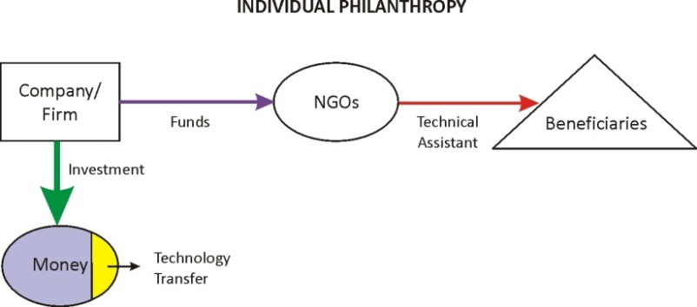
Delivery mechanisms
❶Individual Philanthropy: The idea of ‘giving’ is part of the Indian tradition and is practiced by firms donating to NGOs or Trusts to undertake community services

Slide 9
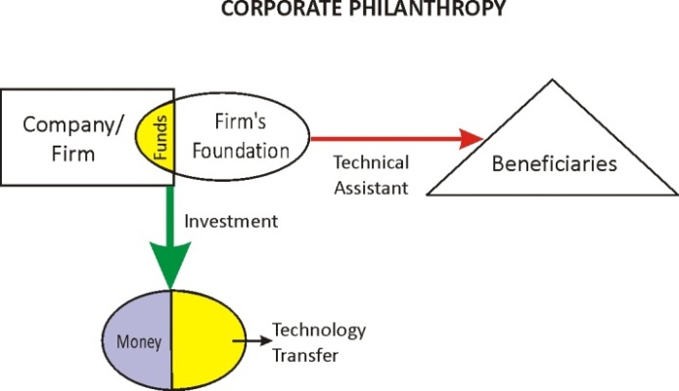
Delivery mechanisms
❷Corporate Social Responsibility/Corporate Philanthropy: allocates a certain amount of its funds either to a department within the business entity, or creates another organisation (e.g., a foundation) for undertaking such activities

Slide 10
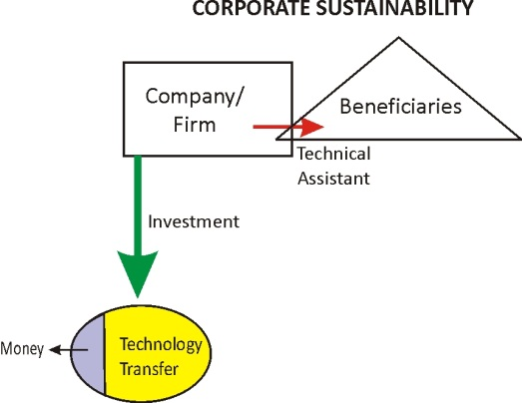
Delivery mechanisms
❸Business Responsibility: According to this approach, the business entity refines/readjusts its model of doing business from within and in the process makes greater positive contribution to societal development.

Slide 11
Role of government
Mandating: formulating laws, regulations, norms to control/monitor business behaviour
Facilitating: developing policies and conditions to enable investment in CSR activities
Partnering: combining skills of the public sector with that of the private sector to undertake CSR activities
Endorsing: recognising CSR activities through award schemes and other incentive measures
Demonstrating: leading the way by ensuring that public sector firms are pioneers in undertaking CSR activities

Slide 12
Current state of play
NVGs provide a framework to guide ‘eligible’ firms for investing in CSR activities
‘Eligible’ firms need to make investments in CSR activities as per Section 135 of Companies Bill
Reports to be submitted in a specific format (ABRR; SEBI has made it mandatory for top 100 listed firms)
Can firms claim tax relief for their CSR investments?
Firms are unlikely to meet their 2% targets early on; it might be possible for them to carry over unspent amounts
Need to align the NVGs with the Companies Bill (amendment of Schedule VII and/or Regulations)

Slide 13
Thank You
rsg@cuts.org
c-cier@cuts.org
www.cuts-ccier.org/BRCC

