Slide 1
Pursuing policy and practice changes (Pro-competitive reforms)- Zambia
By: Faith Mwamba
CUTS Lusaka

Slide 2
Current State of the Market
Bus Transport
In Zambia, specifically, intra city bus transportation is:
characterized by low quality second hand buses
high load factor results in uncomfortable rides
general dissatisfaction among consumers (about 70%) – fares perceived too high for quality of service
Staple Food (Maize)
Maize is the staple food for Zambia
occupies about 70% of the total cultivated land
The central player for maize policy implementation is the Food Reserve Agency (FRA)- also determines the floor prices for maize
The FISP subsidised fertiliser price also stifles competition from the private sector unsubsidised fertiliser

Slide 3
Key Findings
Bus Transport
The quality control system for public buses needs to be enhanced to ensure that only buses of good quality are allowed on the roads.
characterized by low quality second hand buses
high load factor results in uncomfortable rides
Lack of coherence between the fares vis-à-vis the quality of the service.
Fare setting’ process in bus transport in Zambia
Consumers indicated that they do not have any bargaining power to negotiate fares.
Commuters spend about 8.6% of their income on transport
while the operators have largely benefited from the pro-competition reforms, the fare setting process is stilled skewed in the operators’ favour.
This calls for a relook at the fare setting process or a closer enforcement of the current system to ensure better representation of passengers
Route Rationalisation
currently no route allocation framework in Zambia
This reduces accountability for the players as they do not have any incentives to invest in goodwill and good practices
operate anywhere based on profitability

Slide 4
Key Findings
Maize sector
Farmers Input Support Program (FISP)
Procedure of fertilisers procurement seem to enable participation of limited number of private fertiliser suppliers, thereby stifling competition
Firms seem to have found it more convenient to collude than compete
FRA Price Setting of Maize
Prices were set at a high level, which positively impacted only a handful (28%) of Zambian farmers who are net-sellers of maize
High prices offered by FRA for maize increased revenue burden on Govt
It also induced farmers towards a culture of mono-cropping (of maize due to its high prices)
reduced private sector engagement in the sector

Slide 5
Advocacy Goals
Bus Transport
To have better standards for bus seats in Zambia
To have a process based fare setting mechanism for bus transport
To identify the reasons for the lack of route rationalisation ( Additional Research applying a winners Vs Losers approach)
Staple Food (Maize)
Infusing competition principles in public procurement of fertilisers under FISP
Understanding the floor price setting mechanism of FRA (Additional Research)
Notes:
To understand the rationale & price determinations for setting of maize prices by FRA
To make recommendations on best practices in setting the floor prices
Understand the reasons of lack of private sector participation in maize procurement

Slide 6
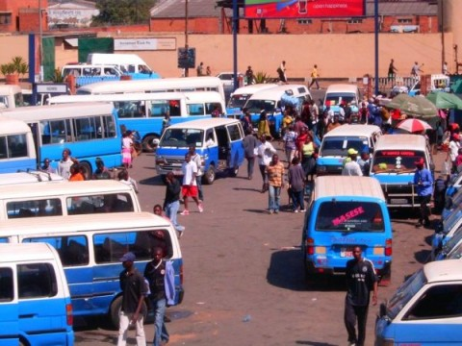
Pursuing Pro- competitive reforms
Need for standard for bus
Brainstorming sessions and discussions with key stakeholder on the impact of the lack of such standard on the consumers
Need for a standard for bus seats in Zambia is appreciated by stakeholder
Developed a way forward;
Development of the standard is underway
CUTS will be invited to provide comments on the draft standard
After the draft standards are ready, there would be a need to decide the roles that the various stakeholders would play in order to ensure the standards
RTSA will adopt standard into their regulations
Once standard is gazetted then it can become a mandatory standard
Bus Transport

Slide 7
Pursuing Pro- competitive reforms
have a process based fare setting mechanism for bus transport
A discussion paper on international best practices in bus transport reforms which touches on fare setting processes was developed
Discussion paper was presented at a CUTS brainstorming meeting and shared with the MoT
MoT engaged a consultant to develop passenger transport regulations and operational guidelines
A stakeholders workshop was held by the Ministry in which CUTS participated
The Ministry has developed a Transport Policy Master Plan, which is currently being reviewed by the Ministry

Slide 8
Pursuing Pro- competitive reforms
To identify the reasons for the lack of route rationalisation ( Additional Research)
further research on the winners versus losers approach on the lack of route rationalisation in the city of Lusaka has been undertaken (Draft report)
Some key Results:
Effective Policing
Reduced Travel Times
Reduced Burden on Drivers
Improved Reliability:

Slide 9
Pursuing Pro- competitive reforms
Farmers Input Support Program (FISP)
Procedure of fertilisers procurement seems to enable participation of limited number of private fertiliser suppliers, thereby stifling competition
Firms seem to have found it more convenient to collude than compete.
The distortions in the fertiliser procurement and distribution process is the Law which governs the procurement process
The evaluation procedure for bids is in three parts, the preliminary stage, technical evaluation and the price evaluation
ZPPA thus told the meeting that they were in the process of initiating the review of the Act and the regulations
Maize Sector
Notes:
question that was therefore raised in the discussions was whether the procedure as outlined in the law was relevant and feasible to ensure execution and achieve the intended outcomes
one of the requirements at preliminary stage is that a company must have participated in fertiliser procurement and supply to qualify
ZPPA affirmed that such a requirement was indeed a barrier in its own context and through such requirements the law has ended up creating three giants
Therefore to be relevant as CREW it would be useful that we provide some substantial inputs into the review process

Slide 10
Pursuing Pro- competitive reforms
FRA Price Setting of Maize
Additional research on the rationale of FRA floor price setting mechanism has been undertaken
Some key Results
FRA determines the floor prices for maize
Floor pricing was established generally for three main purposes
To stabilise maize prices for the farmers
As a poverty reduction strategy to ensure high earnings for farmers
To ensure that farmers in remote areas also get market access
Floor pricing has instead eliminated competition, which would have been healthy for the farmer
Notes:
This is mostly the price at which farmers supply maize to FRA, which must not necessarily be the private sector buying price
FRA activities also squeezed out the private sector
In some years, FRA would buy as much as 86% of the marketed surplus

Slide 11
Way forward based on advocacy
Bus Transport:
Standard being developed
CUTS to facilitate process of implementing the standard through organising some stakeholders meetings
Possibly review the transport Policy Master Plan
Maize Sector:
CCPC is currently investigating the process of procurement tender allocation to private players under FISP
Preparing an ‘institutional guideline’ for procurement of fertiliser- MCTI expressed interest to spearhead this process
CUTS has written to MCTI requesting them to initiate process
Review the ZPPA Act and write a submission during the review process of the Act

Slide 12
Challenges in Advocacy
Both sectors are politically charged- raises the issue of vested interests
Bureaucracy in institutions
Delays internally
Willingness and buy-in from certain institutions ( eg in the agric sector)

Slide 13
Areas for future research
Telecoms sector;
Has three mobile players
Players are overwhelmed and the mobile services are not appealing
SI 55 which restricted entry of other players (policy issue)
The pricing dynamics in the goods sector
the market is liberalised,
There is no law that regulates prices
Study looking into the goods and retail sector
Gather evidence which will be the basis of discussions on price regulation
Consumer survey in key sectors of the economy
Using the CREW methodology approach, undertake a consumer survey in key sectors to understand how consumer welfare is being affected (eg Health, energy)
Develop a tool that will be used to produce similar quarterly surveys
Notes:
Others
Procurement issues in the health sector (just like in fertiliser procurement)

Slide 14
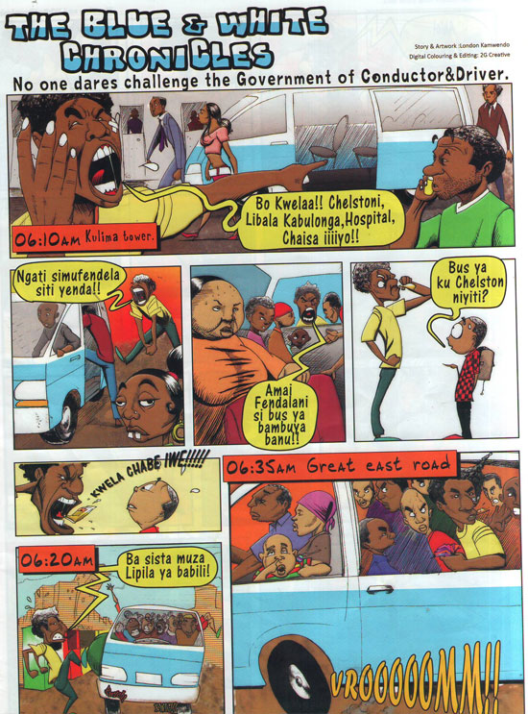
Thank You

