Slide 1
Status Update:
Appiah Adomako
CUTS Accra
Notes:
Notes on behalf of shreya: for the PAC meeting on Nov 19
1. In the slides the mapping is only done for bus
for the maize sector, the mapping has not been included
please include a slide for the same.
2. 3For specific advocacy agenda:
the agenda for maize has been included in the slides
but for the agenda on bus transport
the slide has not been included
3. For the table in developing the advocacy plan:
you are free to remove the section on indicators for success. we feel that it would be premature to already indicate the indicators for success
4. For the approach:
you would have to fill any the prospective actions that CUTS Accra plans to take to advocate for the specific issues

Slide 2
The sectors
Maize and Bus Transport Sectoral Issues

Slide 3
Key Emerging Issues from the DCR
Staple Food/Maize
Pro-competitive reforms in seeds sector is working in the interest of farmers.
Private sector’s involvement in the sales and distribution of fertilizers have also increased the usage of fertilizers among fertilizers.
How can this experience be replicated in other inputs, e.g. – credit?
Greater thought needed in engaging private sector in infrastructure and service provision (supply-chain)

Slide 4
Key Issues……………………
Bus Transport
Introduction of new regulations and standards in the sector.
Competition Reforms in the Bus Transport Industry - Policy Framework
National Road Transport Regulatory Authority- a policy prescription
Policy Reform on Strengthening Private Sector Operation in Bus Transport
Route rationalization

Slide 5
Narrowing down for the Sake of Advocacy
Maize Sector
Possibility of Anti-competitive practices in the transport of the fertilisers (focus on port handling and clearance and internal transportation costs
Role of Market Queens in procurement (Challenges faced by farmers)
Transport Sector
Establishment of National Road Transport Regulatory Authority
Politico-economic analysis of low implementation of LI 2180

Slide 6
Summing up the findings
Maize procurement by the market queens has some anti competitive elements.
Farmers are delighted in selling to the market queens
Farmers not benefiting from govt subsidy due to anti-competitive practices
The presence of many importers has not really brought about competition
Transport cost and handling seems to up the final cost

Slide 7
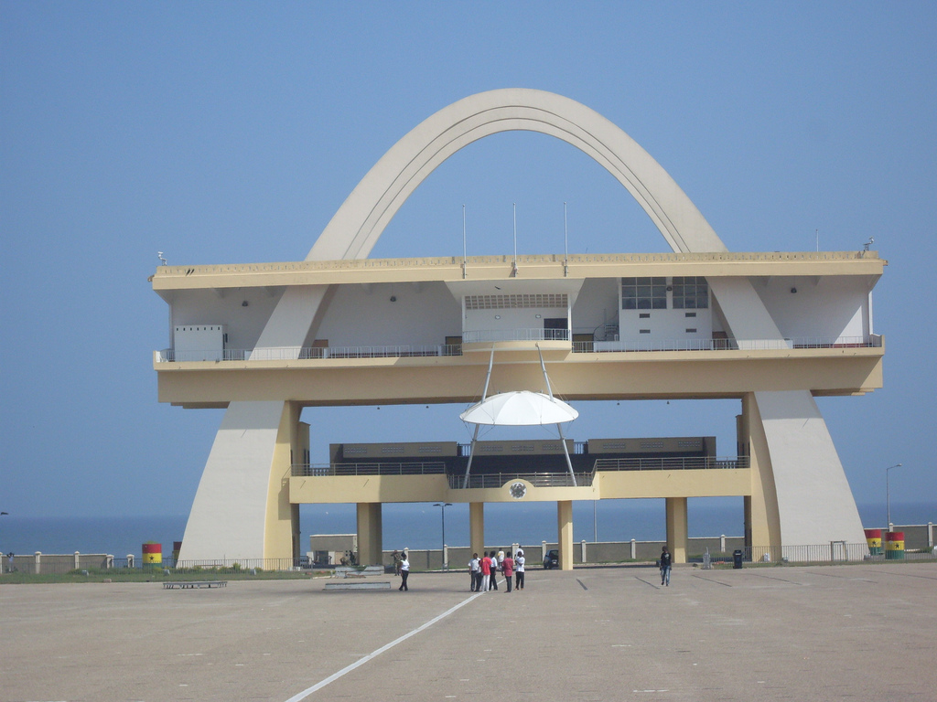
Pursuing Pro-Competitive Agenda in the Two Sectors

Slide 8
Pursuing Pro-Competitive Agenda in the two Sectors
Supplementary research finding completed
Media campaign
Meeting with relevant stakeholders
Submission of policy brief to government and parliamentary select group
National orientation workshop on CPL
Policy briefs

Slide 9
Challenges in the advocacy
News of politics dominate the pages of the press
People seemed to be satisfied with the status quo
Low co-operation from some government officials

Slide 10
Overcoming the challenges
Using case studies to tell the story to make it sticky
Targeting the relevant stakeholders
Making use of local languages
Quantifying the outcome of the advocacy

Slide 11
Traction from the CREW Advocacy
The MOTI has started the process of developing the competition policy, citing evidence generated from CREW
CUTS has become knowledge partner to the MOTI on CPL

Slide 12
Areas of Future Research-demand driven
MOTI wants to CUTS to do a study to understand competition in the banking sector
CUTS would also consider
Competition issues in Public Private Partnership
Competition issues in the cement sector

Slide 13
Thanks for your attention!
apa@cuts.org

