Slide 1

Critical Dimensions of Indian Investment in Africa: A Case Study Of Indian Investment In Zambia
Presentation By: Annie M. Siame
Assistant Programmes Officer
CUTS International-Lusaka
11th September, 2014

Slide 2


Presentation Outline
Introduction
Methodology
Case study: Nava Bharat Ventures Ltd
Survey Results
Key Findings
Recommendations
Way Forward

Slide 3
INTRODUCTION
Relationship Between India And Zambia
Investment Climate In Zambia
Overview of the Mining Sector

Slide 4
INTRODUCTION
India and Zambia have cordial relations.
Economic cooperation between Zambia and India can be traced as far back as the 1970s and has continued to grow over the years.
India has invested in Zambia in different key sectors of the economy such as mining, agriculture, extractive industry, and tourism.
The mining sector is one of the sectors that India is heavily investing in.

Slide 5
INTRODUCTION CONT.
A number of Indian companies are doing business in Zambia and many more have shown interest to invest in this friendly country abundantly endowed with natural resources.
Some of these companies are Airtel Zambia, Tata Africa, Nava Bharat Ventures Ltd., RJ Corporation, Taurian Manganese and others have made large investments in various sectors in Zambia.
Since 2007 Indian foreign direct investment (FDI) to Zambia has surpassed US$3bn.
These companies have employed over 25,000 Zambian nationals.

Slide 6
INTRODUCTION CONT.
India’s export items include drug and pharmaceuticals, machinery and instruments, transport equipment, cotton yarn and fabrics, plastic, rubber, chemicals, and electronic goods.
India’s imports from Zambia include non-ferrous metals, ores (copper and cobalt), semi-precious stones and raw cotton

Slide 7
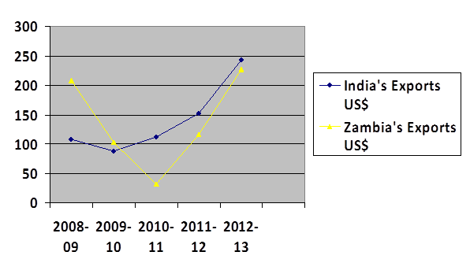
INTRODUCTION CONT.
Zambia and India’s exports

Slide 8




Slide 9
INTRODUCTION CONT.
Investment Climate in Zambia
Zambia offers a very liberal investment environment.
This is attributed to the economic reforms undertaken in the early 1990s, with the key aim of making the country more attractive to private (both domestic and foreign) investment.
The 2 major reform programmes are the Private Sector Development Reform Programme (PSDRP) and the Millennium Challenge Account (MCA).

Slide 10
INTRODUCTION CONT.
Prime growth sectors for investment are Manufacturing, Agriculture and Agro processing, Tourism, Energy and Mining.

Slide 11
INTRODUCTION CONT.
Currently, FDI is governed by the Zambia Development Agency Act of 2006, which offers a wide range of incentives in the form of allowances, exemptions and concessions to companies.
Other policies that affect investment in the country.

Slide 12
INTRODUCTION CONT.
Overview Of The Mining Sector
The mining industry has been the economic and social backbone in Zambia since the first exploitation of copper deposits on the copper belt.
Copper and cobalt are the key commodities produced in Zambia.
The mining industry engages in the production of lead, zinc, coal, silver and gold.
The sector has gone through three main phases of ownership: first, private ownership under a colonial administration, then national ownership post-independence and finally reprivatization from the late 1990s.

Slide 13
INTRODUCTION CONT.
Zambia’s mining sector is currently dominated by entities owned by multinationals.
Currently Copper production in Zambia is over 800,000ton as 2012.
There are approximately more than 15 players in the mining sector currently.
Zambia still has an exceptionally high level of macro-economic dependence on mining.
The sector contributes at least 12 per cent of GDP, to total export earnings it contributes about 80% and accounts for 86 per cent of FDI.
Mining also plays a vital role in generating employment in and around mining districts in Zambia.

Slide 14
INTRODUCTION CONT.
Together the four major mining companies employed 56,300 people in 2012, almost all of whom are Zambian (98–99 per cent).
In relation to government revenue, in 2012, almost one-third (32 per cent) of all tax revenue received by the government was from mining sector taxes.
The mining sector in Zambia also registers its impact on the nation’s social sector through its huge contributions towards Corporate Social Responsibility (CSR) Programmes.
Notes:
K23, 126

Slide 15
INTRODUCTION CONT.
There is no legislative framework governing CSR in Zambia. There are no tangible guidelines for firms on implementing CSR in the country.
The Ministry of Mines and Minerals Development is responsible for enacting legislations for the mining sector in Zambia. The Mines and Minerals Development Act 2008 is the primary statute that governs the mining sector in Zambia.
Zambia is party to numerous international treaties and conventions at the global, regional and sub-regional level. These treaties cover a variety of fields such as trade and investment, diplomatic relations, climate change and human rights.

Slide 16
INTRODUCTION CONT.
In the mining sector Zambia adheres to the following international convection and treaties:
• Safety and Health in Mines Convention, 1995 (No.176)
• Labour Inspection Convention, 1947 (No.81)
• Working Environment (Air Pollution, Noise and Vibration) Convention, 1977 (No.148)
• Occupational Safety and Health Convention, 1981 (No.155)
• Occupational Health Services Convention, 1985 (No.161)

Slide 17
INTRODUCTION CONT.
An overall environmental and natural resources management framework exists through the National Conservation Strategy of 1985, National Environmental Action Plan of 1994, and the National Policy on the Environment of 2007.
The Environmental Management Act also contains provisions that regulate the conduct of mining operations under subsisting mining legislation.

Slide 18
INTRODUCTION CONT.
The Zambia Environmental Management Agency (ZEMA) administers the Environmental Management Act and deals with issues pertaining to mining that arise therefrom
ZEMA is an independent environmental regulator charged with ensuring the sustainable use of the country’s natural resources.
ZEMA’s mandate is outlined in the Environmental Management Act of 2011 that covers all matters affecting the environment, from pollution to waste disposal.

Slide 19
METHODOLOGY
A scoping mission was undertaken before the actual research in order to gain understanding of the area and the operations of the company, Maamba Collieries.
. The mission was concentrated more on interactions with a few selected members of the surrounding communities. A total of 17 community members were met who gave – similar answers – in terms of challenges and opportunities which exist in the community.
The research used both qualitative and quantitative methods.
Primary data was collected using structured questionnaires.

Slide 20
METHODOLOGY CONT.
50 questionnaires were administered to the community members in Maamba.
Interviews were also conducted with other stakeholders; Civil Society Organizations, Regulatory Authorities, Media, The Company and Business Chamber.
Face to face interviews were applied.
Convenience sampling was used (a method of non-probability sampling) with the community.
With the other stakeholders purposive sampling (homogenous sampling) was used.
The responses from the other stakeholders were fed into the quantitative survey.
Data entry and analysis was done using Excel and SPSS and frequency tables were generated in both packages to facilitate presentations and interpretations of results.

Slide 21
CASE STUDY: Nava Bharat Ventures Ltd
Nava Bharat Ferro Alloys Limited (NBFA) commenced operations in 1975 at Paloncha in Andhra Pradesh, a state in Southern India.
To represent better the diversified business activities, the name of the company was changed to Nava Bharat Ventures Limited (NBV) in July 2006.
NBV spread its wings globally through overseas projects and trading activity controlled by Nava Bharat (Singapore) Pte. Limited, a wholly owned subsidiary of NBV, functioning from Singapore.
The domestic business divisions of the company includes: Ferro Alloy, power, sugar, infrastructure and the International business divisions of the company include: Power, Mining, Coal, Ferro Alloy, and Mineral Ore.

Slide 22
CASE STUDY CONT.
NBS holds a majority equity stake (65% equity stake) in Maamba Collieries Limited (MCL), the largest coal mining company in Zambia.
MCL was privatized by the Government of Republic of Zambia in 2010.
The Zambian government selected Singapore-based diversified organisation Nava Bharat Ventures as the strategic and technical partner for Zambia Consolidated Copper Mines (ZCCM), to revamp and develop the existing Maamba coal mine for the purpose of producing and supplying coal to the new coal-fired power plant as well as selling coal domestically and internationally.

Slide 23
CASE STUDY CONT.
The project is developed under public–private partner-ship with ZCCM, which represents the Zambian government, and this is being carried out on a build, own and operate basis.
It has total estimated reserves of 140 million tonnes comprising high grade and thermal grade coal, spread over 1070 hectares out of a total concession area of 7900 hectares.
The Company has revived coal mining operations and is establishing a mine-mouth, 300MW coal fired power plant, with a total capital outlay of around US$ 750 Million.

Slide 24
CASE STUDY CONT.
Since the mine was reopened in May, 2010 the total coal production levels have reached over 400,000 tons in 2013.
Since commencement of production in April 2010, Maamba Collieries Limited (MCL) has created 1, 460 jobs at the mine and the power plant construction site.
These jobs are through the sub-contracted companies it has engaged to carry out various specialized works in Maamba.
MCL has 215 direct jobs but also owns a subsidiary company called Maamba Development Trust (MDT).

Slide 25
SURVEY RESULTS
The survey consisted of 50 questionnaires which were administered to the community.
The aim of the survey was to analyse the impact of Indian investment on the sustainability of local communities in Zambia and to get the perceptions of the community on what they thought about the investment of the Indian owned company (Maamba collieries).
This report benefits from a survey that was conducted on local communities in Maamba, a Township in Sinazongwe district of Southern Province of Zambia, which is about 350 kilometres from the capital city of Zambia, Lusaka.

Slide 26
SURVEY RESULTS CONT.
It was important to get the views of the community in this survey in order to get a useful insight into how people perceive the current investment in their community.
A description of the community, the people’s attitudes and their expectations from the company.
Also the views help identify the needs of the community in order to provide services appropriate to those needs.

Slide 27
SURVEY RESULTS CONT.
Profile of survey respondents

Slide 28
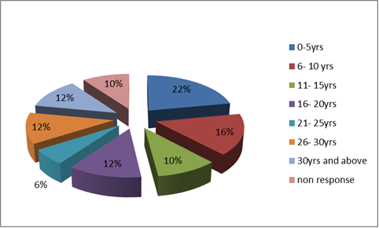
SURVEY RESULTS CONT.
How long respondents have resided in the area
The chart shows that twenty two percent (22%) of the respondents have lived in the area between 0 to 5 years.

Slide 29
SURVEY RESULTS CONT.
Migration

Slide 30
SURVEY RESULTS CONT.

Slide 31
SURVEY RESULTS CONT.
Displacement
Thirty one (31) of the respondents were aware of how the land was acquired.
The company bought the land from the community through the chief.
In comparison with the responses the respondents gave, they believe the company bought the land from the government.

Slide 32
SURVEY RESULTS CONT.
The acquisition of the land by the company was done according to the laws and regulations of the country.
These are the Land Act 1995, Land Acquisition Act 1996 and the Mines And Minerals Development Act 2008
The primary pathways for acquiring customary land are through the consultation of customary land owners (Lands Act 1995, Land Acquisition Act 1996).

Slide 33
SURVEY RESULTS CONT.

Slide 34
SURVEY RESULTS CONT.

Slide 35
SURVEY RESULTS CONT.
Economic Impacts
Most of the respondents (52%) own the homes they live in.
In terms of employment majority of them are self-employed with an income range of between K600 ($100) and K1500 ($250) this compared to the minimum wage of the country as stated by the labour laws is higher.
The minimum wage according to the labour laws of Zambia is k520 ($86).

Slide 36
SURVEY RESULTS CONT.
The respondents felt that the company has increased the community’s employment opportunities.
Thirty six (36) of the respondents felt that the company had increased employment opportunities to the community.
Forty six (46) members of the community felt that were job losses as a result of the establishment of the company,
Twenty four (24) respondents felt that these people were able to find alternative employment.
A majority of 52% of the respondents felt that there had been an increase in the overall income of the local community.
54% of the respondents felt that the local economy had been impacted positively since the company arrived.

Slide 37
SURVEY RESULTS CONT.

Slide 38
SURVEY RESULTS CONT.

Slide 39
SURVEY RESULTS CONT.

Slide 40
KEY FINDINGS
Social
The company has brought about employment opportunities for the locals, leading to income generation which has been seen to be a positive impact for the community.
There has been influx of people in the region since the company started its operations

Slide 41
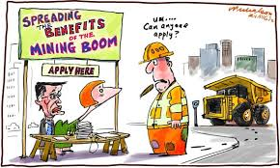

Slide 42
SOCIAL IMPACT CONT.
Due to expansions by the company, some of the residents in the community were displaced.
Those that were displaced were compensated by the company.
According to the company the affected persons were properly resettled – with a compensation package of physical houses, relocation allowance and other related infrastructure (like street lightning, water, recreation hall, roads).
While Zambia has no resettlement policy, the government refers to the World Bank guidelines on resettlement in its communications.

Slide 43
From here
to
There

Slide 44
SOCIAL IMPACT CONT
The respondents have indicated that there has also been infrastructure development as a result of the company’s presence.
The company has employed some women from the community who are working in operatives, middle management as well senior management.
The company does not run any special skill development or similar programme for women (non-employee) but plans are under way to teach unemployed women in income generating skills.

Slide 45
ECONOMIC IMPACTS
Employment opportunities have been increased in the community.
They have been job losses as a result of the establishment of the company.
But those that lost there jobs have been able to find alternative jobs.
The company has created other employment opportunities through backward/forward linkages.
The community feels that there has been an increase in the overall income of the local community.
The local economy has been impacted positively.

Slide 46
ECONOMIC IMPACTS
Civil society organizations indicated that much still needs to be done for the surrounding communities of the mines in terms of employment.
The mining sector is characterized with casual employment and a number of employees have been laid off in the last couple of years.
they pointed out that there has been a reduction in agriculture and pastoral activities due to mining operations in the local community, by the company.

Slide 47
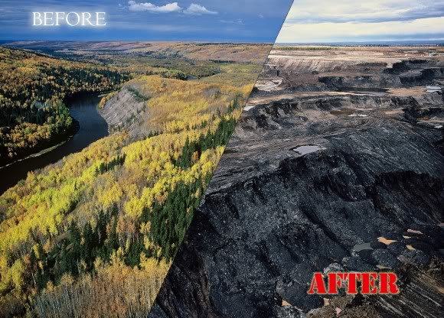

Slide 48
ENVIRONMENTAL IMPACTS
The respondents felt that the company was environmentally responsible but a large number of them also felt that the company was not taking any necessary steps to restore the environment.
The respondents were of the opinion that the only step the company was making to restore the environment was the replacement of water pipes.
80% 0f the respondents felt that the mining activities were negatively affecting the land, and forestry and vegetation and that most of the diseases in the area were due to the mining activities.

Slide 49
ENVIRONMENTAL IMPACTS CONT.
In response to these concerns the company is taking the necessary steps to protect the environment by undertaking massive landscaping within the mine area where trees and lawns have been planted.
Trees have also been planted in the township. The company is also sensitising the community on the dangers of indiscriminate dumping of plastic waste in the environment through “keep Maamba free from plastics” campaign

Slide 50
OVERALL
The respondents felt that the company needed to focus more on improving the educational and health facilities in the community.
the company, they pointed out that they have carried out community need based projects through Corporate Social Responsibility (CSR.).
The company also has a policy that defines CSR. Through this policy the company has committed USD3/ tonne of washed coal sold is channelled towards the company’s CSR
the company’s CSR through the Provision of free medical camps to rural communities, Construction of roads and foot bridges.

Slide 51
OVERALL CONT.
The company further says that the engagement with community has been good and this engagement is being done with the guidance of the company’s stakeholder engagement plan.
The CSO’s indicated that they were still controversies regarding the investment in the community. Controversies with regards to people being displaced from their land and that their compensation was not adequate.
As well as the environmental problems that is caused by the mines. There was a very strong uproar, the local people were not interested in the operational support.

Slide 52
OVERALL CONT.
Issues of Emission, the company said that these emissions are due to heavy traffic to and from the construction site which is normally attended to by regular watering of the affected roads.
The Maamba Collieries is not a member of the chamber of mines of Zambia.
The civil society organisations feel that Indian investment is no different from other investment coming to the country as all investors come with the purpose of making profits.
All stakeholders feel that the measures and/or actions that need to be taken to improve the positive benefits in terms of social, economic and environmental aspects to spill over into local communities are;

Slide 53
OVERALL CONT.
More enquiries into the investors should be done. This should be through open conversation/communication before these companies can invest in the areas. This open communication should highlight/ measure what the local are letting go by introducing the table.
Mining companies should have improved dialogue with the members of the community to find out what the community feels as important.
There is need for constant monitoring and evaluation on the company’s commitment to safeguarding the environment.

Slide 54
OVERALL CONT.
IV. communities need to be sensitized on the environmental impacts of the mines for them to be proactive and be able to identify and act on any violations from the mining company and not wait on government or the environment agency to act.
V. They feel that other actions that need to be taken for more benefits in terms social, economic and environmental aspects towards the community is by expanding and upgrading existing infrastructure like schools, hospital, banks, shops, housing, road network to service the ever increasing population.
VI. All operatives in the mine and thermal power plant construction should be environmental friendly.

Slide 55
OVERALL CONT.
The company has had some coverage by the media on their CSR and on the controversies of the mine.
Some of the stories have been on the coal power station, the positive impact of CSR on the members of the community and on the construction of their new smelter and power plant.
A statement made by the management on occupational health and safety of the workers. This was a positive story because it came from the company in protecting the employees.

Slide 56
RECOMMENDATIONS
Seeing that CSR is not discretionary. There are no tangible guidelines for firms on how to implement CSR programmes in the country. It should therefore, be considered that a policy on CSR should be in order for the surrounding communities and the country at large to feel benefits from foreign investments.
Promote knowledge and skills transfer to local workers to increase their participation in the mining workforce. Mining companies should be required to implement training for the local residents in the surrounding communities.

Slide 57
RECOMMENDATIONS CONT.
In order to prevent potential conflict between foreign workers and locals mining companies should start sharing information on the labour market.
Best practices
NFC African Mining Plc a fast growing mine with a new shaft having been sunk in 2010 at the West Ore body has improved the lives of people in Chambishi through CSR interventions such as donation of sewing machines, donation of heavy duty equipment to local authorities, rehabilitation of roads and police cells, construction of classroom blocks among others at a total cost of US $596,400 for the period 2006 to date.

Slide 58

WAY FORWARD
Advocacy programmes should be done to bring out the importance of CSR programmes and the impact it might have on society and if the beneficiaries are to appreciate and accept such undertakings.
There is need to stir up dialogue that brings mining companies, community members, CSO’s and government to the table to discuss the specific ways in which mining development will impact citizens’ lives is required.

Slide 59
POSSIBLE IMPLICATIONS
The possible implications for the BRICS here is that as they invest in the country and the sector they will tend to emulate what Nava Bharat is doing in terms of business responsibility.
There is potential for this practice to be adopted by other investors to the country. But there is also need for such practices to also be heavily practiced by government.
The government can work as a catalyst and play a crucial role by viewing CSR and codes of conduct as cost-effective ways to enhance development.
Companies that are already leading by example like Nava Bharat can spread the information on the spill over of CSR to communities and show how valuable it is to implement CSR.

Slide 60
The end
THANK YOU

