Slide 1
Assessing the “Critical Dimensions of Indian Investments in Africa (IIA)” The case of Ruchi Soya Farm Gog Wereda, Gambella Region Ethiopia
Tesfaye Getachew and Tewodros Yilma
Lelena Global Consulting PLC, Addis Ababa, Ethiopia
Sept 2014

Slide 2
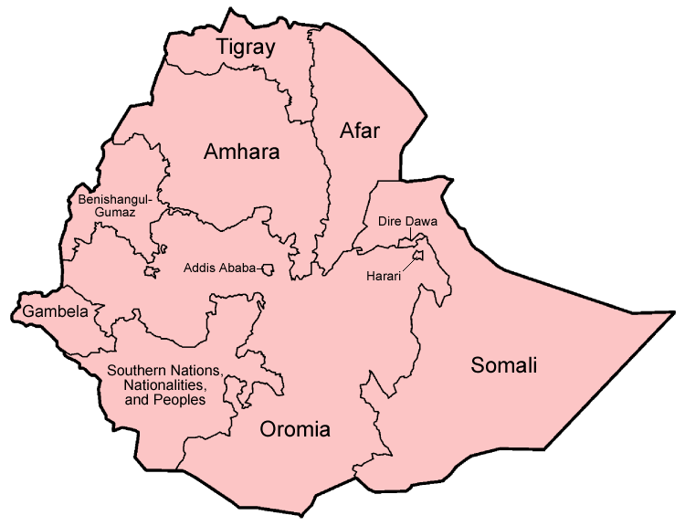
Background
Ethiopia - one of the fastest growing non-oil dependent countries in Africa.
Promising potential for investment
agriculture,
agro-processing,
textiles and garment, leather and leather products,
tourism,
mining and
hydropower

Slide 3
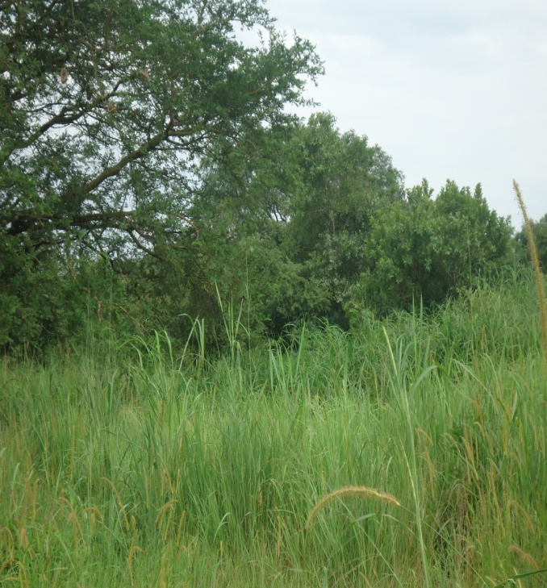
National investment climate
Ethiopia is centrally located within non-stop transport distance to all major markets,
FDI flow to Ethiopia
54.4 billion birr in 2005
169.6 billion birr in 2007 and
to more than 300 % growth in 2012.
FDI - nearly acc for 85.5% of the total private investment projects (1991-2011).

Slide 4
Environmental and Agricultural laws /Acts
Need for Environmental Impact Assessment & Authorization by Federal or regional EPAs
Climate-Resilient Green Economy (CRGE) Strategy (2010)
Protect the country from the adverse effects of climate change and to build a green economy that will help realise its ambition of reaching middle income status before 2025.
Rural Land Administration and Use
Expropriation of Land Holdings for the Public
Forest Development, Conservation and Utilization
Ethiopian Water Resource Management

Slide 5
International treaties and conventions
Bilateral investment treaties (BIT)
Ethiopia has bilateral investment and protection agreements with China, Denmark, Italy, Kuwait, Malaysia, Netherlands, Russia, Sudan, Switzerland, Tunisia, Turkey, Yemen, Spain, Algeria, Austria, UK, Belgium/Luxemburg, Libya, Egypt, Germany, Finland, India, and Equatorial Guinea
Double taxation treaties (DTT Ethiopia
has avoidance of double taxation treaties with fourteen countries, including Italy, Kuwait, Romania, Russia, Tunisia, Yemen, Israel, South Africa, Sudan and the UK

Slide 6
Investment and Trade Agreements
Member of COMESA
Under AGOA Ethiopian export products are entitled to duty-free and quota-free access to the United States market.
Ethiopia is also a beneficiary of the Cotonou Agreement with the EU and is eligible for the “Everything But Arms” initiative, benefiting from the generalized system of preferences

Slide 7
National laws, rules and regulations governing foreign investment
Commercial Registration and Business Licensing revised in 2010 :
Commercial Code, 1960 revised in 2008:
Expropriation of Land Holdings for Public Purposes and Payment of Compensation 55/2005:
Trade Practice and Consumers’ Protection Proclamation 2010:
National Social Protection Policy Of Ethiopia 2012:

Slide 8
Ethiopia’s major sources of FDI
China, India, Germany, Italy, Saudi Arabia, Yemen, United Kingdom, Israel, Canada, and the United Arab Emirates
The larger share of investments are in
Afar,Amhara, Oromia, Gambella, SNNPR
Ethiopia’s Map

Slide 9
Ethiopia-Indian relations
Diplomatic relations -1948
Ambassadorial level -1952
Trade agreement signed in 1997 and set up a Joint Trade Committee that same year
The volume of bilateral trade reached over US$ 500 million in2012
Ethiopia exports raw hides and skins, pulses, oil seeds, spices, and similar products to India.
India, in turn, exports iron and steel products, drugs and pharmaceutical supplies, machinery and instruments to Ethiopia
India initiated a Duty Free Tariff Preference Scheme designed to help Ethiopia and other developing African states export their products to India

Slide 10
Indian enterprises are largely concentrated in Gambella
Karaturi Global is the largest investor in Gambella with plans to farm palm oil, cereals, and pulses on 300,000 ha of land
Ruchi Soya – Acquired 25,000 ha and developed 3,500 ha and produces soybeans
Verdanta Harvests Plc. : Acquired a 50-years lease for 5,000 ha in the Gambela region for a tea and spice plantation
Sannati Agro Farm Enterprise Pvt. Ltd.: Ethiopia Acquired a 25-years lease on 10,000 ha in Dima District, Gambella Region,
Chadha Agro Plc. : Acquired up to 100,000 ha in Guji Zone in Oromia Regional State for a sugar development project
Uttam Sucrotech : Won a $100-million contract to expand the Wonji-Shoa sugar factory

Slide 11
RUCHI SOYA INDUSRIES
Incorporated in 1986
Manufacture of edible oils, vanaspati, bakery fats and soya foods.
It is highest exporter of soya meal and lecithin from India
Corporate social initiatives are executed through Shri Mahadeo Shahra Sukrat Trust
Community collaboration (CSR initiatives)
Education, health and women empowerment
Vocational training courses
RUCHI SOYA-Ethiopia
Chosen Ethiopia considering the availability of labour, its strategic location and the Government support to boost foreign investment
Signed a lease contract for 25-years
Acquired 25,000 ha land in Gambella Region (892km west of AA) for production of soybeans
Total investment capital 704,000,000 Birr (about 35,200,000 USD)
Annual production capacity 100,000 MT palm oil, 10,000 MT palm kernel oil and 2,500,000 MT palm oil Cake

Slide 12
Assessment Results
RESEARCH METHODOLOGY
Research Questions
Does Ruchi Farm, respect the interest of stakeholders and is responsive to needs of partners including communities?
Does the company protect and restore the environment?
Doest it promote inclusive development and respect human rights ?

Slide 13
Data Collection and Analysis
Data Collection
Tools developed by CUTS International to adequately consider the NVG Principles on Social, Environmental & Economic Responsibilities of Business
HH survey
Partner Interviews (KIIs)
FGDs
Limitations
No data was collected from the Company

Slide 14
Data collection …
Data Analysis
Quantitative data was collated and configured by Lelena Global staff using SPSS v15.0 software.
The qualitative interview notes were transcribed into informational matrices on computers for each key informant interview and organized per NVG indicators and the
information was later integrated with the quantitative analysis

Slide 15
Household survey Results
HHs Profile
35 respondents 20 (57%) women
Age ranges 30-39 (49 %) and 20-29 (31%).
Most common HH size 4 (4.7 regional average)
(94%) native to the same village and live in their own houses (rural huts)
88.5 % are unemployed
Live on crop and livestock farming earning on average 200-300 Birr per Month

Slide 16
Social, Environmental and Economic Impacts of Ruchi soya
Social
83% of the respondents said the presence of the company did not benefit the community
No influx or migration due to the company
Individual land use rights were not affected but communal land use rights are affected
Forests were sources of firewood, wild food (fruits & roots), sources of medicinal plants, hunting grounds, wild animals left the place
66% of the respondents said they do not know whether the land acquisition process is a fair and a just process & another 34 % said the process is not fair
All of the respondents said there no infrastructutre dev’t effort they know by the company
More than 57 % of the respondents said, either the company did not create job opportunities for women or they do not know if the company created job opportunities for women.
All of the respondents reported the company did not attempt to run any skill development program
The general feelings were, they could have negotiated on the community interests if were part of the process like land acquisition and would like to be part of it in the future.

Slide 17
Impacts …
Environmental
Economic
74 % of HHs said the increase in community’s employment opportunities are insignificant
54%) of the respondents felt there is no increase in income of the community
All of the HHs said there is big impact on forests –high deforestation
All the respondents said they do not realize company has no impact on water & air quality, diseases and land pollution
All reported no action by the company to restore the environment

Slide 18
Key Findings
Individual land size and use right is not affected, but communal land use right diminished
Clearing forests impacted food sources and diversity, restricted fuel wood collection area and resulted in migration of wild life
Displacement and migration due to acquisition of land by the farm is not a major phenomenon to communities in Gog woreda as such;
Land Transfer needs representation all concerned but in this particular case regional Agri was not part so not closely working with the farm and monitoring it adequately to ensure the adherence to the contractual obligations and to the environmental responsibilities
Similarly the wereda concerned agencies including the agricultural offices have not gone far as they couldn’t solicit the support of the regional and Zonal agencies and also the farm cooperation.
Contributions of the farm to the land, air and water pollution are not visible at this stage. However, continuous use of pesticides, herbicides and overuse of machinery will result in air pollution and will ultimately harm the environment

Slide 19
Key …
Ruchi Farm is not investing in human and physical environment development in its operational area so far. Provision of social services like schooling, health posts, clean water, construction of access roads and grain mils are all development priorities at the community and regional levels.
Introduction of improved products and technologies like improved farming practices which are important to promote the wellbeing of the communities are highly needed,
These all provide an opportunity for Rouchi to involve in as socially responsible company and strengthen its partnership with the community and local authorities and stakeholders at large
Livelihood options created by the farm for the community are not significant as the farm provides only few employment opportunities to the surrounding community members as well as for distant communities.

Slide 20
Key …
The manpower needs are not filled by the local staff
There hasn’t been any promotional material printed or electronic broadcasted either by the company or form the government side to promote the investment
Ruchi is not benefiting from a membership a chamber to introduce its business to the country, network with wide business companies in Ethiopia and in participating in the ongoing public-private dialogue
All the evidences indicate that there is a long way for the company to improve its visibility as well as to show its social responsibility commitment which is vital in its marketing effort as a subsidiary of global company.

Slide 21
Recommendations
Design/adopt/adapt and present a CSR strategy and present to the partners to show its acts are sustainable as well as responsible.
As the assessment indicates that the farm is poorly connected to any partners in its operation area, it is imperative to identify the important partners around the farm operation area with the view of working together in areas of common interest particularly related with CSR attributes.
Design a strategy to make the farm activities environment friendly and greener as well as community and employees centred to minimize and prevent the adverse effects of the investment related with deforestation, use of chemicals and heavy farm and construction machinery.
The farm needs to manage and protect the environment/natural resources through initiating plantation schemes to replace the trees cut and maintaining the biodiversity of plants, reduce use of artificial chemicals and introduce environmentally friendly crop protection methods like biological control

Slide 22
Recomm…
key social infrastructure such as schools, health and sanitation facilities, roads, grain mills are lacking. The farm can work with the local government structure to identify and confirm the priority CSR activities and contribute to the provision such facilities and services.
The different government agencies and the community needs to involve collaboratively and share information and responsibilities in land allocations and transfer and provide regulatory services so that investors are adequately facilitated in their business while at the same time be encouraged to discharge their responsibilities particularly CSR.
Ruchi Soya needs to get the buy in of its project by the community by interacting and communicating more with them on the current and future benefits of the investment to the day to day life of the community by way of expanded employment opportunities, technology and skill transfers, and triggering key services relevant to the community.
It is advisable for the company to take steps to be more transparent about their policies, commitments, product & services and associated operations, spending plan and annually report these both in the country and in India.
It is also important to consider membership with the appropriate business association such as Addis Ababa chamber of commerce and sectoral association to be networked with companies working in the country and to be more familiar with the business law of the country.

