Slide 1
Rethinking Business Responsibility In India: a review of Pharmaceutical & Private Healthcare sectors
Vikash Batham, CUTS International
Developing an Inclusive CSR Index for India by BCF, New Delhi
26th September 2013

Slide 2
Outline
Introduction
Overview of BRCC project
Conceptual Clarity & Research Design
Some Key Findings
Emerging conclusions
Way forward

Slide 3
Exploring the Interplay between Business Regulation and Corporate Conduct in India (BRCC project)

Slide 4
Introduction
Increasing role of private sector as providers of public goods & services - contributing to social & economic development
Need to examine private sector’s role in meeting societal expectation – challenges and opportunities
NVGs provides a framework to undertake such an examination
Understanding the role of regulation in influencing/facilitating this process

Slide 5
BRCC project - Overview
Implemented over 2011-12 by CUTS in collaboration with state level CSOs
Sectors: Pharmaceutical & Private Healthcare
Sectoral Analysis Framework – using the NVGs Principles & Core Elements to identify Critical Elements (Environment and Marketing & Distribution )
States : Andhra Pradesh, Gujarat, Himachal Pradesh & West Bengal

Slide 6
BRCC Project - Objectives
Identify regulatory and operational constraints faced by businesses in select sectors in India and analyse factors for promoting responsible behaviour in these sectors
Understand the role of the different actors in the healthcare and pharmaceutical sectors in promoting responsible business conduct
Motivate firms to adopt ‘good corporate practices.’
Evolve a policy discourse involving business and policymakers to facilitate an environment for business responsibility

Slide 7
Definition and Concept of Business Regulation & Responsible Business
Elements of business regulation include: (i) Public regulation, (ii) Co-regulation & (iii) Self Regulation
Elements of business regulations implemented at National, State and Local levels
Responsible business: NVGs were used as the reference for defining ‘corporate conduct’. Accordingly, the elements of corporate conduct relevant for the sectors (Pharmaceutical and Private Healthcare) were identified

Slide 8
Research Design & Methodology
Selection of sectors and states (AP, Gujarat, HP & WB)
Research Outline (linking BR with CC)
Method: (i) Secondary research – analysis of existing regulatory framework and implications for responsible business & (ii) Primary research – empirical research in four states involving feedback gathering; personal communication with key actors and state-level fora
Literature Review and Information analysis
Regulation
Enforcement
Outcome (Corporate Conduct)
Critical Factors

Slide 9
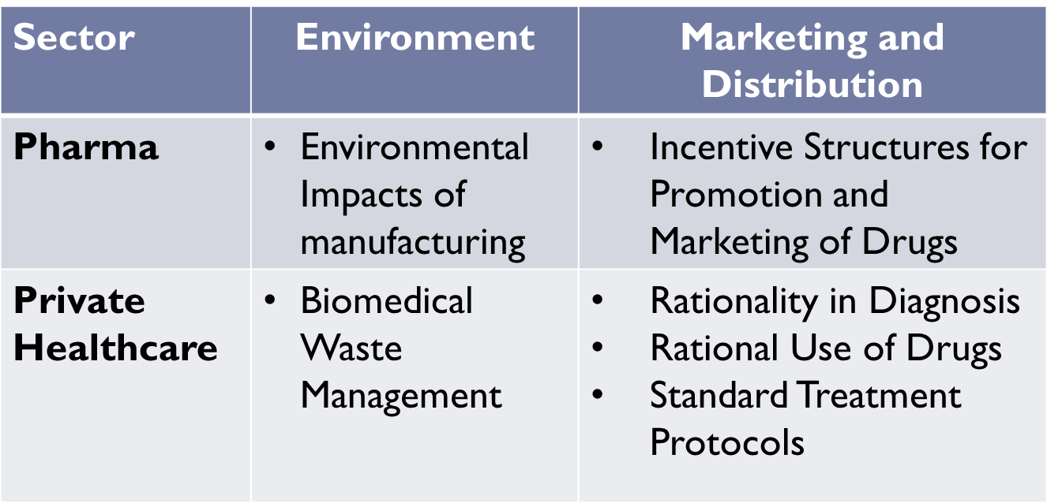
Issues for Investigation (Critical Elements)

Slide 10
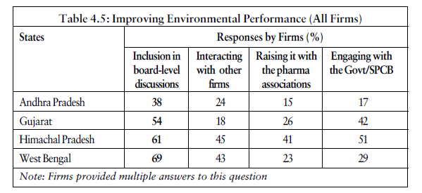
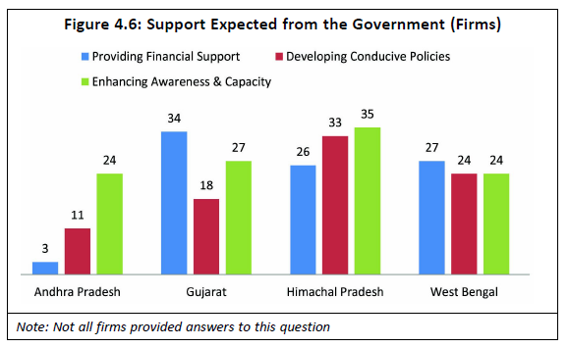
Some Key findings – Pharma Sector (1)
Majority of surveyed firms across states felt that environmental performance can be best improved if included in boardroom discussions
Firms surveyed in some states had much higher expectation of support from the state government’s than others

Slide 11
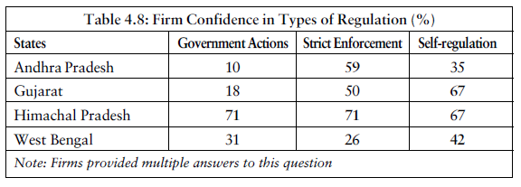
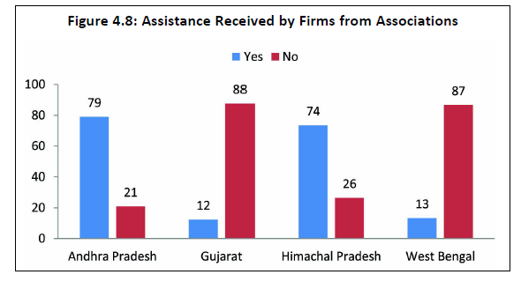
Some Key findings – Pharma Sector (2)
Only a handful of firms preferred government action to stimulate responsible behaviour
Level of support received from sectoral associations varied across states

Slide 12
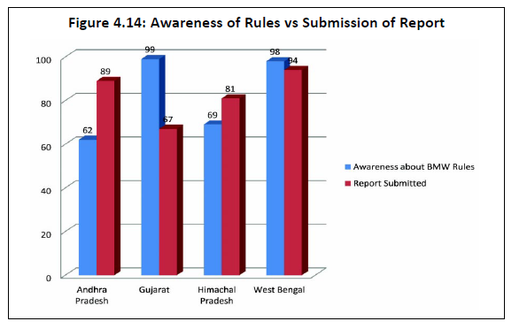
Some Key findings – Private Healthcare (1)
Bio-medical waste management is a relatively new issue and has seen varying levels of response from private hospitals in states
Greater private participation can help develop the market in some states

Slide 13
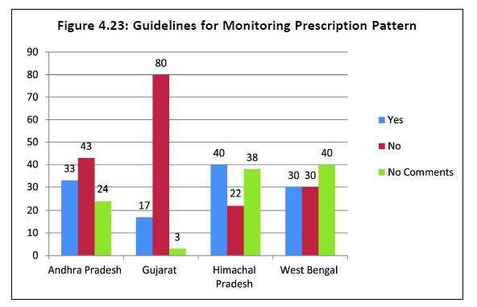
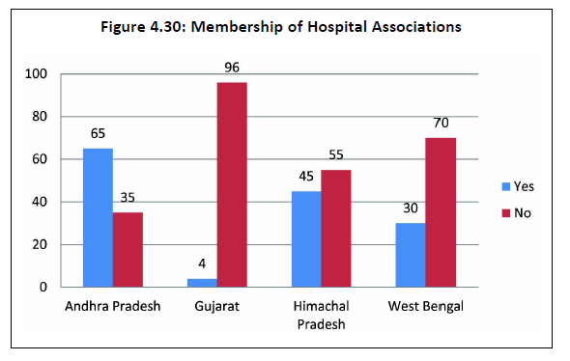
Some Key Findings – Private Healthcare (2)
Only a handful of private hospitals had internal guidance on prescription monitoring
Not all states have associations of private hospitals, and coverage is low

Slide 14
Emerging Conclusions: Micro-Level
Awareness of legislations good, but compliance often weak
Expectation from the government for technical and financial support continues to be high
Conditions of service of Medical Sales Representatives has implications on ethical promotion of drugs and choice at consumer end
Information exchange is poor and erratic between regulators and firms – lack of awareness on relevant legislation
No institutionalised process of Interaction between sectoral association and government/regulators
Sectoral associations not responsible for monitoring behaviour of members

Slide 15
Emerging conclusions: Macro Level
Coordinated regulatory enforcement (among concurrent regulators), missing at state level – key barrier to better regulation
Diversity across state regulators (human and institutional capacity) leads to differential output vis-à-vis responsible business
Unsatisfactory Human Capital Management (number and quality of staff)
Need to strengthen the role of business/sectoral associations
Incentives and disincentive mechanisms ill-developed
Notion of business responsibility restricted to philanthropy

Slide 16
Way forward
A more holistic understanding of business regulation (including self regulation and co-regulation) is necessary
Movement towards better business needs to start from the states – calls for capacity building of key actors
Creating an environment that promotes a culture of responsible business is important
Emphasis on both external conditions and internal processes are necessary
Need for sector specific guidelines (NVGs) for key sectors

Slide 17
Thank You!
www.cuts-ccier.org/BRCC

