Slide 1
Two-Sided Markets, Platforms and their impact on Economy: Cases from India
Dr. V. Sridhar
Professor
International Institute of Information Technology Bangalore, India
vsridhar@iiitb.ac.in
www.vsridhar.info

Slide 2
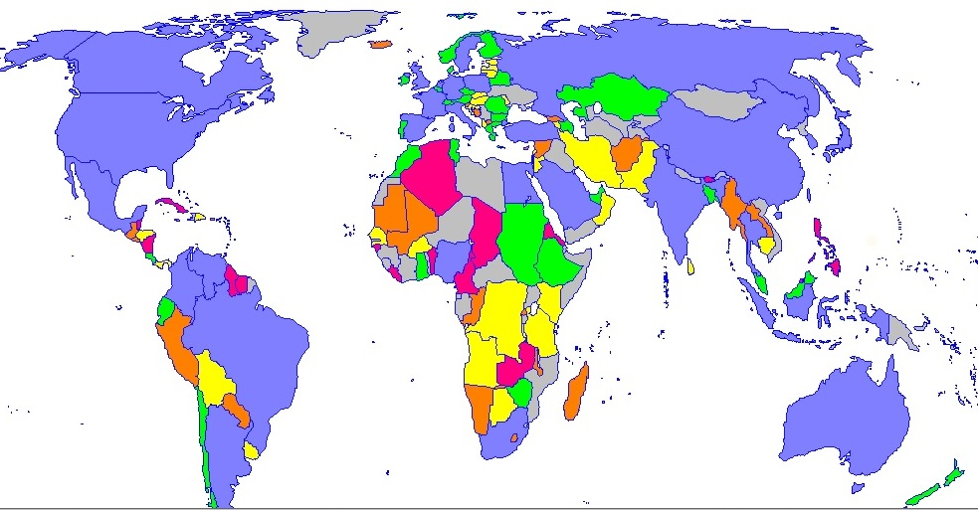
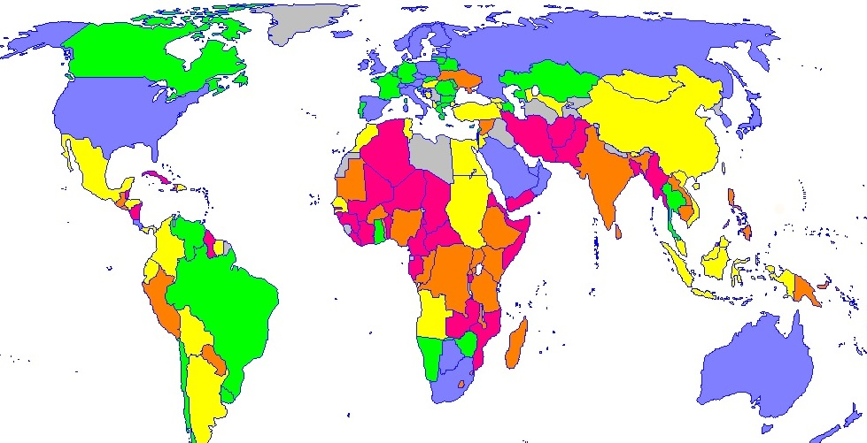
ICT parameters of India (ITU, 2014; IAMAI, 2015)
Mobile broadband subscribers
Mobile broadband Penetration per 100 pop
While Internet in India took more than a decade to move from 10 million to 100 million and 3 years from 100 to 200 million, it took only a year to move from 300 to 400 million users. (IAMAI, 2015)

Slide 3
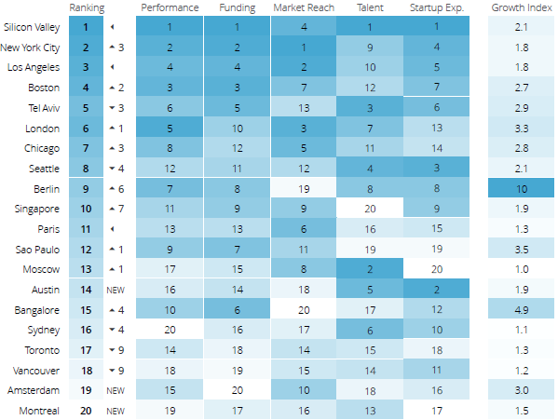
Global Start-up Ecosystem Ranking (Compass, 2015)

Slide 4
Two-Sided Markets and Platforms (2SMP)
Cab Seekers
Cab Drivers
Information seekers
Product/ Service providers
Job seekers
Job Providers
Same-Side Network Effect
User Set 1
Two-Sided Market Platform
User Set 2
Seller
Buyer
Patients
Cross-Side Network Effect
Doctors
Readers
Publishers
Rochet & Tirole, 2004

Slide 5
Characteristics of 2-SMP
Pricing (Prasad & Sridhar, 2014)
Asymmetric
Money side, subsidy side
Competition (Eisenmann, et al., 2006)
Platforms tend to get commoditized
Increasing returns to scale
Winner-take-all
Monopoly or oligopoly
Waterbed effect (Economides & Tag, 2012)
Single-home or multi-home
Compete for single-home users
Charge premium on multi-homing side to subsidize single-homing side

Slide 6
Taxonomy of e-Commerce
Directory Services
Economic Value-Add
Decreasing search cost
Disintermediation
Aggregator Platforms
Regulatory Intervention
Liability
E-Market Places
In emerging markets, many market verticals are relatively unorganized compared to developed markets; there is often information asymmetry leading to high search costs and arbitrage opportunities;

Slide 7
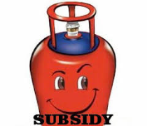
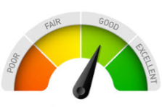
Platform |  |  | Regulatory Arbitrage | Market Efficiency | Competition | Social Benefits
Ola Cabs | Cab Drivers | Cab Seekers
JustDial | Service Providers | Information Seekers
Babajob | Job Providers | Job Seekers
DailyHunt | Advertisers, Readers of e-Books | Readers of newspapers
Practo | Hospitals, Labs | Patients

Slide 8
Competition Issues
Increasing economies of scale due to network effects
Oligopoly or even monopoly results -> reduction in consumer welfare
Horizontal and vertical integration -> public benefits (Rogers, 2015)
Platforms tend to get commoditized -> barriers to entry is less
Predatory pricing
VC investments
Short term vs. long term
Regulatory arbitrage
Level-playing field with incumbents
May reduce efficient use of economic resources (Weber, 2014)
Social costs (privacy, labour benefits) < Social Benefits

Slide 9
Regulatory Guidance
Regulatory rules for e-Commerce to be different compared to the traditional brick-and-mortar business
Mandatory compliance
Cabs should run on LPG -> environmental protection
Background check of housemaids -> improve security
Content editing in mobile news -> social harmony
Background verification of Doctors -> patient wellness
Food safety check -> protect health of foodies
Other market regulatory rules
Fare regulation -> reduces market efficiency
Additional taxation -> increases platform costs
FDI regulation-> reduces overseas investment

