Slide 1
Think global act regional – Setting the agenda through Global grid
Keynote Presentation
Hippu Salk Kristle Nathan
National Institute of Advanced Studies (NIAS)
Bangalore, India
CUTS CONFERENCE
REGIONAL COOPERATION FOR ENERGY SECURITY IN SOUTH ASIA
August 07‒08, 2014
Kolkata, India

Slide 2
The Idea of global grid
Genesis
R. Buckminster Fuller
Global grid as a strategy in World Peace games (alt. to world war games)
Challenged the prevailing nation-state perspective and offered a ‘holistic’ world view.
“How do we make the world work for 100% of humanity in the shortest possible time through spontaneous cooperation without ecological damage or disadvantage to anyone?”
Global grid - Number ONE priority to solve many of the world’s most pressing problems like overpopulation and resource disparity
Dymaxion Map

Slide 3
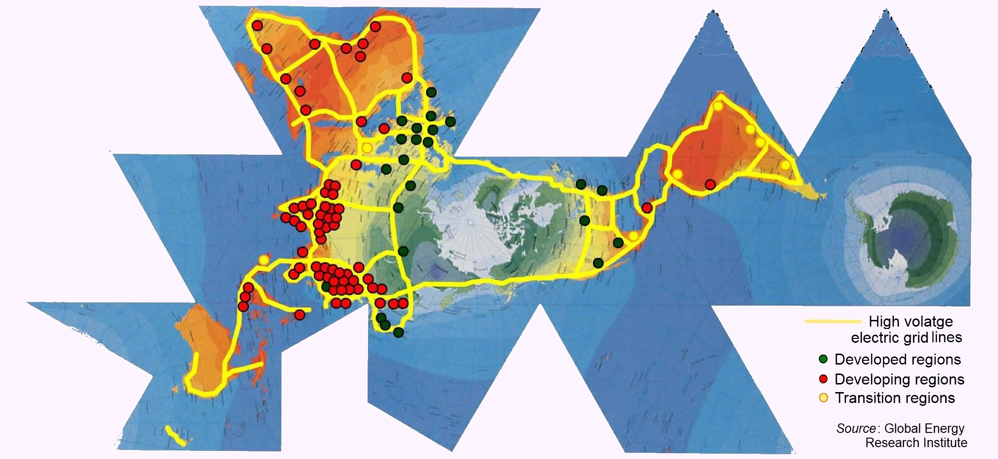
The Idea of global grid
Cont…
Global grid on Dymaxion Map
Global Energy Network Institute (GENI)

Slide 4
Why Global Grid
Cont…
Supply source point of view
Compatible with renewable sources
Two specific rationale
i). Solar, wind, and hydro – never ‘transported’, but ‘transmitted’
ii). Generally demand centers are NOT endowed with renewables
– wind and hydro in Greenland
– solar irradiation from Sahara
Global grid potentially connects remote locations to demand centers
Outcome
Faster replacement of fossil fuels;
CO₂ emissions from power sector.

Slide 5
Why Global Grid
Cont…
Supply source point of view
(Cont…)
Is renewable sources enough!!!
An emphatic YES
One-hr of solar beams on earth – enough to supply one-year of earth’s energy needs
0.3% of sunlight falling Sahara area – can power the Europe
Desertec Energy Project
EUMENA countries – Europe, Middle East, and North Africa
by 2050 - MENA satisfy own energy needs, supply 20% of Europe
Interconnections - secure, affordable, clean, and durable supply
As against interconnection of supply based on depleting fossil fuels

Slide 6
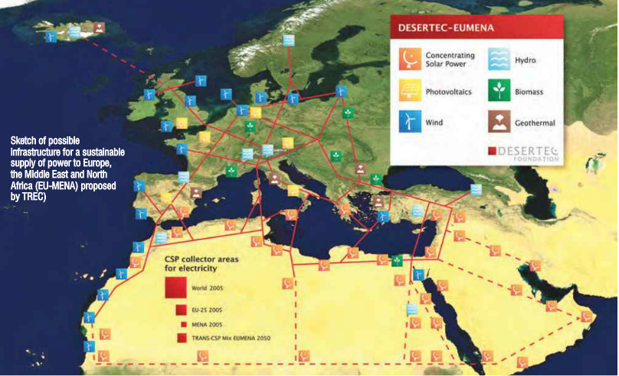
Why Global Grid
Cont…
Supply source point of view
(Cont…)
Desertec Energy Project
(Cont…)

Slide 7
Why Global Grid
Cont…
Operational advantage point of view
‘NO’ storage
Taps into ‘intermittent’ nature of solar, wind, and hydro power
Example: Greenland
Gap of several hours b/w peak time of Europe and North America
No need for storage
How long the transmission line be?
HVDC line: Transmission loss 3% per 1000 km
More economic and efficient than storage systems
Beneficial for USA to to import renewable power from Europe than operate its own fossil fuel
(Chatzivasileiadis et al., 2013)

Slide 8
Why Global Grid
Cont…
Operational advantage point of view
(Cont…)
Transport or transmit? – the great fossil fuel debate
(Oudalov and Reza, 2008)
Primary energy distant from load centers
Physical transport of fossil fuel OR long distance transmission
Three scenarios
(1) Coal by rail with a coal fired power plant in the vicinity of load center
(2) Coal to synthetic natural gas - by pipeline coupled with a gas fired power plant in the vicinity of load center
(3) Mine-mouth coal-fired power plant and transmit through wire.
For a 1000 MW power for 1000 km distance -
(3) is the cheapest
(2) is the next best
(1) is the costliest
Result dependent on multitude factors

Slide 9
Why Global Grid
Cont…
Political purpose
Cause and consequence of international cooperation
Fuller – integrates the day-time and night-time hemisphere
increases the operating capacity of electrical energy system
unprecedented feat of international cooperation
Energy interdependence compels nations to protect each other’s interests rather than harm them
(Nathan et al., 2013)
Mutually assured protection (MAP)
‘Joint-ventured, mutually-benefitting’ cross border projects –
‘increase peace and stability in the region’
‘economic deterrence’ - adverse actions/decisions against each other
Positive ‘alternative’ deterrence strategy to the military strategy of Mutually Assured Destruction (MAD).

Slide 10
Support for Global Grid
Individuals
Al Gore, Boutros Boutros-Ghali, the Dalai Lama, Desmond M. Tutu, and Dr. Jonas Salk
Organizations
African Unity
International Union for Conservation of Nature
United Nations and its agencies
Ministries of some national governments
Assessment studies
Nationally simple
Theoretically undisputable
Technically/technologically feasible
Economically doable

Slide 11
Challenges
Sheer dimension
Multiple stakeholders
Diverse political and legal regime
Security complexities
Cyber-terrorists; global black-outs
Cultural aspects – ‘imposed’
In the absence of strong global institutions
Who will invest and why?
Who will regulate and how?
Who will protect?

Slide 12
In short…
Inevitable -
as more and more appliance move to electric – electric vehicles
as fossil fuel depletes
Equitable -
the problem with energy is NOT supply, BUT distribution
connects remote areas
balances the mismatch in demand and supply
Diversify the supply -
with more renewables
Global energy internet

Slide 13
Indian situation
Centrality to South Asia
One nation – one grid
Jan 01, 2014
South – North got interconnected
A single efficient market – increases trading potential
One of the largest interconnected grid – 232 GW with additional 15% captive power
Desert power development -
Power grid corporation of India December, 2013
5-10% of desert areas of Thar (Rajasthan), Rann of Kutch (Gujarat), Ladakh (J & K), and Lahul & Sipti valley (HP)
Potentially can be part of South Asian or Global grid

Slide 14
South Asian grid - prospects
Intra regional surplus and deficits
Tap vast untapped potential of renewables
Jan 01, 2014
Sixth meeting of the SAFTA (South Asia Free Trade Agreement)
300 $ billion South Asia grid
Natural gas pipelines -
Iran‒Pakistan‒India (IPI) pippeline
Turkmenistan–Afghanistan–Pakistan–India (TAPI) pipeline
Myanmar–Bangladesh–India Pipeline (MBI) pipeline
Spillover effects on the larger economic and political engagements

Slide 15
Thank You
Queries and Suggestions
E-mail:
hsknathan@nias.iisc.ernet.in
happyhippu@gmail.com

