Slide 1
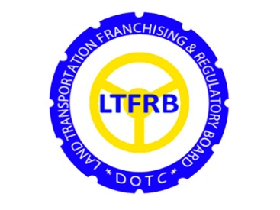
TRANSPORT REGULATION: CHALLENGES AND POLICY RECOMMENDATIONS

Slide 2
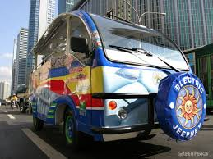
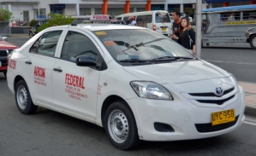
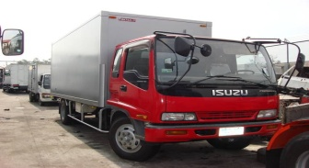
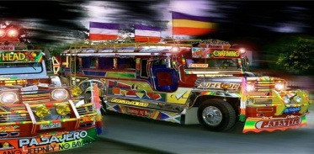
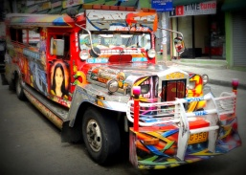
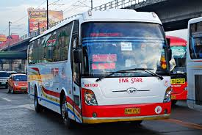
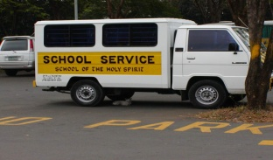
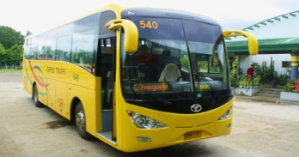
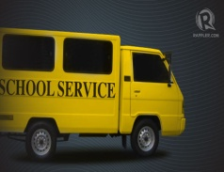
MODERNIZATION OF PUVs

Slide 3
Department Order
No. 2002 - 30
No unit shall be the subject of a new application of franchise, for extension of validity of CPC, for substitution of unit, and for increase of number of unit(s), if said unit is more than the minimum age requirement by the time of expiration of the covering CPC.

Slide 4
Resolution No. 2013-01
Subject: Resolution Mandating the Strict Observance Nationwide of the 15-Year Age Limit of Buses and Mini- Buses Even on Units with Road Worthiness and MVIS Certificates

Slide 5
LTFRB-LTO JOINT ADMINISTRATIVE
ORDER (JAO) 2014-01
Subject: Revised Schedule of Fines and Penalties for Violations of Laws, Rules and Regulations Governing Land Transportation

Slide 6
LTFRB-LTO JOINT ADMINISTRATIVE
ORDER (JAO) 2014-02
Subject: Guidelines in the Determination of Year Model of Motor Vehicles

Slide 7
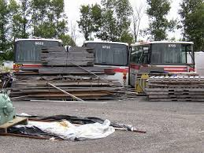
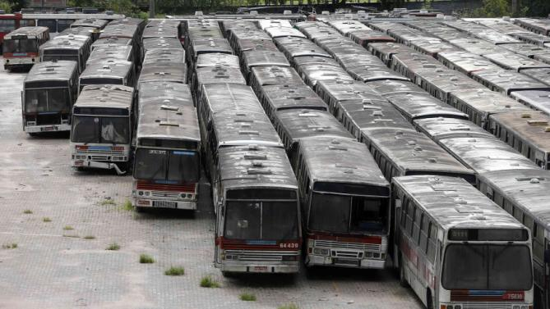
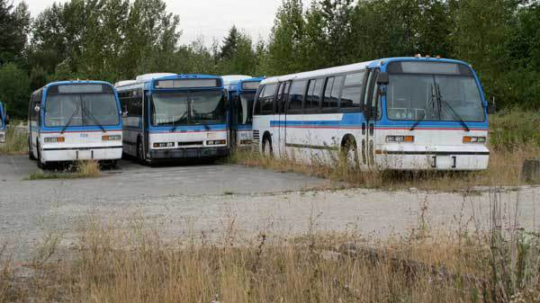
APPROPRIATION OF ABANDONED AND/OR EXPIRED CPCs OF PUBLIC UTILITY BUSES (PUBs) ENTERING METRO MANILA

Slide 8
Total Number of Units of Provincial Buses Touching Metro Manila with Expired Franchises/CPCs
2,141 units

Slide 9
Recommendations of the Board:
All or some of the abandoned and/or expired CPCs of PUB Services touching Metro Manila be opened for appropriation by duly qualified applicants;
Creation of TWG who will be responsible for:
a. verification of the correctness,
completeness and accuracy of the list of
PUBs with expired franchises;
b. recommend which of the abandoned
and/or expired CPCs shall be opened for
appropriation;
c. draft pertinent Department Order and
Memorandum Circular

Slide 10
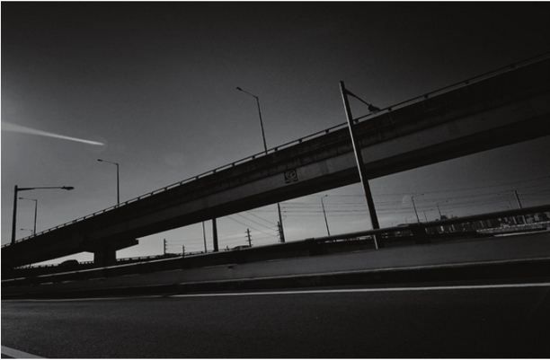
INTEGRATED TRANSPORT SYSTEM (ITS)

Slide 11
1. The project involves the establishment of three mass transportation intermodal terminals at the outskirts of Metro Manila – one in the north of Edsa serving passengers to and from northern Luzon and two in the south serving passengers to and from Laguna or Batangas side and those to and from the Cavite side.
2. The ITS project aims to maximize road usage by reducing vehicle volume and eliminating provincial bus traffic to improve traffic flow along Metro Manila’s major thoroughfares particularly Edsa.

