Slide 1

Transport Regulation:
Lessons from the Maritime Sector
Competition Advocacy Forum
May 2015

Slide 2



Domestic shipping regulation
Maritime Industry Authority
Vessel licensing
Philippine Ports Authority LIBERALIZATION
Port regulation
Coast Guard
Vessel safety

Slide 3
RA 9295 – Domestic Shipping Act of 2004
MARINA authorizes domestic shipping companies to operate, given safety and economic standards
Shipping rates are fully deregulated, provided that effective competition is fostered
Monitoring of shipping operations to ensure public interests are protected
Create rules for monopolized routes

Slide 4

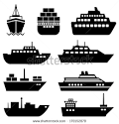
World Bank Group and DOTC: Encouraging greater competition in domestic shipping
DOTC
MARINA
Process re-engineering
Regulatory reform
PPA
Regulatory reform
Database management
Border operations at ports
CPC
Remove opportunity for incumbents to object to granting of CPC
Focus CPC conditions on quality standards
Simplify approval for special permits for foreign vessels to temporarily operate in domestic trade
Drydock
Remove requirement to drydock in the Philippines
SP
Better access to imported vessels
Cargo handling
Remove nexus b/w PPA revenue and cargo handling charges
Pilot port
Quarantine & clearance process
7
1
2
5
6
Maritime data
Improve information on cargo flows and current services
Freely disseminate information to actual & potential market participants
CPC
Expedite CPC approval process
Remove distinction b/w CPC types
Simplify CPC amendment process
3
4
Notes:
Vessel licensing process operates under Commonwealth Era act → exploited by incumbents to delay competition

Slide 5
World Bank Group and DOTC: Encouraging greater competition in domestic shipping
DOTC
MARINA
Process re-engineering
Regulatory reform
PPA
Regulatory reform
Database management
Border operations at ports
CPC
Remove opportunity for incumbents to object to granting of CPC
Focus CPC conditions on quality standards
Simplify approval for special permits for foreign vessels to temporarily operate in domestic trade
Drydock
Remove requirement to drydock in the Philippines
SP
Better access to imported vessels
Cargo handling
Remove nexus b/w PPA revenue and cargo handling charges
Pilot port
Quarantine & clearance process
7
1
2
5
6
Maritime data
Improve information on cargo flows and current services
Freely disseminate information to actual & potential market participants
CPC
Expedite CPC approval process
Remove distinction b/w CPC types
Simplify CPC amendment process
3
4
Notes:
Vessel licensing process operates under Commonwealth Era act → exploited by incumbents to delay competition

Slide 6
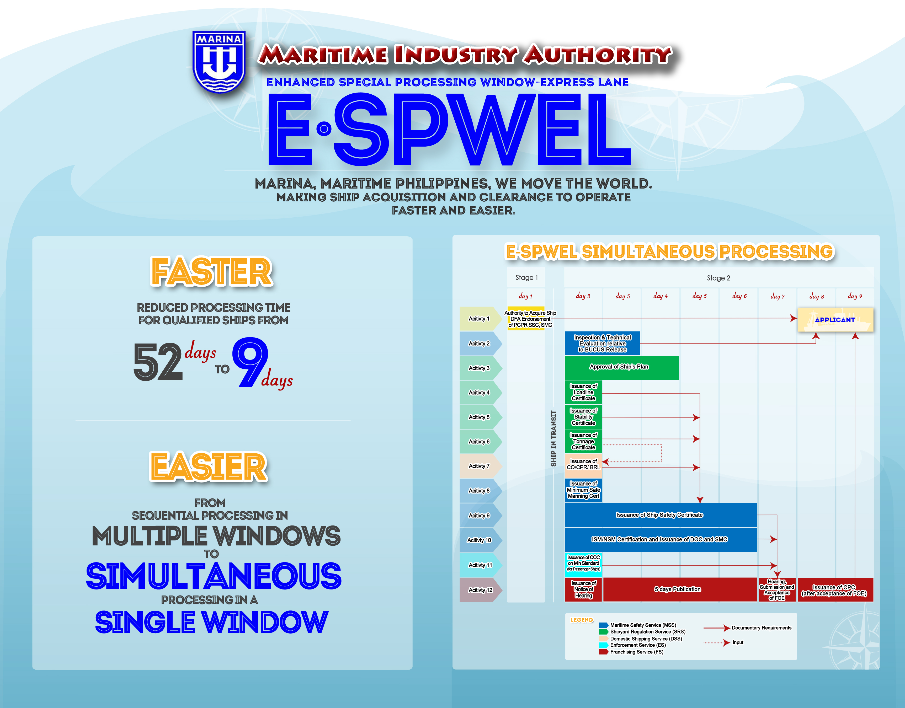
ESPWEL

Slide 7
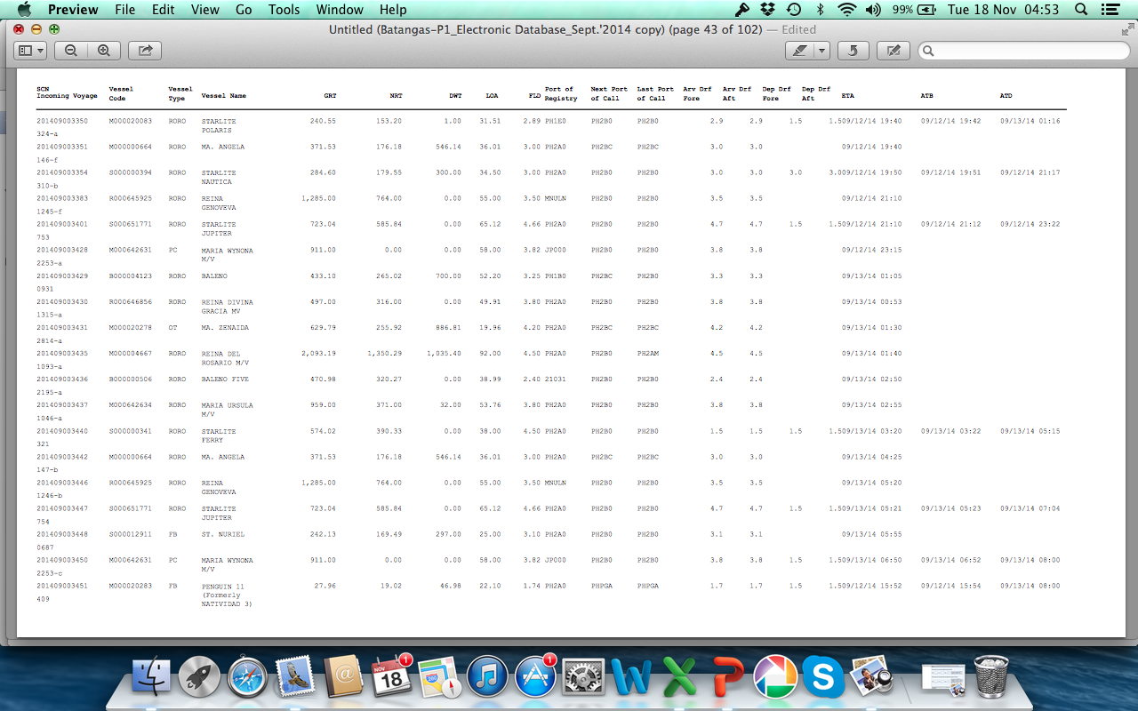
Government collects lots of data but data is not converted into information for regulators
Notes:
Information

Slide 8
Turning data into useful information
Categories and | Data can be provided by | Data-Needs | Actual Data | Data
Type of data | or first Datacheck by | FRANCHISING SERVICE | source | Reason
Shipping line/Operator
Name Shipping line | (SEC) Domestic Office | Yes | 1. Hand | CPC
Name of CPC Grantee |  | Yes | 1. Hand | Amendment of CPC
Address Shipping Line | Domestic Office | Yes | 1. Hand | CPC
Number of Ships operated | Domestic Office | Yes | 1. Hand | CPC
Pricipal Place of Business/office | (SEC) Domestic Office | Yes | 1. Hand | CPC
Type of Legal Entity | Domestic Office | Yes | 1. Hand | CPC
Type of Business Operation | Domestic Office | Yes | 1. Hand | CPC
Company´s Number of Years in Operation | Domestic Office | Yes | 1. Hand | CPC

Slide 9

Need for greater policy coordination across sector regulators
PCG-Focus: Safety
Challenge: implementing a tracking system and work procedures - from paper to e-data
MARINA-Focus: Monitoring
Challenge: regional data updates with complete data input - from office to a shared database
PPA-Focus: Control
Challenge: finding and closing electronic and encoding data issues - improving the validity of data
Joint Agency-Project to promote information sharing and joint policymaking

Slide 10
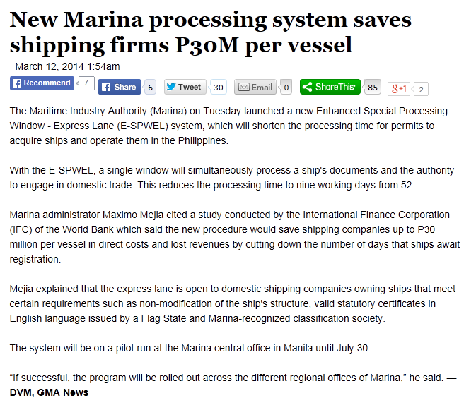
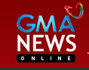
Resulting reforms and private sector savings

Slide 11
Lessons from the maritime sector
More competition
Despite legal deregulation, there remain certain regulations that benefit incumbents
Better decisions
Data should be converted into information and disseminated to public and private stakeholders
Numerous reforms can be conducted with regulatory and not legal reforms
Lower costs
Better coordination among regulators is integral
Streamlined regulations ease market entry, promote operational flexibility, improve competition and lower cost of operations

Slide 12
Transport Regulation:
Lessons from the Maritime Sector
Competition Advocacy Forum
May 2015

